Slide 1
EECS 498
Advanced Embedded Systems
Lecture 1

Slide 2
Welcome
Overview/ Welcome
This is a class on embedded systems. We will be…
  Learning more about embedded systems
    Lecture, labs, homework and presentations.
  Gaining experience working as a group…
    …but also working by yourself on researching and learning material without an instructor’s guidance
  Learning (more?) about the design cycle
    Both theory in lecture and by doing a paper-to-prototype-to-project design.
  Learning how to communicate to your peers

Slide 3
Who am I?
Overview/ Welcome
Dr. Mark Brehob
  Prefer “Mark”, “Dr. Brehob” is okay too.
  Full-time teacher (lecturer)
    Been here for 12 years and I’ve taught a wide variety of courses (281, 203, 452, 470, 373, 100, etc.)
  PhD is in the intersection of computer architecture and theoretical computer science as it relates to caches.
  See http://web.eecs.umich.edu/~brehob/

Slide 4
Today
Overview/ Welcome
Class intro
  Grading, schedule, etc.
A bit on design
  Design requirements, engineering specifications, etc.
An overview of processors used in embedded systems
  Micro controllers, SoC, etc.

Slide 5
Class Introduction
Class overview
  Learning more about embedded systems
    You’ll do 5 labs in 5 weeks
      Starting with microcontrollers and PCB design and moving into Linux driver issues and real-time operating systems (RTOS)
    Lecture will start out on “nuts-and-bolts” issues needed for lab
      But will then focus on higher-level design issues like power and price constraints.
      We’ll also hit on some analog circuit principles and high-speed PCB design issues.
    Homework and presentations
      Give you more practice working with technical documents related to embedded systems
      Review material learned in lecture

Slide 6
We will be…
Class overview
  Gaining experience working as a group…
    This is more-or-less the other side of your Engineering 100 experience.
      We want you to use the technical knowledge you’ve learned in the last few years to make it through the whole engineering cycle with team design.
    Your labs will be in groups of 2
    Your topic reports will be in groups of 3 (or 2 if needed).
    Your projects will be in groups of 4 to 5
      Your group will make a schedule, create a budget, and divide up the work.

Slide 7
We will be…
Class overview
    …but also working by yourself on researching and learning material without an instructor’s guidance
      The project and topic reports will be done without lecture to guide you.
        Each group will be doing something different and your group will be more expert than the instructor or GSI on the topic (at least by the time you are done…)

Slide 8
We will be…
Class overview
Learning (more?) about the design cycle
  Both theory in lecture and by doing a paper-to-prototype-to-project design.
  Back to Engin 100 principles but with your engineering knowledge and 373 experience to provide context.

Slide 9
We will be…
Class overview
  Learning how to communicate to your peers
    Technical Communications in CoE does a pretty darn good job of teaching you how to communicate to a customer
      Organization, good writing, good form in presenations
      But you don’t (generally) learn how to clearly communicate highly technical material to your peers.
    Here we will be writing a white paper, bringing a project into “hand-off ready” status, and writing milestone memos (the memos are very similar to stuff you should have done in TC)

Slide 10
Background
Class overview
  You are assumed to have a background in embedded design (EECS 373) and either a solid programming background (EECS 281) or a reasonable circuits background (EECS 215).
    At times I’ll be assuming both a solid programming background and a basic circuits background. If you are missing one or the other, that’s fine, but you’ll need to work especially hard on those topics.

Slide 11
Class structure
Class overview
We will meet for 3 hours/week as a class
There are 2 lab sections
  (we need to discuss this)
The lab is staffed 10 hours/week.
  As in 373, you will have access to the lab so you can get in whenever.

Slide 12
Hours
Class overview
Instructor: Dr. Mark Brehob, brehob@umich.edu
  If you send email please have 498 in the subject line.
  Office hours:
    Monday 10:30-11:30
    Thursday1:30-2:30.
    In addition I have 370 office hours on Tuesdays from 1-2:30 and Thursdays 2:30-4.
      You are welcome to come to those, but 370 students have priority during those times.
GSI: Jeremy Nash, nashj@umich.edu
  Staffed hours (not including cheduled labs) are:
    Tuesday 6-9, Sunday 12-3.
    While we are doing labs, Jeremy will be acting as a traditional lab GSI. After that he’ll be acting more as a consultant and some of his hours will be schedulable via Doodle.

Slide 13
Work/grades
Work/Grades
15% | Labs
4% | Homework
6% | Oral Report
5% | Written Report
10% | Midterm
15% | Final Exam
45% | Final Project

Slide 14
Labs (1/2)
Work/Grades
There are 5 labs
  2 Arduino, 1 PCB design, 1 Linux and 1 scheduling lab
  Pre-labs are done individually and are worth 25% of the lab grade.
    They are due before lab starts
  In-labs are done in groups of two.
    They have two parts a “sign-off” part and a “question” part.
    The post-labs are just an extension of the “question” part of the in-lab.
    They are due before the start of the next lab.
  Late labs lose 10% per day late (including weekends, not including holidays).

Slide 15
Labs (2/2)
Work/Grades
Thursday 6:30-9:30
  Rebecca Doebler, Rahul Thirugnanam, Kai Wu, Justin Paupore, Karthik Shivaram, James Carl, Dru Steeby, Josh Rickmar, Renzhi Qian, Joe Romeo, Frithjof Nerdrum, Rohan Divekar, John Marcoux, Muhammad Umair Siddiqui.
Friday 1:00-4:00
  Everyone else (if you can’t make this lab section, please see me right after class. I’ll be asking for class schedules…)

Slide 16
Project (1/2)
Work/Grades
You will work in groups of 4-5 on designing and building an embedded system of your choosing
  We are working on getting a per-group budget for you
    Will depend a bit on how many groups get external funding…
  There will be a stronger emphasis on having a reliable system in place.
  There may be external customers who would be interested in working with (and perhaps funding) your project
    One is a ball-balancing system where having a controls background would be darn handy.

Slide 17
Project (2/2)
Work/Grades
There will be a number of due dates (proposal, milestones, final project)
There will be a significant degree of formalism in your reports and presentations.
Your project will be presented at the CoE design expo on Dec 6th.
You have significant design freedom.
  The only real restrictions are that it has to be doable in the time given, be technically interesting and do something useful or interesting.
  As you think of ideas, please feel free to run them past me.

Slide 18
Topical presentation/report
Work/Grades
In addition to the labs and projects you will be asked to write a report and present material to the class.
  Class report will be done with two or three other students.
  Dates are on the class schedule
  More details to come.

Slide 19
Midterm exam
Work/Grades
After the 5 labs are done, there will be an exam. It will cover the lab/class material up to that point.

Slide 20
Homework
Work/Grades
You will have ~four homework assignments.
  The first will be to proposed project ideas.
  The rest will be used to reinforce classroom material or to give you a chance to drill down a bit farther on topics then we can in class/lab.

Slide 21
Class participation
Work/Grades
Class participation will be a part of the homework grade
Your attendance at the student presentations and any guest speakers will be noted and used as the primary (only?) measure of class participation.
  Basically I want you to be there to learn and so the presenters aren’t the only ones there.

Slide 22
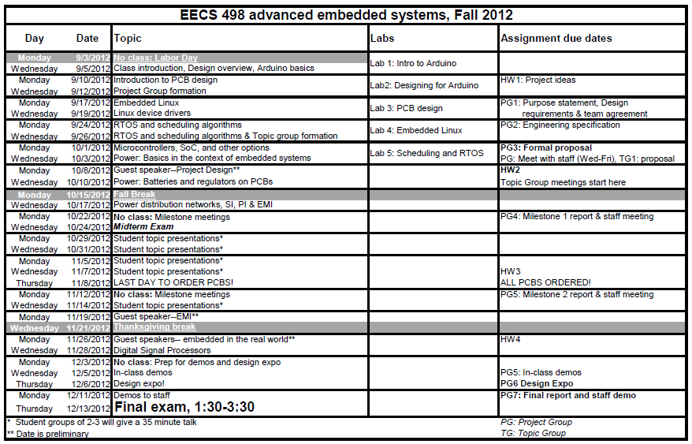
Schedule

Slide 23
A (very brief) introduction to design
Brief design overview

Slide 24
What is the design process?
Brief design overview
Unlike the material in 95% of your engineering classes, this question is a matter of opinion.
  There are tons of books on the topic, and they all use different words and emphasize different things.
  That said, they (almost) all have similar ideas.

Slide 25
The stages of design
Brief design overview
Where design ends is debated.
  Pretty much everyone agrees that identifying a problem to be solved is the first step.
    Though some have some pretty significant steps to be taken here (requirements gathering, user surveys, marketing analysis etc.)
  But is the last step
    Handing off the design to be manufactured?
    Dealing with manufacturing issues?
    Supporting users of the design?
    Dealing with end-of-life issues?

Slide 26
Design stages in this class (1/4)
Brief design overview
Identifying the purpose*
  Identifying a problem
Design requirements
  What characteristics does the device need?
    This should be things like “light-weight” or “easy to use” rather than “less than 8oz” or “iPhone-like interface”
*There is often a research step between this step and developing the design
requirements. What are current solutions/work arounds? What do people
really want? What is doable in this space?

Slide 27
Design stages in this class (2/4)
Brief design overview
Engineering specification
  The design requirements turned into measurable outcomes.
    8 oz or less
    new users can start measurement in less than 10 seconds on the average
    48-hour battery life in the worst case.

Slide 28
Design stages in this class (3/4)
Brief design overview
Work out possible solutions
  Identify a few ways to solve this problem
Pick a solution
  Find the one you like best.
Prototyping
  Building a prototyped device
    Likely not the right form-factor etc.
    Probably on a breadboard, but mechanical issues also need to be addressed.
  Let’s you see what’s doable.
    Gives you a testbed develop your solution

Slide 29
Design stages in this class (4/4)
Brief design overview
Implement your design
  For us this involves ordering a PCB and getting your software up and running.
Test and debug
  Get everything working
  Test to see if engineering requirements are met.

Slide 30
Design and this class
Brief design overview
This class is about getting a useful design done.
  Following the steps of the design process helps a lot more than you might think.

Slide 31
An overview of embedded processors
Microcontrollers, DSPs,
System-on-a-chip (SoP), ASICs
and more

Slide 32
Where to start?
Processing unit overview
When designing an embedded system, one key question is:
  “What processor should I use?”
Obviously the answer depends on a massive number of factors.
  CPU computational power needed
    And even the type of computational power needed
  Interfaces needed
  Cost
  Power
  Expected design time
    Debug capabilities
    Current familiarity with tools
  Etc.

Slide 33
Highest level:
ASIC, off-the-shelf processor, FPGA
Processing unit overview
These three categories are pretty straightforward and mostly non-overlapping.
  An ASIC is an Application Specific Integrated Circuit.
    You are “spinning” a chip designed specifically for your application.
    Manufacturing costs are a bit difficult to figure out
      MOSIS would charge $10,000 for an extremely small chip (40 chips, 1 square mm each) in a very large (700nm) process.
      I’ve seen groups pay prices of $50K for a couple of larger ARM-based chips.
      Design costs are yet more.
  So:
    Pros?
    Cons?

Slide 34
Highest level:
ASIC, off-the-shelf processor, FPGA
Processing unit overview
An off-the-shelf processor is one that has been manufactured by someone else.
  This doesn’t mean that the processor isn’t highly specialized.
    There are chips designed just for printers for example
      the HP Unity is MIPs based, ½ GHz, ½ Gbyte standard
  Pros?
  Cons?

Slide 35
Highest level:
ASIC, off-the-shelf processor, FPGA
Processing unit overview
You all know what an FPGA is.
  But when would you choose to use one in an embedded system?
  Even if it isn’t in your embedded system, why else might an FPGA be helpful to embedded system designers?
  Pros?
  Cons?

Slide 36
But at this high level, things are fuzzy
Processing unit overview
Sometimes an FPGA and off-the-shelf processor are integrated.
  Actel in 373
  Cypress Semiconductor
    Their fabric is generally a bit less flexible than an FPGA, but easier to work with.
And many ASICs are based on standard “off-the-shelf” architectures
  ARM being the most common these days
    MIPS was similar at one point.

Slide 37
Let’s start with off-the-shelf processors…

Slide 38
What device options are there?
Off-the-shelf
One fun part about this is that there are a number of terms used to describe the options, but they aren’t very well defined.
  For example, what’s the difference between a microprocessor, a microcontroller and a System-on-a-Chip (SoC)?
More peripherals and
interface capability
SoC
Micocontroller
Processor
It’s really not clear
  One axis is that a SoC is expected to have a richer set of peripheral interface capability

Slide 39
However the terms also carry other connotations
Off-the-shelf
For example, in the “CPU-capability” axis microcontrollers are generally thought of as being very limited, generally in the 1-30 MIPs range.
  And correspondingly, the microcontroller is expected to have lower power needs.
Processor
SoC
Micocontroller
CPU-capability
So keep in mind that terms aren’t always well-defined!

Slide 40
So…
Off-the-shelf
While those terms (SoC, Microcontroller, Processor) are commonly used
  They aren’t all that well-defined.
None-the-less, we are stuck with them
  So let’s explore a bit…

Slide 41
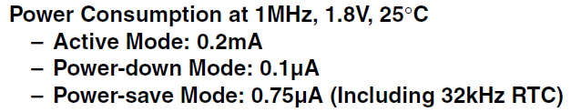
Microcontroller
Off-the-shelf
The AVR processor (which we’ll be using in lab 1 and 2) is an example of a microcontroller
  Flash, SRAM, EEPROM
  6-30 GPIOs
  4-20MHz
  Basic serial I/O capability

Slide 42
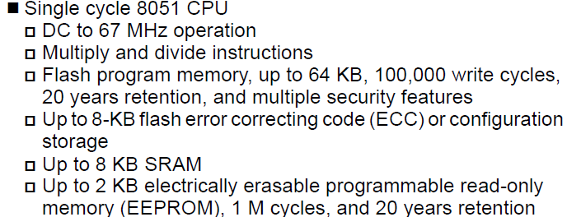
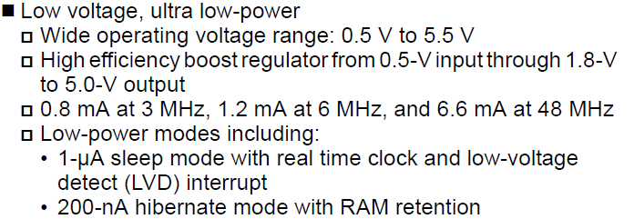
Example SoC:
Cypress PSoC 3: CY8C38
Off-the-shelf

Slide 43
Example SoC: Cypress
Off-the-shelf
It looks similar to our AVR processor
  A bit faster for sure, but when you are advertising multiply and divide…
  Power:
    How long would a 2000mAh battery be able to keep this thing running?
But it’s peripherals are much more significant.
  68 GPIOs,
  Highly configurable on the fly. Can have:
    Built-in hardware blocks for FIR/IIR filters @67MHz
    Has 4 built-in op-amps (less parts on board)
    Can directly interface to a capacitive touch screen

Slide 44
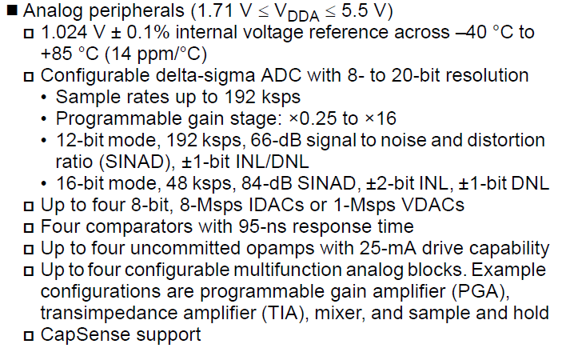
Just the analog…
Off-the-shelf

Slide 45
Processor
Off-the-shelf
When people discuss processors they often mean something like a desktop CPU.
  Power in the 20-200W range for example, but speeds in the 2-3 GHz range.
However there are things like the Atom core (which, Intel markets as a SoC…)

Slide 46
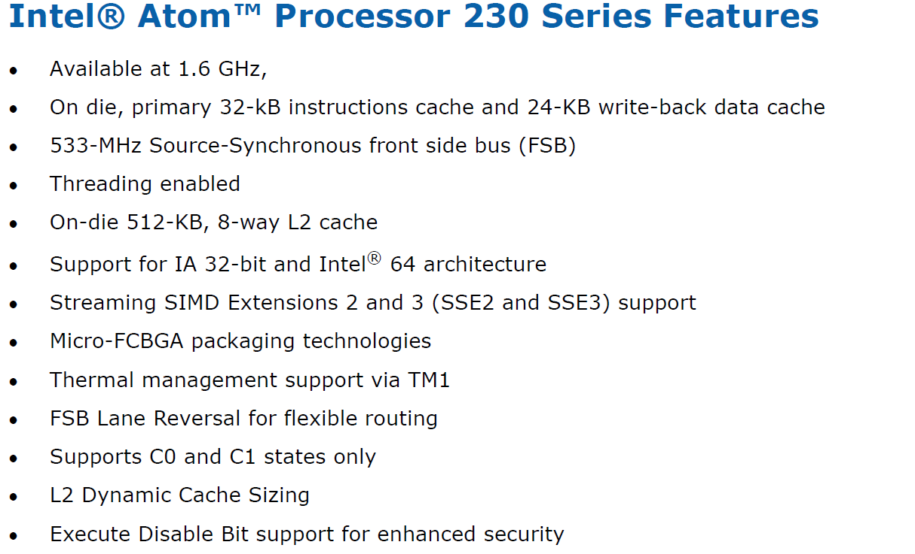
Intel Atom
What looks different?
Off-the-shelf

Slide 47
What type of specialized off-the-shelf processors are there?
Off-the-shelf
Generally speaking, you are looking at either
  CPU instructions and features focused on improving performance on a specific type of application
    DSP and encryption both have very specific needs.
  Specialized I/O.
    So CAN bus (standard automotive shared serial bus)
    Capacitive touch screen interfaces

Slide 48
Let’s look at DSP
Off-the-shelf
Application characteristics:
  Generally walk through fixed size circular buffers
  Generally are taking sums-of-products of two buffers.
  Often (but not always) use fixed-point notation
  Occasionally need to bit-reverse memory.
  Low power is often critical.
So what do digital signal processors need to supply?

Slide 49
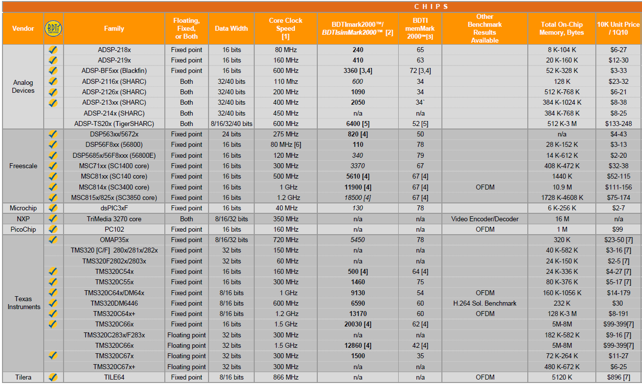
Off-the-shelf

Slide 50
ASIC
ASIC
Not a lot to say here, each case is, by definition, different.
  A lot of embedded systems work is with ASICs these days.
    The (vast?) majority of cell phones use in-house designed processors, 95%+ of which are ARM based.
    The iPad uses an ASIC.
    What’s interesting is how design costs generally dominate over the one-off mask costs
      Not that mask costs aren’t a major factor.
      You really want to avoid respins…
  If you have a large market, need decent performance and are highly power constrained
    ASIC is clearly the way to go.

Slide 51
FPGA
FPGA
There can be quite a bit of feature difference between the different FPGA choices.
  You can find FPGAs for as little as $10 and as much as $3000.
  Some use non-volatile memory, others need external help on power-up.

Slide 52
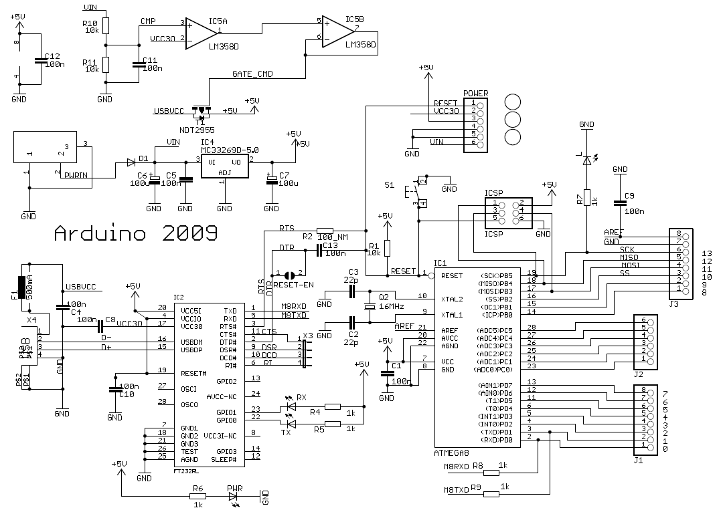
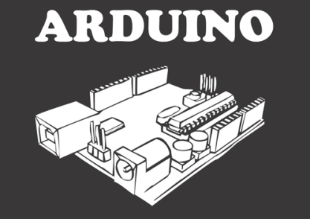
Introduction to Arduino
Stolen from Chris Meyer
(CC-SA)
http://www.danielandrade.net/

Slide 53
Arduino
ARRRR, like a pirate /
/ DWEE, just say "do we“ fast /
/ NO, as in no.
”ARRR-DWEE-NO”
http://www.arduino.cc/cgi-bin/yabb2/YaBB.pl?num=1191602549%3Bstart=all

Slide 54
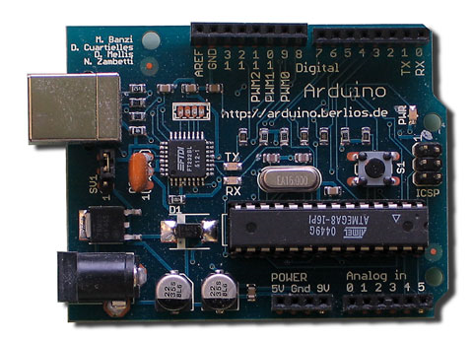
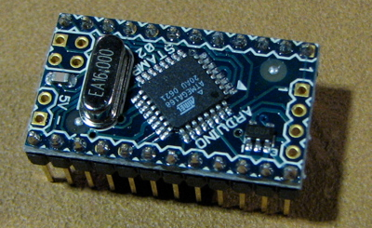
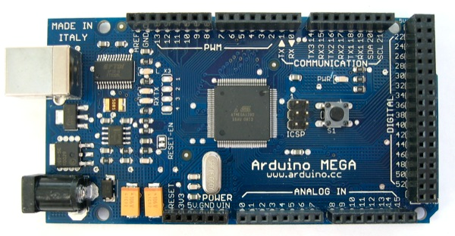
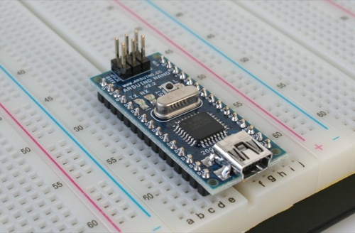
What is Arduino?
Arduino
Open Source Hardware Development Platform
USB Programmable Microcontroller (MCU)
$30 Investment!

Slide 55
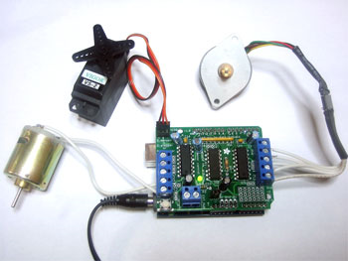
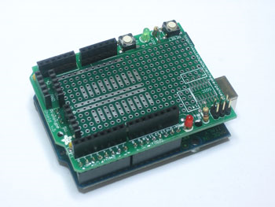
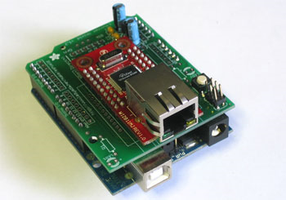
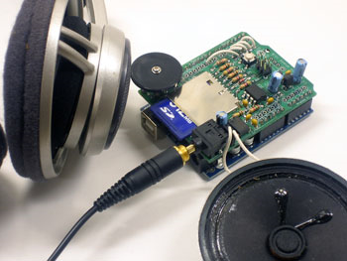
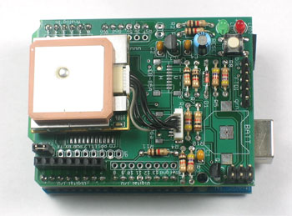
Shields?
Arduino
Shields break-out/wire-up
additional components to MCU
Servo/Stepper/DC Motors
Ethernet
Prototyping
GPS
Audio / MP3

Slide 56
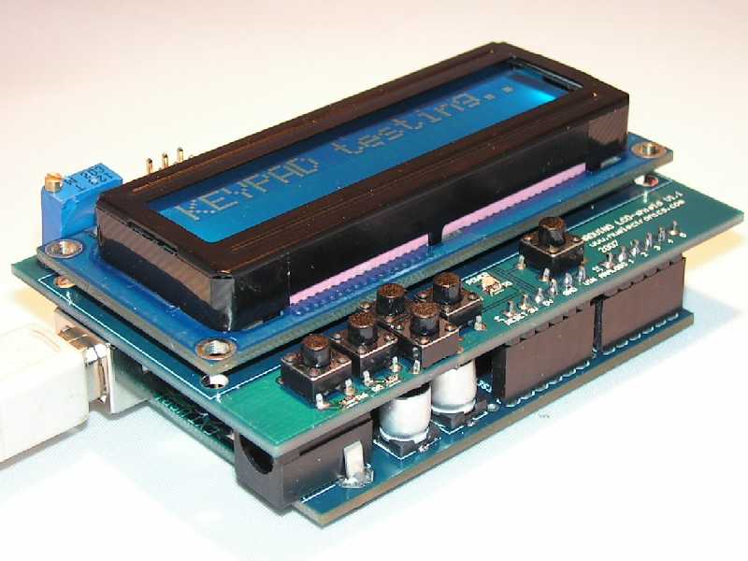
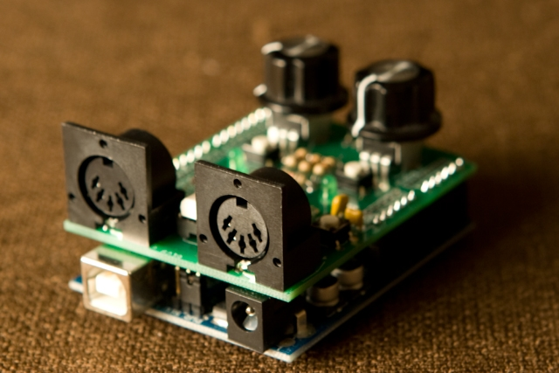
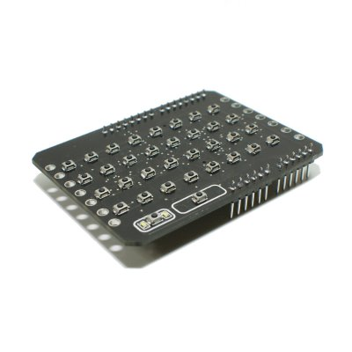
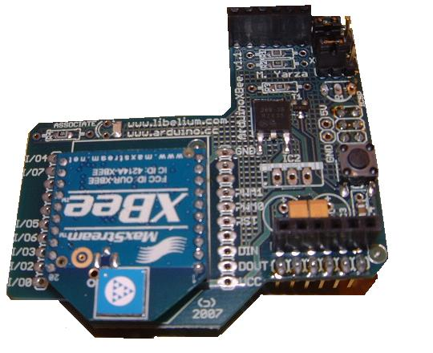
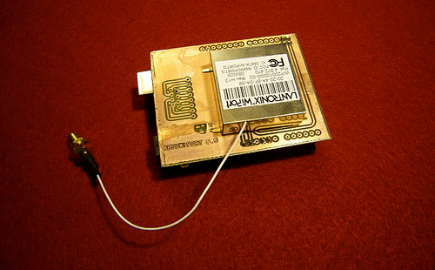
More Shields!
Arduino
LCD
MIDI
LED Display
Zigbee
WIFI

Slide 57
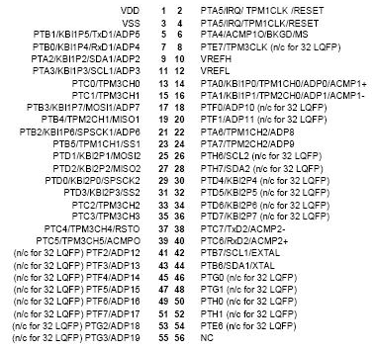
So What?
Arduino
Previously, MCU’s were very difficult to learn to use
Required learning libraries, specialized protocols, timings, code minimization, 1,000+ page documentation

Slide 58
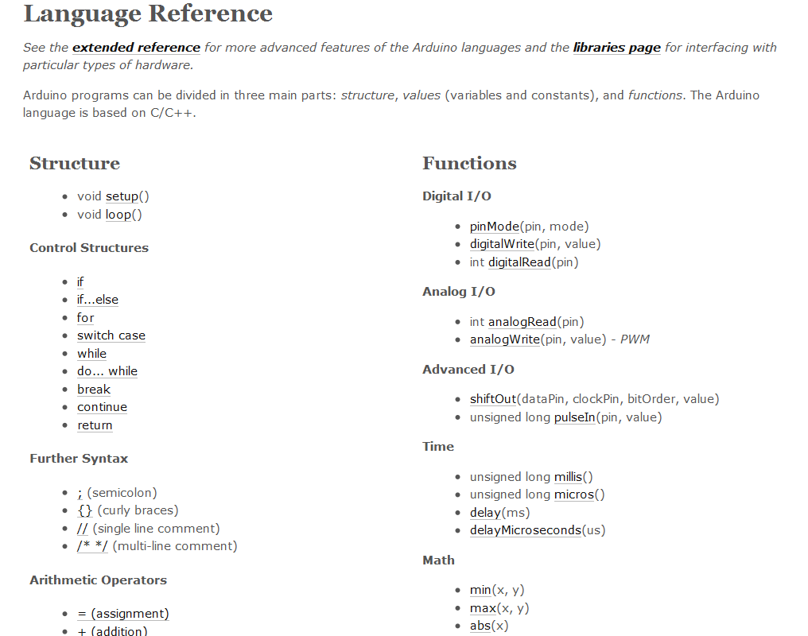
Arduino makes it Easy!
Arduino
@Arduino.cc

Slide 59
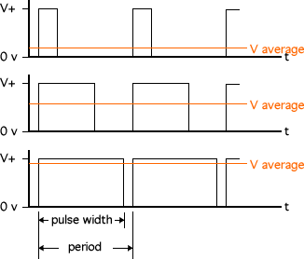
Servo Control
Arduino
Pulse Width Modulation (PWM)
We Provide:
+5VDC
PWM Signal
Ground
We Get:
0-180 Degree
Range of Motion
http://www.micromouseinfo.com/introduction/images/intro_hardware/PWM.gif

Slide 60
That’s it for today!
Next time on to PCB design.

