Slide 1
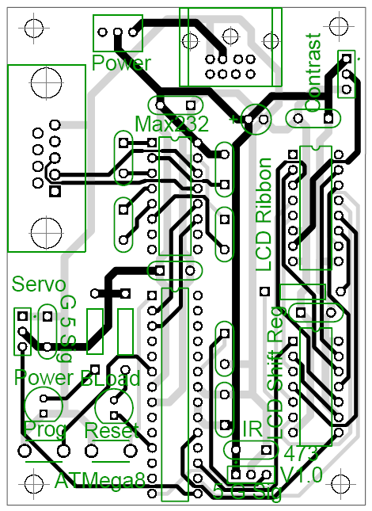
EECS 498 Advanced Embedded Systems
Lecture 2 Interrupts reviewed, PCB design, and a bit on communication.

Slide 2
Things upcoming (way too much!)
HW1 (project ideas) due today @10pm.
We know this is a really short time frame.
Just remember you don’t have to actually do the project you propose.
The hope is to
Get some project ideas out there
Get you thinking about the time and budget constraints now!
Talk to Jeremy or me if you have questions.
On Wednesday we’ll form project groups
On Monday (a week from now) your group will turn in a short document describing your proposed project (Assignment PG1)
Posted on the website
Prelab 2, questions from lab1
Due in lab!

Slide 3
Stuff due soon
HW1
Due today at 10pm
Lab1 in-lab and post-lab
Due in lab this week
We’ll spend a short bit of time on post-lab stuff today.
Lab2 pre-lab (posted)
Due in lab this week
PG1:
Due a week from today
Pretty short write-up, but lots of talking

Slide 4
Project Group Assignment #1 (PG1)
You’ll be asked for three things.
3-5 sentences which describe the project your group is doing
What problem it solves mainly.
4-7 design requirements
“number-free” requirements.
“Light enough to carry”
“Costing much less than current alternatives”
A project group contract
Lists expectations of members, etc.
Assignment posted on Wednesday before class.

Slide 5
Today
Introduction to PCB design
Review interrupts
Discuss communication
Project discussion (time allowing)

Slide 6
Today
Introduction to PCB design
Overview and definitions
Design steps
Review interrupts
Discuss communication
Project discussion (time allowing)

Slide 7
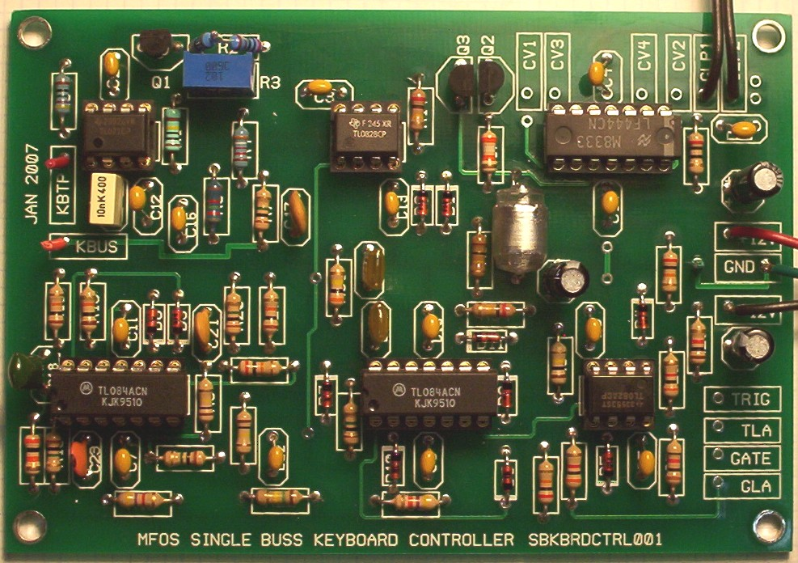
So you want to make a Printed Circuit Board…
PCBs – basic terminology
At the end of the day a PCB is just a set of wires that connect components.
But there are some issues
The wires have restricted dimensionality
The wires are very thin
So high resistance (as conductors go)
The board needs to include holes (or pads) for the devices.
You can’t easily change things once you build it.
http://www.linkwitzlab.com/Pluto/supplies-subw.htm,
http://www.musicfromouterspace.com/analogsynth/SINGLEBUSSKEYBOARD2007/SINGLEBUSSKEYBOARD2007.php

Slide 8
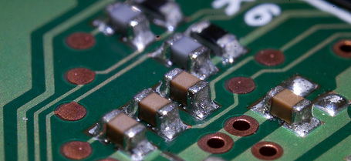
Basic Terminology
PCBs – basic terminology
The wires you are laying out are called “traces” or “tracks”
Inside of a given “layer” traces which cross are electrically connected.
If you have traces on both sides of the board, you are said to have two layers.
Through-hole: Having holes in the PCB designed to have pins put through the hole
Contrast with surface mount where device goes on top.

Slide 9
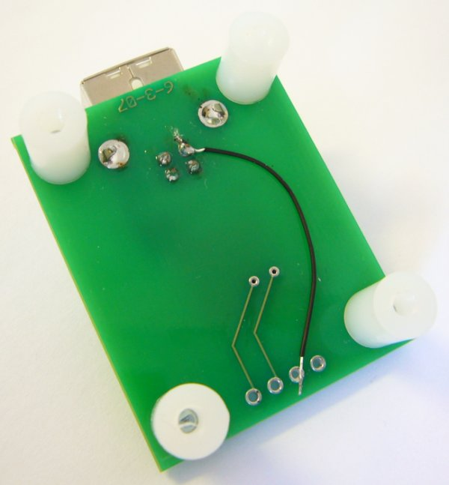
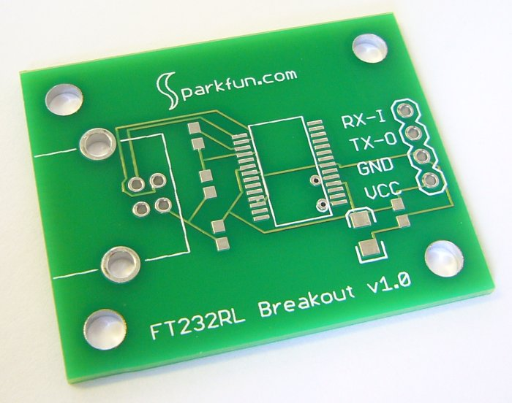
Parts of a PCB
PCBs – basic terminology
Copper
(pads & traces)
Silkscreen
(white)
Soldermask
(green)
Via
Bottom side
Drill holes

Slide 10
Vias
PCBs – basic terminology
Sometimes you need to connect two traces on two different layers.
To do this we use a via.
It is just a a plated through hole
Generally smaller than a through hole for a part.

Slide 11
Clearances
PCBs – basic terminology
There will be space between the traces, plated holes and each other.
You need to meet the requirement of the manufacturer.

Slide 12
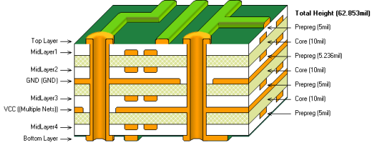
The layered construction of a PCB: A six layer board
PCBs – basic terminology
Figure from altium.com

Slide 13
So, how do I design a PCB?
PCBs – design steps
Create schematic
Place parts
Route interconnect
Generate files

Slide 14
Step 1: Create schematic
PCBs – design steps: schematic
The first thing you want is something that looks like a textbook circuit diagram. It just shows the devices and how they are connected.
Sometimes you will worry about pinouts here (say when working with a microprocessor maybe)
But usually you don’t
No notion of layout belongs here!

Slide 15
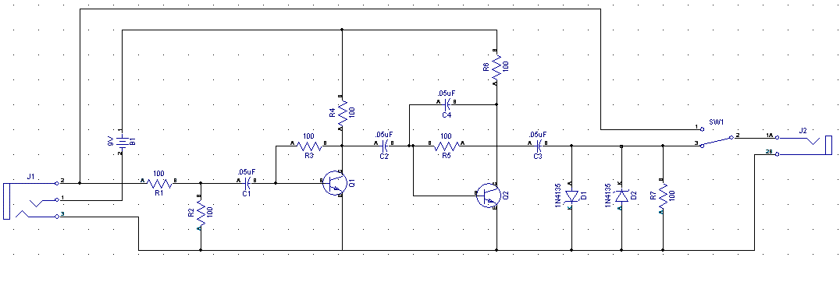
Example schematic
PCBs – design steps: schematic

Slide 16
Why a schematic?
PCBs – design steps: schematic
In general it is drawn to be readable.
This is probably what your sketch on paper would look like.
You can find and fix bugs more easily here than the PCB layout.

Slide 17
Step 2: Place parts
PCBs – design steps: placement
You need to place the patterns on the board.
You need to not overlap them to that the components can actually fit on the board.
You want to leave room for the traces to connect everything.
This is very much an art form.
In fact you will find people who rant about “sloppy” or “unprofessional” placements.
Some tools will do this for you. No one seems to like them.

Slide 18
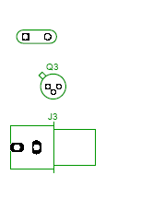
Patterns
PCBs – design steps: placement
Once you know what it is you want to build, you need to figure out how to lay it out on the board.
You need to know how big each piece is, and where the holes need to be placed.
Each device has a pattern which shows exactly that.
You will occasionally need to create a pattern.

Slide 19
Step 3: Route interconnect
PCBs – design steps: routing
A route is a connection between devices.
It may consist of multiple traces
There are design rules which include:
Minimum trace width
Minimum spacing between traces and holes
Minimum spacing between holes and holes.
These rules will vary by manufacturer.
Even better, units will vary by manufacturer!
Time for a brief aside…

Slide 20
Issues of measure
PCBs – an aside
PCB land uses some interesting terminology.
A “thou” is a thousandth of an inch.
A “mm” is a millimeter
A “mill” is a thousandth of an inch.
Thou is generally preferred over mill to avoid confusion, but most tools/vendors use mill.

Slide 21
Trace width
PCBs – an aside
In general most PCB manufactures seem to have trace-width minimums of 6-10 thous.
Most are willing to go smaller for a price.
A rule of thumb is to use a 50 thou minimum for power/ground and 25 for everything else.
This is to drop the resistance of the traces.
In general you are worried about heat dissipation
There are lots of guidelines for width/power but in general you are looking at:
A 10cm trace needs to be 10 thou wide if it will carry 1 amp.
5 amps at 10cm would require 110 thou.

Slide 22
Trace width continued
PCBs – an aside
The problem with wide traces is that they are hard to route.
In particular you might wish to go between pins of a device.
One solution is to be wide normally and “neck down” when you have to.
This is more reasonable than you think.
Think resistors in series.

Slide 23
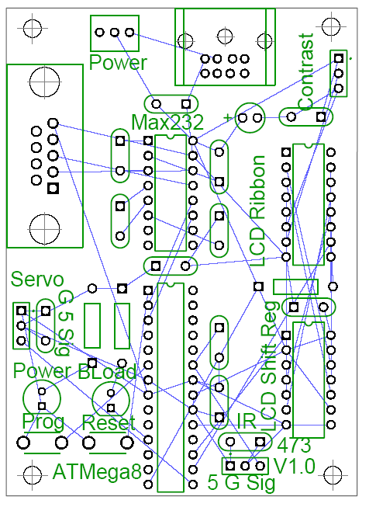
Rat’s nest.
PCBs – design steps: routing
A rat’s nest shows the placement of the devices and the connections but not the routing
Automatically generated for you.
Sometimes before placement, sometimes after
Varies by tool.

Slide 24
Routing for real
PCBs – design steps: routing
You can use an autorouter to route your traces
Some people hate these as the design will be “ugly”
Saves a lot of time.
Oddly, not as good as a person can do.
But much faster.
Still generally need to do some (or all) of the routing by hand
Very tedious...

Slide 25
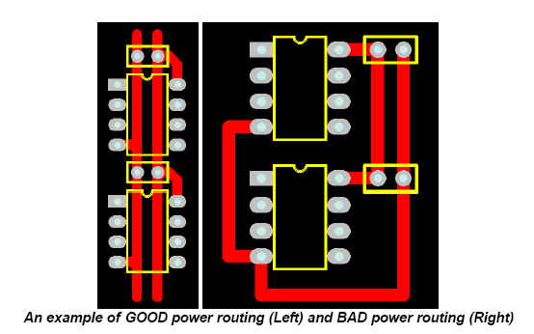
Routing quality
PCBs – design steps: routing

Slide 26
Step 4: Generate files
PCBs – design steps: generate files
Once the design is done, a set of files are generated.
Each file describes something different (e.g.)
Copper on a given layer
Silkscreen
Solder mask
Most files are in “Gerber” format
Human-readable (barely) ASCII format
Has commands like draw and fill.
Drill files are a different format called Excellon
Also human-readable (barely) ASCII with locations and diameters for the holes.
Generally you zip all these files up and ship them as a single file to the PCB manufacturer.
Often a good idea to include the design file(s) too.

Slide 27
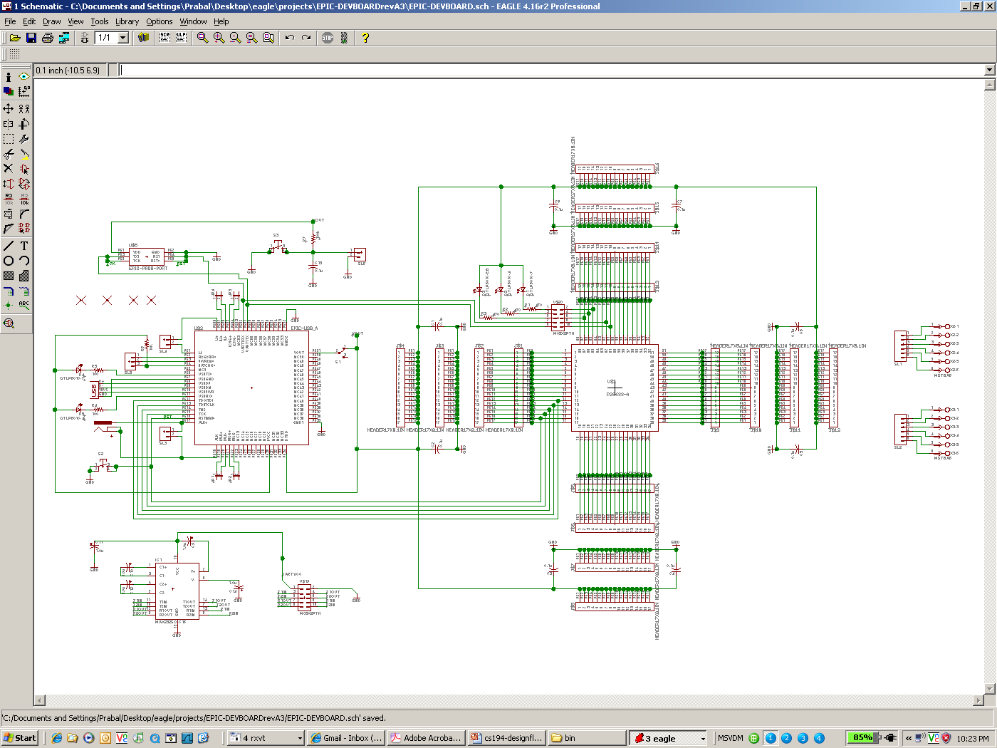
The schematic captures the logical circuit design
PCBs – closing example

Slide 28
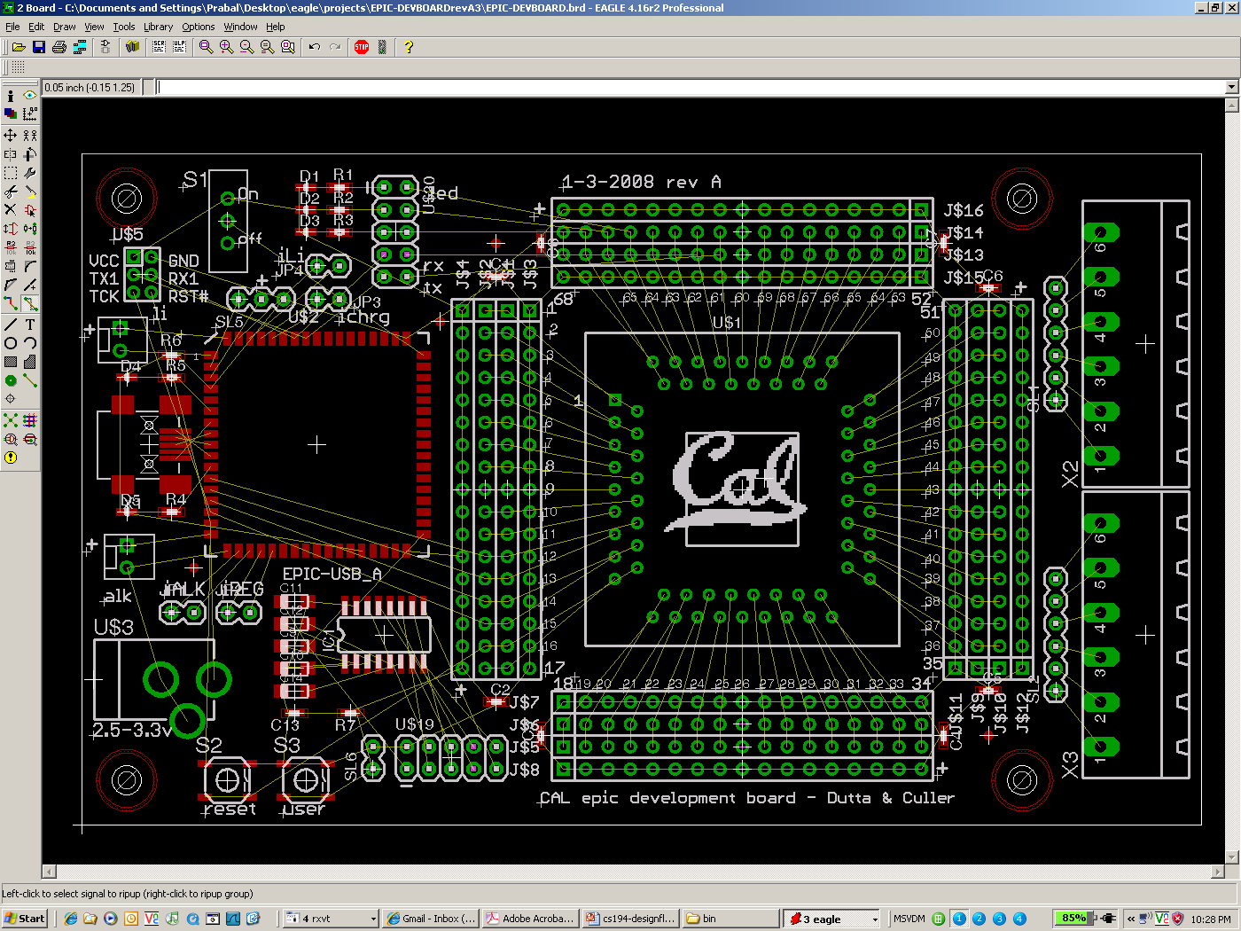
Floorplanning captures the desired part locations
PCBs – closing example

Slide 29
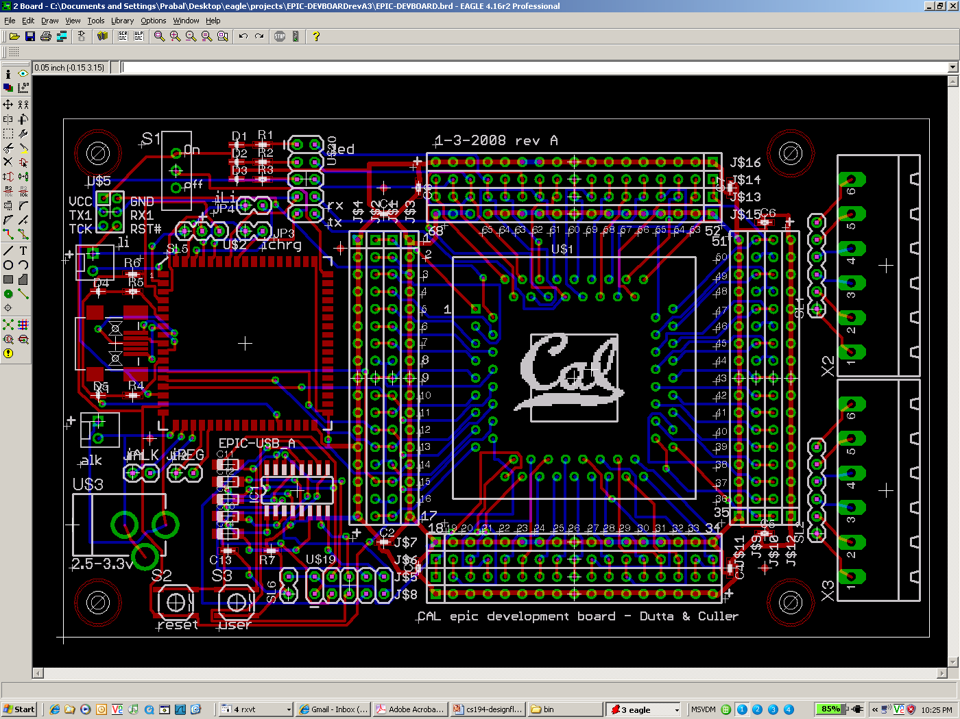
The auto-router places tracks on the board, saving time
PCBs – closing example

Slide 30
The layered construction of a PCB: A six layer board
PCBs – back to a side view
Figure from altium.com

Slide 31
Much material taken from others:
PCBs –references
http://alternatezone.com/electronics/files/PCBDesignTutorialRevA.pdf
Very nice tutorial/overview
Seems to have strong viewpoint
http://www.goldengategraphics.com/pcgloss.htm
Some definitions taken verbatim.
Dr. Dutta (closing example)
Wikipedia
And others where noted.

Slide 32
Today
Introduction to PCB design
Review interrupts (very brief)
Discuss communication
Project discussion (time allowing)

Slide 33
Interrupts reviewed (1/3)
What is an interrupt?
A way to have some other code suddenly start running on the core.
What can cause an interrupt?
Pretty much anything
“Asynchronous interrupts”
An event external to the core.
Timer, certain pin going high, serial packet arrirving
Synchronous interrupts
The code currently running generates an interrupt.
Why?

Slide 34
Interrupts reviewed (2/3)
How do they work?
When the event happens, the core saves a bit of state, changes the PC, and (usually) disables some or all other interrupts.
Save state in hardware
Usually just a minimum amount
PC of instruction where we should return to
Maybe some other things
Machine state register
Certain GPRs
Often have a stack frame created.

Slide 35
Interrupts reviewed (3/3)
How do you return from an interrupt?
Generally a special-purpose instruction
“rfi” or something like it.
Undoes whatever was saved
Including popping the stack if needed

Slide 36
Why do we use interrupts?
Discuss…

Slide 37
Today
Introduction to PCB design
Review interrupts (very brief)
Discuss communication
Project discussion (time allowing)

Slide 38
“Communication” basics
Well, not generic communication.
Rather, how can you avoid interference, errors and similar problems.
Your post-lab asks a bunch of questions.
One running issue (fairly well disguised) is
“How do you deal with noise?”
In particular what if you see something where nothing was supposed to be?
And what if you see the wrong thing?

Slide 39
“Communication” basics
Say you are expecting a message of the form “Xn” where X is ASCII X and n is a number from 0-9.
You could image writing code that says:
If char==X
Get next char
if char==0 to 9 return char
else return error
Say you actually send “X3” and that gets received correctly.
In what circumstance would your algorithm still fail? (Assume there could be “false data” before or after “X3”.)

Slide 40
“Communication” basics
One traditional trick
Start-of-packet and End-of-packet characters.
If you see the SoP signal, you start over (SoP and EoP can’t be inside of a legal packet).
You only call a packet valid if it ends in an EoP.
Now noise outside of the packet can’t really hurt you.
But you lose some bandwidth (why? How much do you lose?)
Assume 1000 byte packet of data, with 1 byte SoP and 1 byte EoP.

Slide 41
“Communication” basics
What about errors inside of the packet?
Checksum
Add a few bits to the packet which can be checked to see if there is an error.
Some examples
Word-wise parity.
Sum of bytes
CRC

Slide 42
(Bonus) Making our interface useful
Let’s discuss what interface we might want for a servo.
(Then project?)

