Slide 1
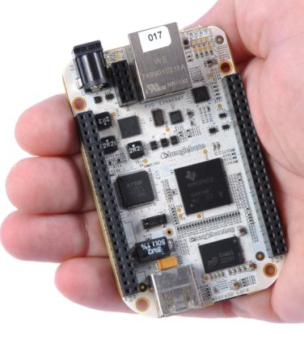
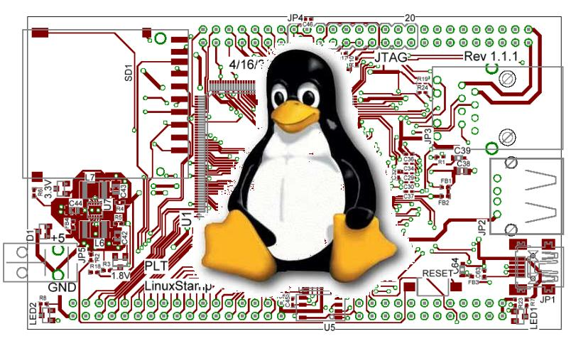
EECS 498 Advanced Embedded Systems
Lecture 3 Evaluation boards & Embedded Linux

Slide 2
Outline
We are really covering two topics today
Off-the-shelf boards (8 minutes)
Why they are useful
An example
Embedded Linux (60 minutes)
Linux/Unix overview
How embedded Linux is different
Working with Embedded Linux
Linux realtime

Slide 3
Designing an Embedded System
Off-the-shelf boards
In lecture 1 we discussed a couple high-level choices for the “processor”
Micro-controller, SoC, desktop processor, FPGA etc.
We also discussed off-the-shelf vs. custom ASIC.
Today we are going to focus on software options
In fact we’ll focus on one option: embedded Linux.
But first let’s take a higher-level view.

Slide 4
How do we pick a platform?
Off-the-shelf boards
The very first question should almost always be “can I use an off-the-shelf solution?”
In this case, I mean a pre-built board.
Unless you have huge quantities, you are almost always better off with an existing board.
No engineering cost (to you)
(Hopefully) no testing or debugging phase
Well, some testing during evaluation…
But we’ll find we can almost never use a pre-built board.
Why not?

Slide 5
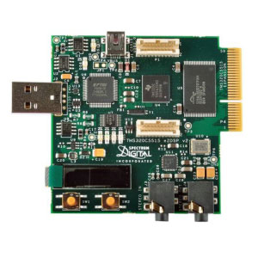
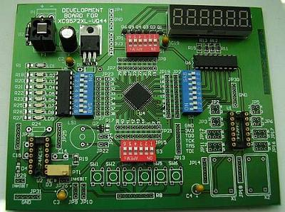
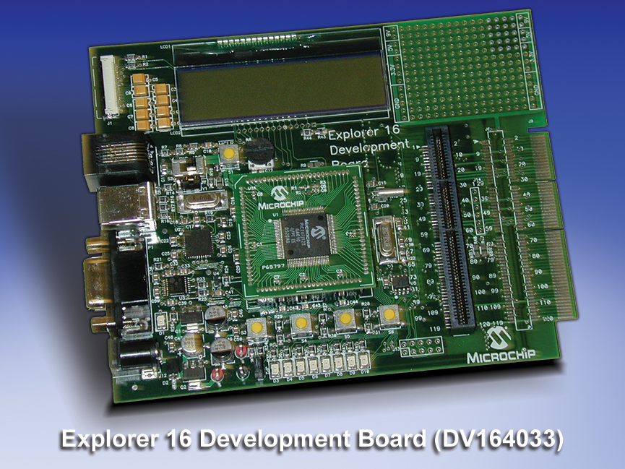
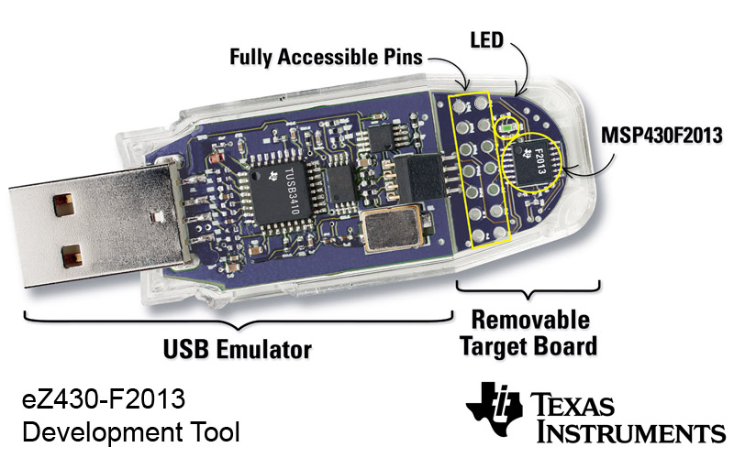
Development board, evaluation board etc.
Off-the-shelf boards
There are many “generic” boards that exist mainly to give developers the chance to evaluate and prototype devices.
The Actel board in 373 is an example.
If you are doing embedded development you really want to be able to use a dev. board to prototype where possible.
Nice to be able to get software up and running
Not to mention nice to learn you can’t do what you thought you could do!
Also nice because the schematics are often available to you.
Things like power supply design are done and tested!
Huge variety of these…

Slide 6
Personal Example:
Off-the-shelf boards
I am currently “specing” a board. It needs to be:
Be able to mostly do the 270 labs
Switches, buttons, LEDs, FPGA with decent free software.
7-segment displays would be really nice.
2000+ gates, 100+ flip-flops
Ideally twice that or more
Cheap in quantity--$20 target price at 5,000 units.
No external wiring or power supply other than a USB cable.
First check is what’s out there…

Slide 7
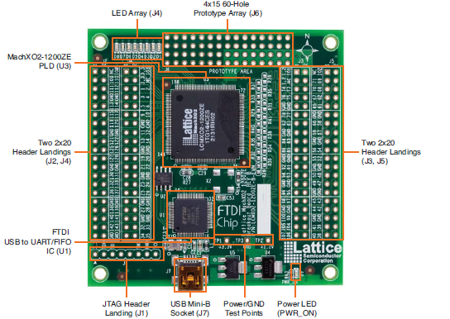
Market check
Off-the-shelf boards
Best I could find:
Digilent C-Mod
$22 in quantities of 1, has solid FPGA.
Basically no I/O, requires expensive programming cable.
Polmaddie2
Has traffic-light LEDs!, plenty of FPGA, only USB cable
$80 in quantities of 100, not enough I/O.
Asked around and found
MachXO2-1200ZE
Plenty of potential I/O (lots of headers), USB-only, $30 in quantities of 1 from Digikey (lots of potential for lower price), has LEDs.
No actual switches, 108 LUTs, price may be too much?

Slide 8
Even that board isn’t ideal
Off-the-shelf boards
But encouraging that I might be able to design one (or have one designed) that fits the specification.
Spend an extra dollar on the FPGA and probably get one more than large enough.
Switches/7-segment displays remarkably expensive.
Probably $3 in parts for what I want?

Slide 9
So…
Off-the-shelf boards
There may be a board out there that does what you need.
Even if price/form factor/power isn’t acceptable, still really useful for development!
Always look.
You’d rather develop on an existing board.
You’d also like to have it as a starting point.

Slide 10
Embedded Linux

Slide 11
Linux?
A POSIX-compliant and widely deployed desktop/server operating system licensed under the GPL
POSIX
Unix-like environment (shell, standard programs like awk etc.)
Desktop OS
Designed for users and servers
Not designed for embedded systems
GPL
Gnu Public License. May mean you need to make source code available to others.
First “copyleft” license.
Linux is licensed under GPL-2, not GPL-3.
Many figures and text in this section taken from Embedded Linux Primer, second edition
We (kind of) have on-line access to the book.

Slide 12
Outline
Background
Legal issues, versioning, building, user basis, FHS, booting
Embedded Linux (common but not required attributes)
Small footprint (BusyBox)
Flash file system
Real time support

Slide 13
Outline
Background
Legal issues, versioning, building, user basis, FHS, booting
Embedded Linux (common but not required attributes)
Small footprint (BusyBox)
Flash file system
Real time support

Slide 14
GPL in two slides (1/2)
Background: legal issues
A licensee of GPL v2-licensed software can:
copy and distribute the program's unmodified source code
modify the program's source code and distribute the modified source
distribute compiled versions of the program, both modified and unmodified
Provided that:
all distributed copies (modified or not) carry a copyright notice and exclusion of warranty
all modified copies are distributed under the GPL v2
all compiled versions of the program are accompanied by the relevant source code, or a viable offer to make the relevant source code available
Largely taken from http://www.oss-watch.ac.uk/resources/gpl.xml

Slide 15
GPL in two slides (2/2)
Background: legal issues
Some points
If you don’t redistribute the code, you don’t need to share the source.
You can bundle software with GPL-ed software and not have to license the bundled software.
“Mere aggregations” aren’t impacted.
Loadable Kernel Modules are tricky though
Often we need device drivers for our application (we’ll be writing them later)
But they touch the Linux code in a non-trivial way.
There is some debate about if a LKM is an aggregation or a modification of the original kernel.
In general there are proprietary drivers out there and even open source groups that help support said drivers.
General theme:
Be sure you understand the law before you use software licensed under the GPL on a proprietary project.
Using gcc to compile or ddd to debug is fine, but when you are modifying the code of software licensed under the GPL you might be obligated to release your code.
Read: The Cathedral and the Bazaar

Slide 16
Linux Kernel history
Background: versions
2.4 has been around forever, was “end-of-lifed” Dec 2011.
2.6 is still active, but no new releases planned
3.0 isn’t a radical change from 2.6, instead a 2.6 upgrade was move to 3.0 for Linux’s 20th anniversary.
So what are the big changes? NOTHING. Absolutely nothing. Sure, we have the usual two thirds driver changes, and a lot of random fixes, but the point is that 3.0 is *just* about renumbering… [https://lkml.org/lkml/2011/5/29/204]
Figure modified from “Linux kernel” article on Wikipedia

Slide 17
What version am I working with?
Background: versions
If running, use “uname” command
“uname -a” for all information
If looking at source,
First few lines of the top-level Makefile will tell you.

Slide 18
How do I download and build the kernel?
Background: building
Use git.
Typing “make” with no target at the top-level should build the kernel.
Need gcc installed (no other compiler will do).
Should generate an ELF file called “vmlinux”
But lots of configuration stuff

Slide 19
Kernel configuration
Background: building
There is a file, “.config” which drives the build.
It determines the functionality (including cross-compling?) of the kernel.
Things like USB support, etc.
It is setup in any number of ways.
The default is to ask a huge number of questions.
There are editors and defaults you can use instead.
make defconfig should just do all defaults for example.
make help should give a solid overview of options
The .config file scheme has some problems.
It is easy to miss, as files that start with a “.” (dot) are hidden files in Linux ("ls -a" will show them)
It is easy to blow away.
make distclean will delete it for example…

Slide 20
Linux user basics--shell
Background: user basics
You have a shell which handles user commands
May just search for an executable file (application) in certain locations
Allows for moving data between those applications.
Is itself a programming language.
There are many of these (bash, sh, tcsh, csh, ksh, zsh)
Most have very similar interfaces (type application name, it runs), but the programming language part varies quite a bit.
Geek humor:
sh is called the Bourne shell, written by Stephen Bourne
bash, often treated as an upgrade to sh, is the “Bourne again shell”

Slide 21
Linux user basics—file systems
Background: user basics
Linux supports a huge variety of file systems.
But they have some commonalities.
Pretty much a standard directory structure with each directory holding either other directories or files.
Each file and directory has a set of permissions.
One owner (a single user)
One group (a list of users who may have special access)
There are three permissions, read, write and execute
Specified for owner, group and world.
There are also links (hard and soft)
So rather than copying files I can point to them.

Slide 22
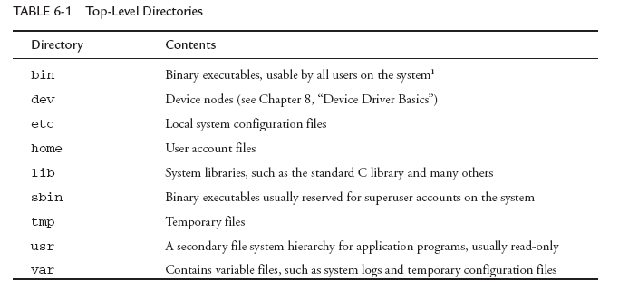
FHS: File System Hierarchy Standard
Background: FHS
There is a standard for laying out file systems
Part of this is the standard top-level directories

Slide 23
A “minimal” file system
Background: FHS
Busybox is covered later

Slide 24
Background: booting
Background: booting
Some circuit magic happens
Get clock running, reset registers etc.
Bootloader starts
Initialize devices such as I2C, serial, DRAM, cache, etc.
Starts the OS
Kernel starts
Might set up other things needed
Init gets called
Lots of stuff…

Slide 25
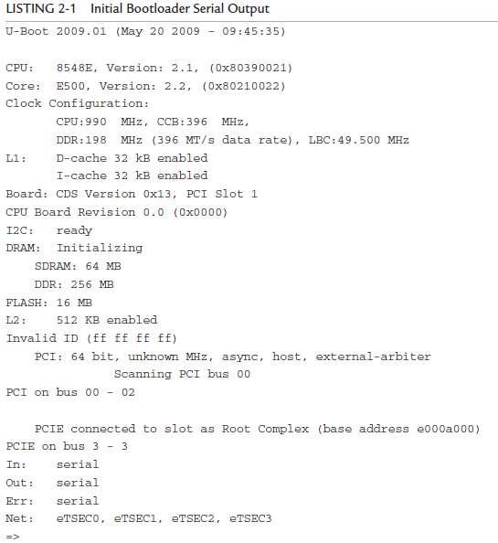
Background: booting

Slide 26
Handoff from the Kernel
Background: booting
Kernel tries to start init.
Tries a few locations
Doesn’t return if successful, so first that succeeds is all that runs.

Slide 27
The init process (6.3)
Background: booting
Init is the ultimate parent of all user-space processes.
Provides all default environment variables including PATH
Init uses a text file, /etc/inittab.
That file includes a number of “run levels” that are used to determine what init should do.
Halt, reboot, general-purpose multi-user, etc.

Slide 28
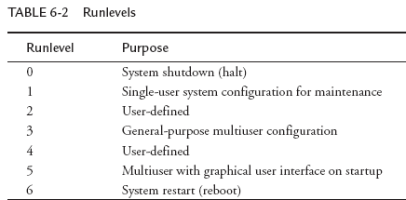
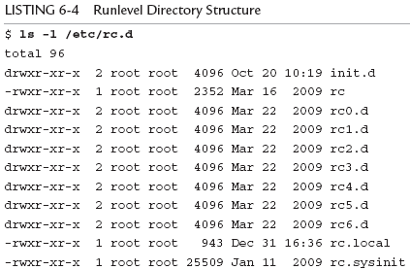
Init (continued)
Background: booting
rcN.d holds symlinks to start or kill each process
associated with that runlevel.
init.d holds the scripts for each service.

Slide 29
Outline
Background
Legal issues, versioning, building, user basis, FHS, booting
Embedded Linux (common but not required attributes)
Small footprint (BusyBox)
Flash file system
Real time support

Slide 30
What makes a Linux install “embedded”?
Embedded Linux
It’s one of those poorly defined terms, but in general it will have one or more of the following
small footprint
flash files system
real-time extensions of some sort

Slide 31
Small footprint--Busybox
Embedded Linux—small footprint
addgroup, adduser, ar, ash, awk, basename, blkid, bunzip2, bzcat, cat, chattr, chgrp, chmod, chown, chpasswd, chroot, chvt, clear, cmp, cp, cpio, cryptpw, cut, date, dc, dd, deallocvt, delgroup, deluser, df, dhcprelay, diff, dirname, dmesg, du, dumpkmap, dumpleases, echo, egrep, env, expr, false, fbset, fbsplash, fdisk, fgrep, find, free, freeramdisk, fsck, fsck.minix, fuser, getopt, getty, grep, gunzip, gzip, halt, head, hexdump, hostname, ttpd, hwclock, id, ifconfig, ifdown, ifup, init, insmod, ip, kill, killall, klogd, last, less, linuxrc, ln, loadfont, loadkmap, logger, login, logname, logread, osetup, ls, lsmod, makedevs, md5sum, mdev, microcom, mkdir, mkfifo, mkfs.minix, mknod, mkswap, mktemp, modprobe, more, mount, mv, nc, netstat, nice, nohup, nslookup, od, penvt, passwd, patch, pidof, ping, ping6, pivot_root, poweroff, printf, ps, pwd, rdate, rdev, readahead, readlink, eadprofile, realpath, reboot, renice, reset, rm, rmdir, rmmod, route, rtcwake, run-parts, sed, seq, setconsole, etfont,sh, showkey, sleep, sort, start-stop-daemon, strings, stty, su, sulogin, swapoff, swapon, switch_root, sync, sysctl, syslogd, tail, tar, tee, telnet, telnetd, test, tftp, time, top, touch, tr, traceroute, true, tty, udhcpc, udhcpd, umount, uname, uniq, unzip, uptime, usleep, vi, vlock, watch, wc, wget, which, who, whoami, xargs, yes, zcat
A single executable that implements the functionality of a massive number of standard Linux utilities
ls, gzip, ln, vi. Pretty much everything you normally need.
Some have limited features
Gzip only does the basics for example.
Pick which utilities you want it to do
Can either drop support altogether or install real version if needed
Highly configurable (similar to Linux itself), easy to cross-compile.
Example given is around 2MB statically compiled!

Slide 32
Using busybox
Embedded Linux—small footprint
Two ways to play
Invoke from the command line as busybox
busybox ls /
Or create a softlink to busybox and it will run as the name of that link.
So if you have a softlink to busybox named “ls” it will run as ls.

Slide 33
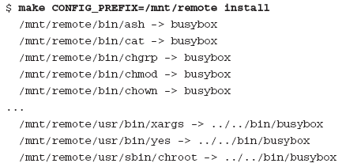
Links done for you
Embedded Linux—small footprint
Normally speaking, you’ll use the softlink option.
You can get it to put in all the links for you with “make install”
Be darn careful you don’t overwrite things locally if you are doing this on the host machine.
That would be bad.

Slide 34
System initialization
Embedded Linux—small footprint
Busybot can also be “init”
But it’s a simpler/different version than the init material covered above.
More “bash” like
#!/bin/sh
echo “Mounting proc”
mount -t proc /proc /proc
echo “Starting system loggers”
syslogd
klogd
echo “Configuring loopback interface”
ifconfig lo 127.0.0.1
echo “Starting inetd”
xinetd
# start a shell
busybox sh

Slide 35
BusyBox Summary
Embedded Linux—small footprint
BusyBox is a powerful tool for embedded systems that replaces many common Linux utilities in a single multicall binary.
BusyBox can significantly reduce the size of your root file system image.
Configuring BusyBox is straightforward, using an interface similar to that used for Linux configuration.
System initialization is possible but somewhat different with BusyBox
From Embedded Linux Primer, second edition

Slide 36
Outline
Background
Legal issues, versioning, building, user basis, FHS, booting
Embedded Linux (common but not required attributes)
Small footprint (BusyBox)
Flash file system
Real time support

Slide 37
Flash storage devices
Embedded Linux—flash filesystem
Significant restrictions on writing
data can be changed from a 1 to a 0 with writes to the cell’s address
0 to 1 requires an entire block be erased.
Therefore, to modify data stored in a Flash memory, the block in which the modiﬁed data resides must be completely erased.
Write times for updating data in Flash memory can be many times that of a hard drive.
Also very limited write cycles (100 to 1,000,000 or so) before wear out.

Slide 38
Flash: NAND vs. NOR
Embedded Linux—flash filesystem
Differences vary by manufacturer.
NAND typically has longer until wear out.

Slide 39
Organizing flash memory
Embedded Linux—flash filesystem
The bootloader is often placed in the top or bottom of the Flash memory array
Following the bootloader, space is allocated for the Linux kernel image and the ramdisk ﬁlesystem image, which holds the root ﬁlesystem
When booted, a ﬁlesystem image stored in Flash is read into a Linux ramdisk block device, mounted as a ﬁlesystem, and accessed only from RAM

Slide 40
Flash file systems
Embedded Linux—flash filesystem
Manage data similar to a hard drive
Wear leveling
As discussed earlier, Flash blocks are subject to a ﬁnite write lifetime. Wear leveling algorithms are used to distribute writes evenly over the physical erase blocks of the Flash memory in order to extend the life of the Flash memory chip.
One of the more popular Flash ﬁle systems in use today is JFFS2, or Journaling Flash File System 2
It has several important features aimed at improving overall performance, increasing Flash lifetime, and reducing the risk of data loss in the case of power failure

Slide 41
Outline
Background
Legal issues, versioning, building, user basis, FHS, booting
Embedded Linux (common but not required attributes)
Small footprint (BusyBox)
Flash file system
Real time support
RT Linux patch
Other solutions

Slide 42
Real-time Kernel Patch
Embedded Linux—real time?
The patch had many contributors, and it is currently maintained by Ingo Molnar; you can find it at:
www.kernel.org/pub/linux/kernel/projects/rt/
Since about Linux 2.6.12, soft real-time performance in the single-digit milliseconds on a reasonably fast x86 processor is readily achieved

Slide 43
Features
Embedded Linux—real time?
The real-time patch adds a fourth preemption mode called PREEMPT_RT, or Preempt Real Time.
Features from the real-time patch are added, including replacing spinlocks with preemptable mutexes.
This enables involuntary preemption everywhere within the kernel except for areas protected by preempt_disable().
This mode significantly smoothes out the variation in latency (jitter) and allows a low and predictable latency for time-critical real-time applications.
The problem is…
Not all devices can handle being interrupted.
This means that with the RT patch in play you might get random crashes.

Slide 44
There are lots of other attempts and discussions about a real-time Linux
Embedded Linux—real time?
RTLinux
Wind River had something up and running for years.
Ended support in 2011.
Seems fairly restrictive.
Real Time Linux Foundation, Inc.
Holding workshops on this for 13 years.
http://lwn.net/Articles/397422/
Nice overview of some of the issues

