Slide 1
EECS 498 Advanced Embedded Systems
Lecture 5:
An Introduction to Real Time Systems
Chunks adapted from work by
Dr. Fred Kuhns of Washington University
and Farhan Hormasji

Slide 2
What is a Real-Time System?
What is a RTS?
Real-time systems have been defined as: "those systems in which the correctness of the system depends not only on the logical result of the computation, but also on the time at which the results are produced";
J. Stankovic, "Misconceptions About Real-Time Computing," IEEE Computer, 21(10), October 1988.

Slide 3
Real-Time Characteristics
What is a RTS?
Pretty much your typical embedded system
Sensors & actuators all controlled by a processor.
The big difference is timing constraints (deadlines).
Those tasks can be broken into two categories¹
Periodic Tasks: Time-driven and recurring at regular intervals.
A car checking for a wall every 0.1 seconds;
An air monitoring system grabbing an air sample every 10 seconds.
Aperiodic: event-driven
That car having to react to a wall it found
The loss of network connectivity.
¹Sporadic tasks are sometimes also discussed as a third catagory.. They are tasks similar to aperiodic tasks but activated with some known bounded rate. The bounded rate is characterized by a minimum interval of time between two successive activations.

Slide 4
Some Definitions
What is a RTS?
Timing constraint: constraint imposed on timing behavior of a job: hard, firm, or soft.
Release Time: Instant of time job becomes available for execution.
Deadline: Instant of time a job's execution is required to be completed. If deadline is infinity, then job has no deadline.
Response time: Length of time from release time to instant job completes.

Slide 5
Soft, Firm and Hard deadlines
What is a RTS?
The instant at which a result is needed is called a deadline.
If the result has utility even after the deadline has passed, the deadline is classified as soft, otherwise it is firm.
If a catastrophe could result if a firm deadline is missed, the deadline is hard.
Examples?
Definitions taken from a paper by Kanaka Juvva, not sure who originated them.

Slide 6
Why is this hard? Three major issues
What is a RTS?
We want to use as cheap ($$, power) a processor as possible.
Don’t want to overpay
There are non-CPU resources to worry about.
Say two devices both on an SPI bus.
So often can’t treat tasks as independent
Validation is hard
You’ve got deadlines you must meet.
How do you know you will?
Let’s discuss that last one a bit more

Slide 7
Validating a RTS is hard
What is a RTS?
Validation is simply the ability to be able to prove that you will meet your constraints
Or for a non-hard time system, prove failure is rare.
This is a hard problem just with timing restrictions
How do you know that you will meet all deadlines?
A task that needs 0.05s of CPU time and has a deadline 0.1s after release is “easy”.
But what if three such jobs show up at the same time?
And how do you know the worst-case for all these applications?
Sure you can measure a billion instances of the program running, but could something make it worse?
Caches are a pain here.
And all that ignores non-CPU resource constraints!
We need some formal definitions to make progress here…

Slide 8
Properties for Scheduling tasks
What is a RTS?
Priority
If two tasks are both waiting to run at the same time, one will be selected. That one is said to have the higher priority.
Fixed/Dynamic priority tasks
In priority driven scheduling, assigning the priorities can be done statically or dynamically while the system is running
Preemptive/Non-preemptive tasks
Execution of a non-preemptive task is to be completed without interruption once it is started
Otherwise a task can be preempted if another task of higher priority becomes ready
Multiprocessor/Single processor systems
In multiprocessor real-time systems, the scheduling algorithms should prevent simultaneous access to shared resources and devices.

Slide 9
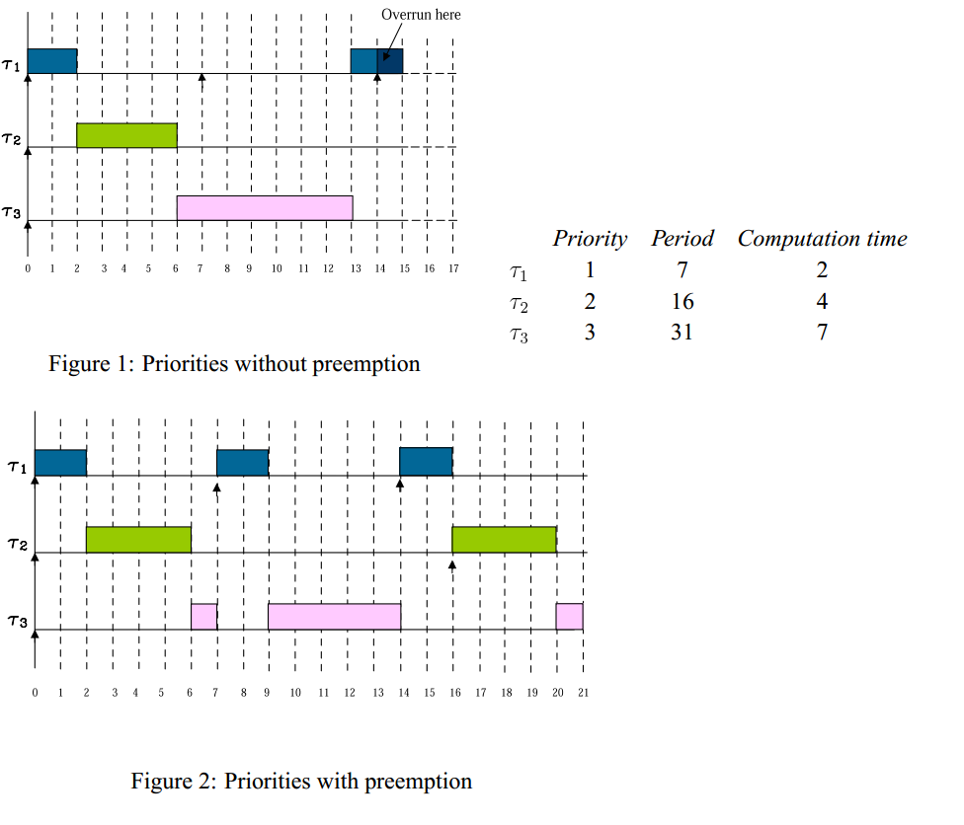
Preemption What it is and how it helps
What is a RTS?
For periodic tasks we generally
assume the deadline is the same
as the period (you must finish the
the current one before the next
one is released).
Mohammadi, Arezou, and Selim G. Akl. "Scheduling Algorithms for Real-Time Systems." (2005)

Slide 10
Scheduling algorithms
A scheduling algorithm is a scheme that selects what job to run next.
Can be preemptive or non-preemptive.
Dynamic or static priorities
Etc.
We’ll look at two schemes today.

Slide 11
Two scheduling schemes
Rate monotonic (RM)
Static priority scheme
Simple to implement
Nice properties
Earliest deadline first (EDF)
Dynamic priority scheme
Harder to implement
Very nice properties

Slide 12
RM and EDF assumptions
No task has any non-preemptable section and the cost of preemption is negligible.
Only processing requirements are significant; memory, I/O, and other resource requirements are negligible.
All tasks are independent; there are no precedence constraints.

Slide 13
Terms and definitions
Execution time of a task - time it takes for a task to run to completion
Period of a task - how often a task is being called to execute; can generally assume tasks are periodic although this may not be the case in real-world systems
CPU utilization - the percentage of time that the processor is being used to execute a specific scheduled task
where e_{i} is the execution time of task i, and P_{i} is its period
Total CPU utilization - the summation of the utilization of all tasks to be scheduled

Slide 14
RM Scheduling
RM scheduling
It is a static-priority preemptive scheme involving periodic tasks only.
Well, it mumbles about non-periodic tasks, but…
Basic idea:
Priority goes to the task with the lowest period.
Mohammadi, Arezou, and Selim G. Akl. "Scheduling Algorithms for Real-Time Systems." (2005)

Slide 15
How well does RMS work?
RM scheduling
Surprisingly well actually.
Let n be the number of tasks.
If the total utilization is less than n(2^{1/n}-1), the tasks are schedulable.
That’s pretty cool.
At n=2 that’s ~83.3%
At n=∞ that’s about 69.3%
This means that our (extremely) simple algorithm will work if the total CPU utilization is less than 2/3!
Still, don’t forget our assumptions (periodic being the big one)
Also note, this is a sufficient, but not necessary condition
Tasks may still be schedulable even if this value is exceeded.
http://cn.el.yuntech.edu.tw/course/95/real_time_os/present%20paper/Scheduling%20Algorithms%20for%20Multiprogramming%20in%20a%20Hard-.pdf

Slide 16
What if the sufficiency bound is not met?
RM scheduling
Critical instant analysis
The worst case for RMS is that all tasks happen to start at the exact same time.
If RM can schedule that, the tasks are schedulable.
Note that it might still be schedulable even if it’s not schedulable in the critical instant.
Can you find an example?
With RM scheduling we can always jump to doing the critical instant analysis
Mohammadi, Arezou, and Selim G. Akl. "Scheduling Algorithms for Real-Time Systems." (2005)

Slide 17
Example #1
RM scheduling
http://www.idsc.ethz.ch/Courses/embedded_control_systems/Exercises/SWArchitecture08.pdf

Slide 18
Example #2
RM scheduling
Task | Execution Time | Period | Priority
T1 | 1 | 3 | High
T2 | 1 | 4 | Low

Slide 19
Example #3
RM scheduling
Task | Execution Time | Period | Priority
T1 | 1 | 3 | High
T2 | 2.1 | 4 | Low

Slide 20
Example #4
RM scheduling
Task | Execution Time | Period | Priority
T1 | 1 | 2 | High
T2 | 2 | 5 | Low

Slide 21
Easy?
RM scheduling
Consider interrupt priorities as a way to implement…

Slide 22
EDF Scheduling
EDF scheduling
Also called the deadline-monotonic scheduling algorithm, it is a priority driven algorithm in which higher priority is assigned to the request that has earlier deadline, and a higher priority request always preempts a lower priority one
Uses dynamic priority assignment in the sense that the priority of a request is assigned as the request arrives
We make all the assumptions we made for the RM algorithm, except that the tasks do not have to be periodic
Same runtime complexity as RM scheduling if sorted lists are used
EDF is an optimal uniprocessor scheduling algorithm
Mohammadi, Arezou, and Selim G. Akl. "Scheduling Algorithms for Real-Time Systems." (2005)

Slide 23
EDF issues
EDF scheduling
Dynamic priorities
When do you need to recompute priorities?
How much time will you need to take?
O(?)
When it fails…

Slide 24
others?
other schemes

Slide 25
LLF (Least Laxity First) Scheduling
other schemes
The laxity of a process is defined as the deadline minus remaining computation time
In other words, the laxity of a job is the maximal amount of time that the job can wait and still meet its deadline
The algorithm gives the highest priority to the active job with the smallest laxity
While a process is executing, it can be preempted by another whose laxity has decreased to below that of the running process
A problem arises with this scheme when two processes have similar laxities. One process will run for a short while and then get preempted by the other and vice versa, thus causing many context switches occur in the lifetime of the processes.
The least laxity first algorithm is an optimal scheduling algorithm for systems with periodic real-time tasks

Slide 26
round robin (no priorities)
other schemes
Task | Execution Time | Period
T1 | 5 min | 1 hr
T2 | 0.6 sec | 1 sec

Slide 27
Optimal?
Finally…
An optimal real-time scheduling algorithm is one which may fail to meet a deadline only if no other scheduling algorithm can meet the deadline.

Slide 28
Of course, this ignores a lot
Finally…
We’ve only worried about the CPU as a resource.
What if one task is waiting on another to free a resource?

Slide 29
Priority Inversion
Finally…
In a preemptive priority based real-time system, sometimes tasks may need to access resources that cannot be shared.
The method of ensuring exclusive access is to guard the critical sections with binary semaphores.
When a task seeks to enter a critical section, it checks if the corresponding semaphore is locked.
If it is not, the task locks the semaphore and enters the critical section.
When a task exits the critical section, it unlocks the corresponding semaphore.
This could cause a high priority task to be waiting on a lower priority one.
Even worse, a medium priority task might be running and cause the high priority task to not meet its deadline!
Mohammadi, Arezou, and Selim G. Akl. "Scheduling Algorithms for Real-Time Systems." (2005)

Slide 30
Priority Inversion
Finally…
How could you solve it?

