Slide 1
EECS 498 Advanced Embedded Systems
Lecture 7:
An Introduction to Real Time OSes

Slide 2
Outline
Quick review of real-time systems
Overview of RTOSes
Goals of an RTOS
Features you might want in an RTOS
Learning by example: FreeRTOS
Introduction
Tasks
Interrupts
Internals (briefly)
What’s missing?

Slide 3
Outline
Quick review of real-time systems
Overview of RTOSes
Goals of an RTOS
Features you might want in an RTOS
Learning by example: FreeRTOS
Introduction
Tasks
Interrupts
Internals (briefly)
What’s missing?

Slide 4
What is a Real-Time System?
RTS review
Real-time systems have been defined as: "those systems in which the correctness of the system depends not only on the logical result of the computation, but also on the time at which the results are produced";
J. Stankovic, "Misconceptions About Real-Time Computing," IEEE Computer, 21(10), October 1988.

Slide 5
Real-Time Characteristics
RTS review
Pretty much your typical embedded system
Sensors & actuators all controlled by a processor.
The big difference is timing constraints (deadlines).
Those tasks can be broken into two categories¹
Periodic Tasks: Time-driven and recurring at regular intervals.
A car checking for a wall every 0.1 seconds;
An air monitoring system grabbing an air sample every 10 seconds.
Aperiodic: event-driven
That car having to react to a wall it found
The loss of network connectivity.
¹Sporadic tasks are sometimes also discussed as a third catagory.. They are tasks similar to aperiodic tasks but activated with some known bounded rate. The bounded rate is characterized by a minimum interval of time between two successive activations.

Slide 6
Some Definitions
RTS review
Timing constraint: constraint imposed on timing behavior of a job: hard, firm, or soft.
Release Time: Instant of time job becomes available for execution.
Deadline: Instant of time a job's execution is required to be completed. If deadline is infinity, then job has no deadline.
Response time: Length of time from release time to instant job completes.

Slide 7
Soft, Firm and Hard deadlines
RTS review
The instant at which a result is needed is called a deadline.
If the result has utility even after the deadline has passed, the deadline is classified as soft, otherwise it is firm.
If a catastrophe could result if a firm deadline is missed, the deadline is hard.
Examples?
Definitions taken from a paper by Kanaka Juvva, not sure who originated them.

Slide 8
Why is this hard? Three major issues
RTS review
We want to use as cheap ($$, power) a processor as possible.
Don’t want to overpay
There are non-CPU resources to worry about.
Say two devices both on an SPI bus.
So often can’t treat tasks as independent
Validation is hard
You’ve got deadlines you must meet.
How do you know you will?

Slide 9
Outline
Quick review of real-time systems
Overview of RTOSes
Goals of an RTOS
Features you might want in an RTOS
Learning by example: FreeRTOS
Introduction
Tasks
Interrupts
Internals (briefly)
What’s missing?

Slide 10
Goals of an RTOS?
Well, to manage to meet RT deadlines (duh).
While that’s all we need we’d like a lot more.
After all, we can meet RT deadlines fairly well on the bare metal (no OS)
But doing this is time consuming and difficult to get right as the system gets large.
We’d like something that supports us
Deadlines met
Interrupts just work
Tasks stay out of each others way
Device drivers already written (and tested!) for us
Portable—runs on a huge variety of systems
Oh, and nearly no overhead so we can use a small device!
That is a small memory and CPU footprint.

Slide 11
Detailed features we’d like
Deadlines met
Interrupts just work
Ability to specify scheduling algorithm
We’d like priority inversion dealt with
Interrupts are fast
So tasks with tight deadlines get service as fast as possible
Basically—rarely disable interrupts and when doing so only for a short time.
Don’t need to worry about saving/restoring registers
Which C just generally does for us anyways.
Interrupt prioritization easy to set.

Slide 12
Aside: What is priority inversion again?
Low priority task “C” locks resource “Z”.
High priority task “A” preempts “A” then requests resource “Z”
Deadlock, but solvable by having “A” sleep until resource is unlocked.
But if medium priority “B” were to run, it would preempt C, thus effectively making C and A run with a lower priority than B.
Thus priority inversion.
Solving it: Priority Inheritance
When a high priority task sleeps because it is waiting on a lower priority task, have it boost the priority of the blocking task to its own priority.
There are other solutions
For example, if there are only 2 priorities this can’t happen ☺

Slide 13
Detailed features we’d like: Tasks stay out of each others way
This is actually remarkably hard
Clearly we need to worry about CPU utilization issues
That is what our scheduling algorithm discussion was to address
But we also need to worry about memory problems.
One task running awry shouldn’t take the rest of the system down.
So we want to prevent tasks from harming each other
This can be key. If we want mission critical systems sharing the CPU with less important things we have to do this.
Alternative it to have separate processors.
$$$$
The standard way to do this is with page protection.
If a process tries to access memory that isn’t its own, it fails.
Probably a fault.
This also makes debugging a LOT easier.
This generally requires a lot of overhead.
Need some sense of process number/switching
Need some kind of MMU in hardware
Most microcontrollers lack this…
So we hit some kind of minimum size.
Further reading on page protection (short) http://homepage.cs.uiowa.edu/~jones/security/notes/06.shtml

Slide 14
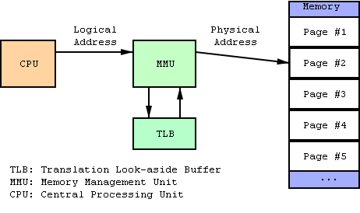
Aside: What is an MMU?
Memory Management Unit
Tracks what parts of memory a process can access.
Actually a bit more complex as it manages this by mapping virtual addresses to physical ones.
Keeps processes out of each other’s memory.
Figure from Wikipedia

Slide 15
Silly Contest:
Cheapest device with an MMU at Digikey (Quantity 1)?
Winner gets a candy bar next Monday!

Slide 16
Device drivers written (and tested!) for us
Ideally the RTOS has drivers for all the on-board peripherals.
It’s a lot easier to call a “configure_I2C()” function than to read the details of the device specification than to do the memory-mapped work yourself
Hummm, this may be a standard task for 473 in the future. Could be quite portable with some effort…
I rather like this…

Slide 17
Portable
RTOS runs on many platforms.
This is potentially incomputable with the previous slide.
It’s actually darn hard to do even without peripherals
For example I just spent 10 hours debugging a RTOS that had a pointer problem that only comes up if the pointer type is larger than the int type (20 bit pointers, 16 bit ints, yea!)
Things like timers change and we certainly need timers.

Slide 18
Outline
Quick review of real-time systems
Overview of RTOSes
Goals of an RTOS
Features you might want in an RTOS
Learning by example: FreeRTOS
Introduction
Tasks
Interrupts
Internals (briefly)
What’s missing?

Slide 19
Learning by example: FreeRTOS
Introduction taken from Amr Ali Abdel-Naby
Nice blog:
http://www.embedded-tips.blogspot.com

Slide 20
FreeRTOS Features
Source code
Portable
Romable
Scalable
Preemptive and co-operative scheduling
Multitasking
Services
Interrupt management
Advanced features
Amr Ali Abdel-Naby@2010
Introduction to FreeRTOS V6.0.5

Slide 21
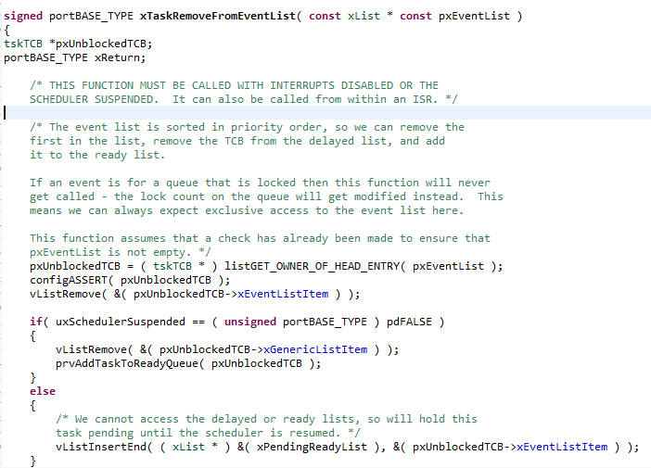
Source Code
High quality
Neat
Consistent
Organized
Commented
Amr Ali Abdel-Naby@2010
Introduction to FreeRTOS V6.0.5

Slide 22
Portable
Highly portable C
24 architectures supported
Assembly is kept minimum.
Ports are freely available in source code.
Other contributions do exist.
Amr Ali Abdel-Naby@2010
Introduction to FreeRTOS V6.0.5

Slide 23
Scalable
Only use the services you only need.
FreeRTOSConfig.h
Minimum footprint = 4 KB
Version in lab is 24 KB including the application (which is fairly large) and data for the OS and application.
Pretty darn small for what you get.
~6000 lines of code (including a lot of comments, maybe half that without?)
Amr Ali Abdel-Naby@2010

Slide 24
Preemptive and Cooperative Scheduling
Preemptive scheduling:
Fully preemptive
Always runs the highest priority task that is ready to run
Comparable with other preemptive kernels
Used in conjunction with tasks
Cooperative scheduling:
Context switch occurs if:
A task/co-routine blocks
Or a task/co-routine yields the CPU
Used in conjunction with tasks/co-routines
Amr Ali Abdel-Naby@2010
Introduction to FreeRTOS V6.0.5

Slide 25
Multitasking
No software restriction on:
# of tasks that can be created
# of priorities that can be used
Priority assignment
More than one task can be assigned the same priority.
RR with time slice = 1 RTOS tick
Amr Ali Abdel-Naby@2010
Introduction to FreeRTOS V6.0.5

Slide 26
Services
Queues
Semaphores
Binary and counting
Mutexes
With priority inheritance
Support recursion
Amr Ali Abdel-Naby@2010
Introduction to FreeRTOS V6.0.5

Slide 27
Interrupts
An interrupt can suspend a task execution.
Interrupt mechanism is port dependent.
Amr Ali Abdel-Naby@2010
Introduction to FreeRTOS V6.0.5

Slide 28
Advanced Features
Execution tracing
Run time statistics collection
Memory management
Memory protection support
Stack overflow protection
Amr Ali Abdel-Naby@2010
Introduction to FreeRTOS V6.0.5

Slide 29
Device support in related products
Connect Suite from High Integrity Systems
TCP/IP stack
USB stack
Host and device
File systems
DOS compatible FAT
Amr Ali Abdel-Naby@2010
Introduction to FreeRTOS V6.0.5

Slide 30
Licensing
Modified GPL
Only FreeRTOS is GPL.
Independent modules that communicate with FreeRTOS through APIs can be anything else.
FreeRTOS can’t be used in any comparisons without the authors’ permission.
Amr Ali Abdel-Naby@2010
Introduction to FreeRTOS V6.0.5

Slide 31
A bit more
System runs on “ticks”
Every tick the kernel runs and figures out what to do next.
Interrupts have a different mechanism
Basically hardware timer is set to generate regular interrupts and calls the scheduler.
This means the OS eats one of the timers—you can’t easily share.
OK, onto tasks!

Slide 32
Outline
Quick review of real-time systems
Overview of RTOSes
Goals of an RTOS
Features you might want in an RTOS
Learning by example: FreeRTOS
Introduction
Tasks
Interrupts
Internals (briefly)
What’s missing?

Slide 33
Tasks
Each task is a function that must not return
So it’s in an infinite loop (just like you’d expect in an embedded system really, think Arduino).
You inform the scheduler of
The task’s resource needs (stack space, priority)
Any arguments the tasks needs
All tasks here must be of void return type and take a single void* as an argument.
You cast the pointer as needed to get the argument.
I’d have preferred var_args, but this makes the common case (one argument) easier (and faster which probably doesn’t matter).
Code examples mostly from Using the FreeRTOS Real Time Kernel (a pdf book), fair use claimed.

Slide 34
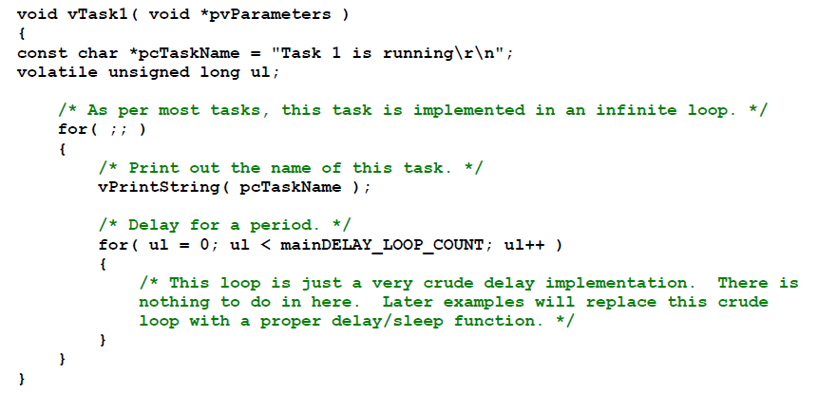
Example trivial task with busy wait (bad)

Slide 35
Task creation
portBASE_TYPE xTaskCreate(
pdTASK_CODE pvTaskCode,
const char * const pcName,
unsigned short usStackDepth,
void *pvParameters,
unsigned portBASE_TYPE uxPriority,
xTaskHandle *pvCreatedTask
);
Create a new task and add it to the list of tasks that are ready to run. xTaskCreate() can only be used to create a task that has unrestricted access to the entire microcontroller memory map. Systems that include MPU support can alternatively create an MPU constrained task using xTaskCreateRestricted().
pvTaskCode: Pointer to the task entry function. Tasks must be implemented to never return (i.e. continuous loop).
pcName: A descriptive name for the task. This is mainly used to facilitate debugging. Max length defined by tskMAX_TASK_NAME_LEN – default is 16.
usStackDepth: The size of the task stack specified as the number of variables the stack can hold - not the number of bytes. For example, if the stack is 16 bits wide and usStackDepth is defined as 100, 200 bytes will be allocated for stack storage.
pvParameters: Pointer that will be used as the parameter for the taskbeing created.
uxPriority: The priority at which the task should run. Systems that include MPU support can optionally create tasks in a privileged (system) mode by setting bit portPRIVILEGE_BIT of the priority parameter. For example, to create a privileged task at priority 2 the uxPriority parameter should be set to ( 2 | portPRIVILEGE_BIT ).
pvCreatedTask: Used to pass back a handle by which the created task can be referenced.
pdPASS: If the task was successfully created and added to a ready list, otherwise an error code defined in the file errors.h
From the task.h file in FreeRTOS

Slide 36
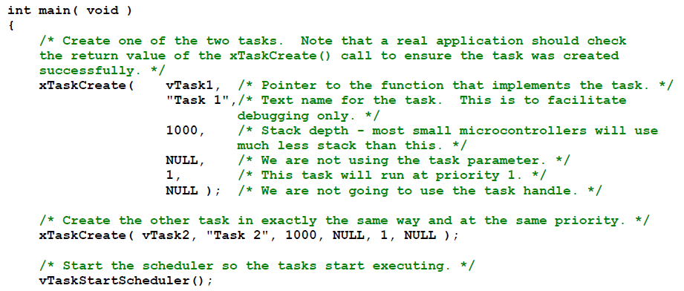
Creating a task: example

Slide 37
OK, I’ve created a task, now what?
Task will run if there are no other tasks of higher priority
And if others the same priority will RR.
But that begs the question: “How do we know if a task wants to do something or not?”
The previous example gave always wanted to run.
Just looping for delay (which we said was bad)
Instead should call vTaskDelay(x)
Delays current task for X “ticks” (remember those?)
There are a few other APIs for delaying…
Now we need an “under the hood” understanding

Slide 38
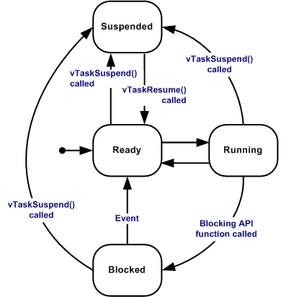
Task status in FreeRTOS
Running
Task is actually executing
Ready
Task is ready to execute but a task of equal or higher priority is Running.
Blocked
Task is waiting for some event.
Time: if a task calls vTaskDelay() it will block until the delay period has expired.
Resource: Tasks can also block waiting for queue and semaphore events.
Suspended
Much like blocked, but not waiting for anything.
Tasks will only enter or exit the suspended state when explicitly commanded to do so through the vTaskSuspend() and xTaskResume() API calls respectively.
Mostly from http://www.freertos.org/RTOS-task-states.html

Slide 39
Tasks: there’s a lot more
Can do all sorts of things
Change priority of a task
Delete a task
Suspend a task (mentioned above)
Get priority of a task.
Example on the right
But we’ll stop here…
void vTaskPrioritySet( xTaskHandle pxTask,
unsigned uxNewPriority );
Set the priority of any task.
pxTask: Handle to the task for which the priority is being set. Passing a NULL handle results in the priority of the calling task being set.
uxNewPriority: The priority to which the task will be set.

Slide 40
Outline
Quick review of real-time systems
Overview of RTOSes
Goals of an RTOS
Features you might want in an RTOS
Learning by example: FreeRTOS
Introduction
Tasks
Interrupts
Internals (briefly)
What’s missing?

Slide 41
Interrupts in FreeRTOS
There is both a lot and a little going on here.
The interface mainly uses whatever the native environment uses to handle interrupts
This can be very port dependent. In Code Composer Studio you’d set it up as follows:
#pragma vector=PORT2_VECTOR
interrupt void prvSelectButtonInterrupt( void )
That would cause the code to run on the PORT2 interrupt.
Need to set that up etc. Very device specific (of course).

Slide 42
More: Deferred Interrupt Processing
The best way to handle complex events triggered by interrupts is to not do the code in the ISR.
Rather create a task that is blocking on a semaphore.
When the interrupt happens, the ISR just sets the semaphore and exits.
Task can now be scheduled like any other. No need to worry about nesting interrupts (and thus interrupt priority).
FreeRTOS does support nested interrupts on some platforms though.
Semaphores implemented as one/zero-entry queue.

Slide 43
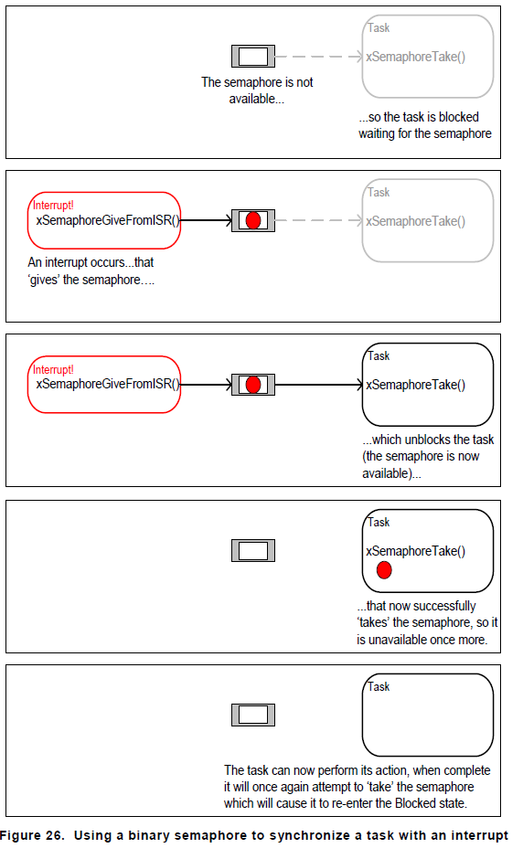
Semaphore example in FreeRTOS
Figure from Using the FreeRTOS Real Time Kernel (a pdf book), fair use claimed.

Slide 44
Semaphore take
xSemaphoreTake(
xSemaphoreHandle xSemaphore,
portTickType xBlockTime
)
Macro to obtain a semaphore. The semaphore must have previously been created.
xSemaphore A handle to the semaphore being taken - obtained when the semaphore was created.
xBlockTime The time in ticks to wait for the semaphore to become available. The macro portTICK_RATE_MS can be used to convert this to a real time. A block time of zero can be used to poll the semaphore.|
TRUE if the semaphore was obtained.
There are a handful of variations.
Faster but more locking version, non-binary version, etc.

Slide 45
Outline
Quick review of real-time systems
Overview of RTOSes
Goals of an RTOS
Features you might want in an RTOS
Learning by example: FreeRTOS
Introduction
Tasks
Interrupts
Internals (briefly)
What’s missing?

Slide 46
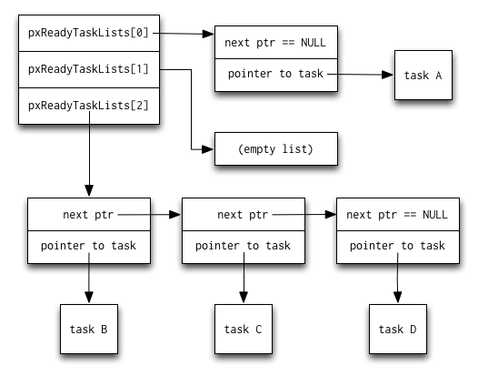
Common data structures
This figure and the next are from http://www.aosabook.org/en/freertos.html

Slide 47
