Slide 1
EECS 498 Advanced Embedded Systems
Lecture 8:
Topic Groups, RTOS Review & Power Introduction

Slide 2
Today we are covering three things
Today…
Topic group stuff (5 minutes)
Start on electrical issues for PCBs
Specifically power integrity issues
And necessarily some review on power/energy topics
RTOS review (10-15 minutes?)

Slide 3
First: Candy bars I owe?

Slide 4
Topic groups and dates
Topic groups
10/31: TBD topic, Touch panels
11/7: OBD, USB
11/14: Audio Jack, Cameras

Slide 5
Topic groups: schedule
Topic groups
2 weeks before:
Group comes to office hours with an outline.
6-10 school days before:
Give first practice talk (10% of grade)
~4 school days before
Give second practice talk (10% of grade)
Day of:
Give 25 minute (group of 2) or 35 minute (group of 3) talk in class.
A week after
Written report due
Note: occasionally groups need a third (ungraded) practice talk.

Slide 6
Doodle for practice talks
Topic groups
First set of appointment times:
http://tinyurl.com/498f12-talks1

Slide 7
Some electrical issues related to the building of PCBs

Slide 8
High-speed PCB design issues
EE issues overview
There are a lot of electrical issues to deal with when working with high-speed PCBs.
Supplying power, storing energy and dissipating heat
Power supplies, batteries, and heat sinks.
Power Integrity (PI)
We need to be sure that we keep the power and ground at approximately constant values.
Signal Integrity (SI)
We need to make sure data on the wires gets there.
Electro-magnetic interference/compatibility (EMI/EMC)
We need to watch out for generating radio-frequency noise
The FCC is a bit picky about this.
We don’t want RF noise to interfere with us.

Slide 9
Outline
Background
Understanding power and energy
Basics of In
EECS 215 “review/introduction”
On capacitors, inductors, resistors and impedance
Power integrity (PI)

Slide 10
Power!
Electric power is the rate at which electric energy is transferred by an electric circuit. The SI unit of power is the Watt. (Wikipedia)
Power (as opposed to energy), in-and-of itself is important in embedded system design.
For example there may be a cap on power draw from a given set of batteries.
That is, they can’t supply energy at more than a given rate.
Melting issues are power issues
Admittedly over time.

Slide 11
What do we mean by Power?
Understanding Power and Energy
Max Power: Artificial code generating max CPU activity
Worst-case App Trace: Practical applications worst-case
Thermal Power: Running average of worst-case app power over a time period corresponding to thermal time constant
Average Power: Long-term average of typical apps (minutes)
Transient Power: Variability in power consumption for supply net

Slide 12
Power vs. Energy
Understanding Power and Energy
Power consumption in Watts
Determines battery life in hours
Sets packaging limits
Energy efficiency in Joules
Rate at which power is consumed over time
Energy = power * delay (Joules = Watts * seconds)
Lower energy number means less power to perform a computation at same frequency

Slide 13
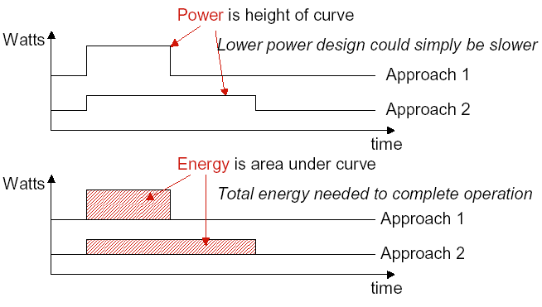
Power vs. Energy
Understanding Power and Energy

Slide 14
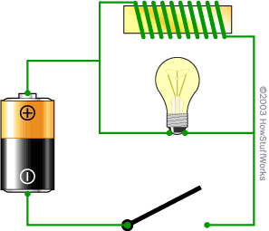
Background issue #1: Inductance
EECS 215/Physics 240 “review”
An inductor “resists the change in the flow of electrons”
The light bulb is a resistor. The wire in the coil has much lower resistance (it's just wire)
so what you would expect when you turn on the switch is for the bulb to glow very dimly.
What happens instead is that when you close the switch, the bulb burns brightly and then gets dimmer.
And when you open the switch, the bulb burns very brightly and then quickly goes out.
http://electronics.howstuffworks.com/inductor1.htm

Slide 15
Background issue #2: Capacitance
EECS 215/Physics 240 “review”
A capacitor resists the change of voltage
When you first connect the battery, bulb lights up and then dims
If you then remove the battery and replace with a wire the bulb will light again and then go out.
http://electronics.howstuffworks.com/capacitor1.htm

Slide 16
Background issue #3: Impendence
EECS 215/Physics 240 “review”
Impedance (symbol Z) is a measure of the overall opposition of a circuit to current, in other words: how much the circuit impedes the flow of current.
It is like resistance, but it also takes into account the effects of capacitance and inductance. I
Impedance is measured in ohms.
Impedance is more complex than resistance because the effects of capacitance and inductance vary with the frequency of the current passing through the circuit and this means impedance varies with frequency!
The effect of resistance is constant regardless of frequency.
http://www.kpsec.freeuk.com/imped.htm

Slide 17
A look at impedance (with capacitors, inductors and resistors vs. frequency)
EECS 215/Physics 240 “review”
Notice the log scales!

Slide 18
Power Integrity
Power Integrity
In order to get digital electronics to work correctly, they need a minimum voltage differential.
If we get below that, the devices might
Be slow (and thus not meet setup times)
Lose state
Reset or halt
Just plain not work.
Even a very (very) short “power droop” can cause the chip to die.
In my experience, this is a really common problem.
Keeping power/ground constant and noise/droop free is “Power Integrity”

Slide 19
So?
Power Integrity
We need the Vcc/Ground differential to be fairly constant.
But rapid changes in the amount of current needed will cause the voltage to spike or droop due to inductance.
We basically want a “no-pass” filter.
That is we don’t want to see any signal on the Vcc/Ground lines.
The obvious thing?
“Add a capacitor”
That should keep the voltage constant, right?
The problem is we need to worry about a lot of frequencies AND capacitors aren’t ideal.

Slide 20
Lots of frequencies
Power Integrity
Even fairly slow devices these days are capable of switching at very high frequencies.
Basically we get drivers that have rise and fall times capable of going 1GHz or so.
This means we generally have to worry about frequencies from DC all the way to 1GHz.
Because our chip may be varying its draw at rates up to that fast.

Slide 21
Non-ideal devices.
Power Integrity
ESR is Effective Series Resistance
ESL is Effective Series Inductance
Ceff is the effective capacitance.
How does quantity effect these values?
Obviously impendence will be varying by frequency.

Slide 22
Other things can add to ESR/ESL
Power Integrity
Generally a bad solder job can make ESR/ESL worse.
Packaging has an impact
wires have inductance so surface-mount packages preferred
Pads can have an impact

Slide 23
Given the previous table..
Power Integrity

Slide 24
Removing the PCB…
Power Integrity

Slide 25
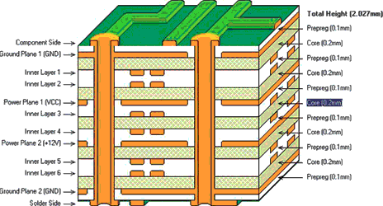
What is the PCB part?
Power Integrity

Slide 26
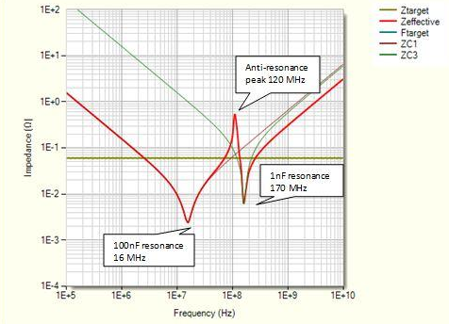
But wait…
Power Integrity
VRM
Voltage regulator module
bulk bypass (tantalum) and decoupling capacitors (ceramic).
These capacitors supply instantaneous current (at different frequencies) to the drivers until the VRM can respond.
However sets of different capacitors cause problems!
http://www.pcbdesign007.com/pages/columns.cgi? artcatid=0&clmid=65&artid=85396&pg=3&_pf_=1

Slide 27
Power Integrity (PI) summary
Power Integrity
Power integrity is about keeping the Vcc/ground difference constant.
This is hard because the devices that sink power do so in “pulses” due to their own clocks
Need caps to keep value constant
But parasitic ESR/ESL cause problems
So lots of them==good
Reduce ESR/ESL
Increase capacitance.
But anti-resonance can cause problems!
Need Spice or other tools to model.

Slide 28
RTOS review/context
RTOS
Going to discuss ticks, scheduler and more.
Done on board.

