Slide 1
EECS 498 Advanced Embedded Systems
Lecture 9:
Batteries and DC converters

Slide 2
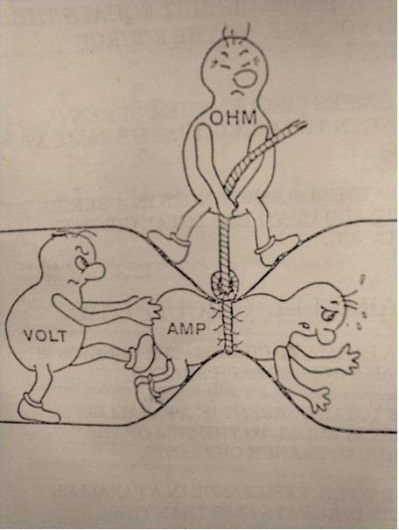
Continuing with power issues
Today…
Review
Basic power issues
Power Integrity
Discuss
Battery selection
DC converter options

Slide 3
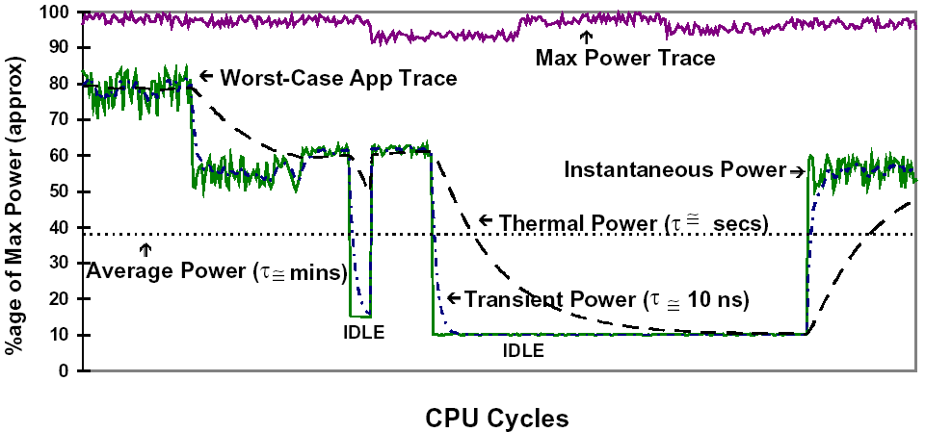
Review: Basic power issues
Electric power is the rate at which electric energy is transferred by an electric circuit.
We often look at average power on different time scales depending on what we are wanting to know.
Need to remember that lower power isn’t always the same as lower energy
especially if the lower-power solution takes significantly longer

Slide 4
Review: Power integrity (1/2)
Processors and other ICs have varying current demands
Sometimes at frequencies much greater than the device itself runs at
Why?
So the power/ground inputs need to be able to deal with that.
Basically we want those wires to be ideal and just supply how ever much or little current we need.
If the current can’t be supplied correctly, we’ll get voltage droops.
How much power noise can we accept?
Depends on the part (read the spec).
If it can run from 3.5V to 5.5V we just need to insure it stays in that range.
So we need to make sure that given the current, we don’t end up out of the voltage range.
Basically need to insure that we don’t drop too much voltage over the wires that are supplying the power!

Slide 5
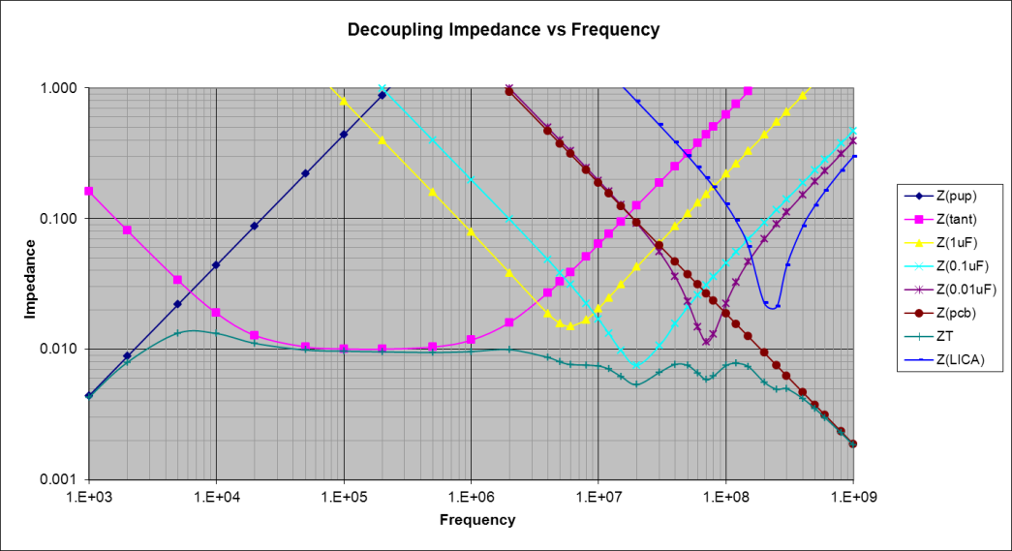
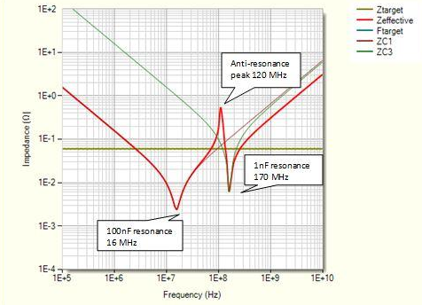
Review: Power integrity (2/2)
So we need the impedance of the wires to be low.
Because the ICs operate at a wide variety of frequencies, we need to consider all of them.
The wires themselves have a lot of inductance, so a lot of impedance at high frequencies.
Need to counter this by adding capacitors.
Problem is that the caps have parasitic inductance and resistance.
So they don’t help as well as you’d like
But more in parallel is good.
Each cap will help with different frequency ranges.
We also can get a small but low-parasitic cap out of the power/ground plane.
Finally we should consider anti-resonance*.
* http://www.n4iqt.com/BillRiley/multi/esr-and-bypass-caps.pdf provides a very nice overview of the topic and how to address it.

Slide 6
Review-ish: Didn’t actually do last time
Why was 0.01 chosen as the target impedance?
I flubbed this last time
Answer:
If you can’t have more than a .1V ripple and you are pulling 10 Amps you need your impedance to be below .01 Ohms
(V=IR so R=V/I)

Slide 7
On to Batteries

Slide 8
Outline
Introduction
What is a battery?
What characteristics do we care about?
Define some terms.
Look in depth at a few battery types
Large parts of this section on batteries come from Alexander Cheng, Bob Bergen & Chris Burright

Slide 9
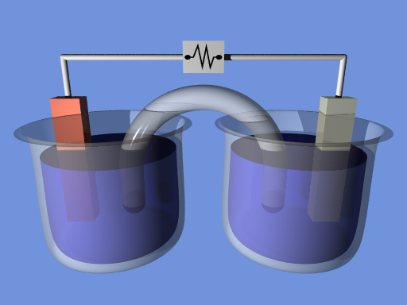
Background: What is a battery?
Voltaic Cells
Two "half cells" connected in series by a conductive electrolyte containing anions and cations.
One half cell contains the anode, which anions from the electrolyte migrate to. The other the cathode, which cations migrate to.
Redox Reaction
Anions at anode are oxidized
removes electrons
Cations at cathode are reduced
adds electrons
Creates an electrical current as electrons move.
Image from wikipedia
3

Slide 10
What do we care about?
When picking batteries there are a number of characteristics to be aware of including:
Voltage
Max current
Energy
Results of mechanical failure
Energy loss while idle
You have a lot of options because
Many different battery types (Alkaline, LiPo, etc.)
Different topologies (ways to connect the cells together)

Slide 11
Lots of terms
Capacity
The amount of electric charge it can store, typically measured in mAh
Charge Density
Charge/Volume, measured in mWh/cm^3 or mWh/kg
Charge Limit
The maximum voltage the battery can produce under ideal conditions
Primary Cells
Non-rechargeable (disposable) batteries
Secondary Cells
Rechargeable batteries
Lifetime
Primary Cells - "self discharge", how long the battery lasts when not in use.
Secondary Cells - recharge limits
Cycle Life
The number of charge cycles until battery can no longer reach 80% maximum charge

Slide 12
Let’s look at “capacity”
Generally measured in mAh*, this tells us how much energy we can expect to get out of the device before it runs down.
The problem is, we get less total energy the more quickly we drain the battery.
Called “Peukert Effect”
Actual capacity is dependent on the current draw.
The faster you draw the current, the less you have total.
Often irrelevant if just driving a microcontroller, but if have motors etc. it can be a big deal.
* While this unit isn’t really a measure of energy, it would be if voltage were fixed (which it more-or-less is)

Slide 13
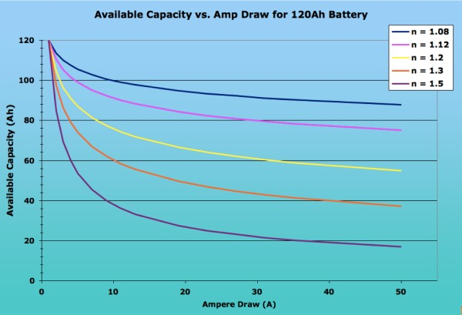
Peukert Effect
Image from http://www.vonwentzel.net/Battery/00.Glossary/

Slide 14
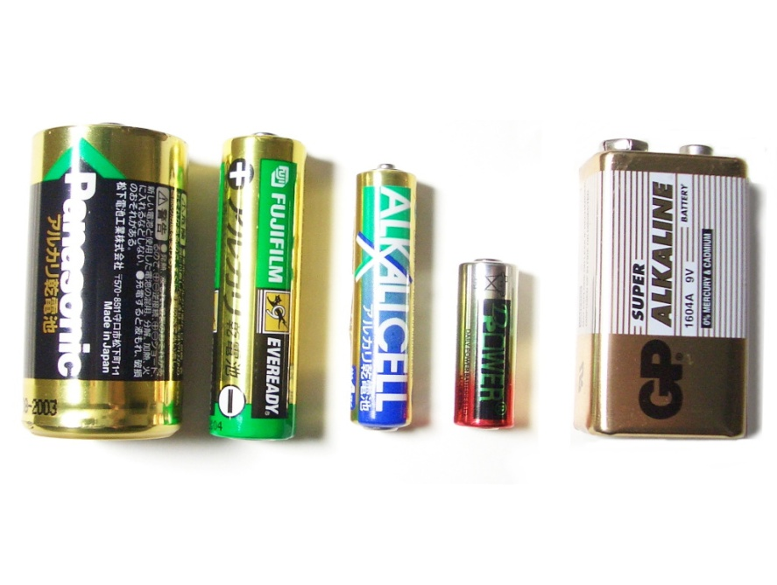
Alkaline Battery
Primary Battery
Disposable
Most common "off the shelf" battery
Accounts for over 80% of manufactured batteries in the U.S.
Over 10 billion individual units produced worldwide
Image from Wikipedia
9

Slide 15
Lithium-Ion Polymer Battery
Common abreviations:
Li-poly, Li-Pol, Li-Po, LIP, PLI or LiP
Secondary cell batteries
Typically contain multiple cells in parallel
Used to increase discharge current capacity
Can cause charging difficulties
Cells must be balanced for safe charging
12

Slide 16
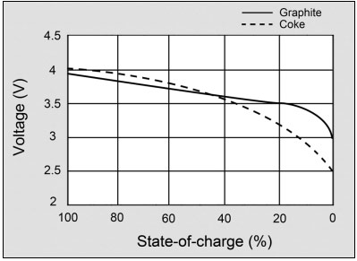
Lithium-Ion Polymer - Chemistry
Sony's original lithium-ion battery used coke for the anode
Coke was a by-product of the coal industry
Modern lithium-ions began using graphite for the anode in about 1997
Provides a flatter discharge curve
Material combinations have been tested for the anode
Tradeoffs are application dependent
14

Slide 17
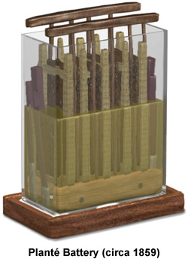
Lead Acid Battery
Invented in 1859 by Gaston Plante
Oldest rechargeable battery type
Low energy to weight ratio
Low energy to volume ratio
Can supply high surge currents and hence high power to weight ratio
The U.S. produces nearly 99 million wet-cell lead-acid batteries each year
16

Slide 18
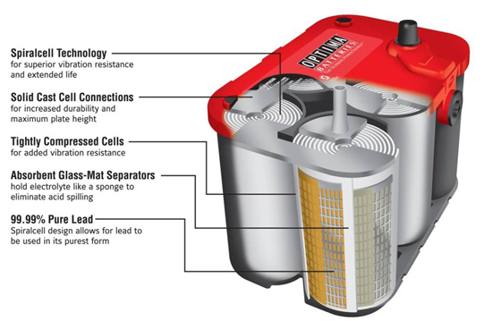
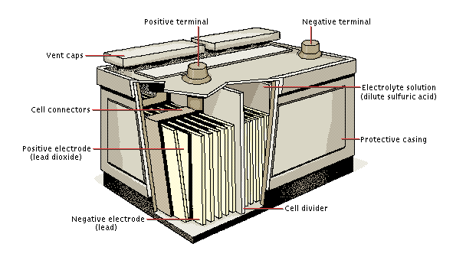
Lead Acid - Types
Lead Acid Battery Constructs:
Flooded Cell (Wet Cell)
Valve Regulated Lead Acid (VRLA)
Gel
Absorbed Glass Mat (AGM)
Lead Acid Battery Types:
Starting Battery
Deep Cycle Battery
Marine Cycle
18

Slide 19
Comparisons

Slide 20
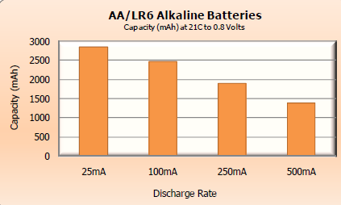
Electrical Properties - Capacity
Alkaline
Li-Po
Typically 1100-1500 mAh per cell
Like most Li-Ion a single battery contains multiple cells
Lead-Acid
Varies by size and type
Car batteries are usually 50 Ah
20

Slide 21
Electrical Properties - Current
Alkaline
Dependent on the size of the battery
Rule of thumb:
AA - 700mA max, 50mA typical
Li-Po
Can drive large currents
Batteries rated for 1000mAh at 100mA draw can typically supply up to 1.5A, 15x their rated current
This applies no matter the capacity or current draw ratings
Connected in parallel to increase current rates
Lead-Acid
Can produce up to 500 amps if shorted
21

Slide 22
Electrical Properties - Charge Density
Alkaline
Much higher than other "off the shelf" battery types
Common cells typically 110 Wh/kg
Li-Po
100-180 Wh/kg
Lead-Acid
30-50 Wh/kg
22

Slide 23
Cost
Alkaline
Very low cost to produce
$0.19/Wh
Most of the cost is placed on the consumer
Li-Po
Varies with chemical composition
~$0.47/Wh
Cheaper than traditional Li-Ion
Lead Acid
$0.20/Wh
Relatively cheap for high voltage applications
Expensive for a full battery
24

Slide 24
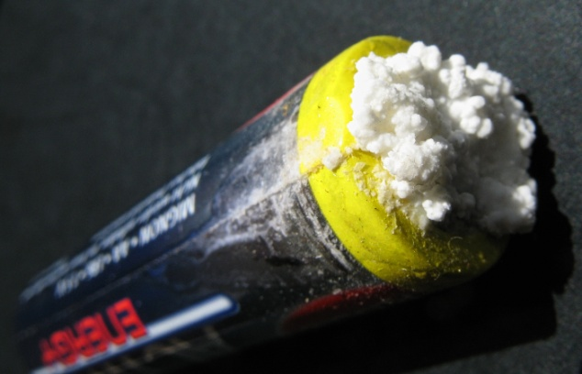
Hazards - Leaks
Alkaline
Cells may rupture and leak potassium hydroxide
This will corrode the battery and the device
May cause respiratory, eye, and skin irritation
Li-Po
Unlikely to leak because of solid internals
Lead Acid
Cells may rupture or be punctured
Wet cells will leak strong sulfuric acid
25

Slide 25
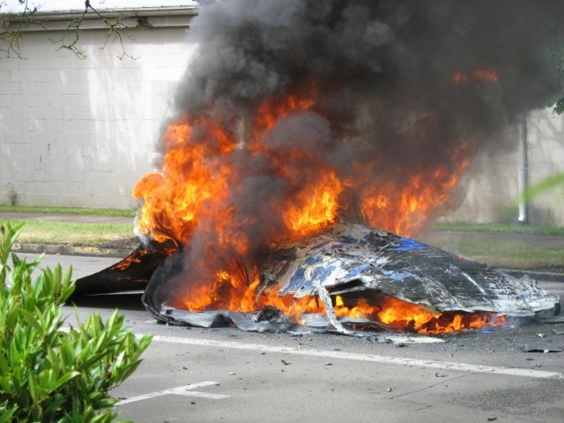
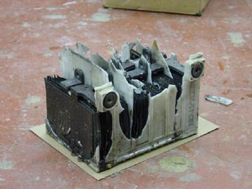
Hazards - Explosions/Fires
Alkaline
Unlikely to explode or catch fire
Li-Po
May explode or catch fire if mishandled
Charging/Discharging too quickly builds heat
Damaged cells are prone to explosions
Lead Acid
Electrolysis in flooded cells occurs when overcharge
Produces hydrogen and oxygen gases which may explode if ignited
VRLA does not contain liquid electrolytes
lithium-ion fire (http://www.gazettetimes.com/news/local/article_803a17e6-afd8-11e0-bedd-001cc4c03286.html)

Slide 26
Hazards - Environmental Concerns
Alkaline
Ends up in landfills after one use
Potassium hydroxide can corrode objects it touches
Li-Po
No major recycling programs in place currently
Polymer requires strong chemicals and a lot of energy to produce
Lead Acid
Lead is a toxic metal
97% of the lead is recycled
27

Slide 27
Alkaline Battery Review
Pros
Disposable
Cheap to produce, easy to obtain
Maintenance-free
Cons
Non-rechargeable
Moderate charge density
Relatively low current drain limits
Must be justifiable to the user
Applications
Household and mobile electronics
Children's Toys
Must be low current to justify disposable costs
Low up-front costs
28

Slide 28
Lithium-Ion Polymer - Review
Pros:
High energy density
Relatively low self-discharge
Low maintenance
No periodic discharge is needed
No memory
Cons:
Requires protection circuit to limit voltage and current
Subject to aging, even if not in use
Transportation regulations for shipping in large quantities
Applications
Lightweight portable electronic devices
Cell phones, GPS, laptops, etc.
Radio controlled model planes/cars
29

Slide 29
Lead Acid - Review
Pros
Relatively cheap
Long lifespan
Able to provide extreme currents (500A+)
Cons
Heavy
Large physical size
Some models require periodic maintenance
Applications
Vehicle batteries
Energy storage
Off-the-grid systems
Back up power supply
Renewable energy systems
Solar, wind, etc.
Long term remote energy supply
30

Slide 30
Example Situations
Battery powered flashlight
Must be compact and lightweight
Needs to be cheap up front
Batteries should be replaceable vs rechargeable
Battery needs to have a long shelf life
MP3 Player
Must be compact and lightweight
Expensive product can incorporate a higher battery cost
Must be rechargeable
Should recharge quickly
Needs to have large energy capacity
Must last 500+ recharge cycles without maintenance

Slide 31
DC converters

Slide 32
Outline
What are DC converters?
Linear regulators
LDOs
Switching converters
Large parts of this section on converters come from Eric Lin

Slide 33
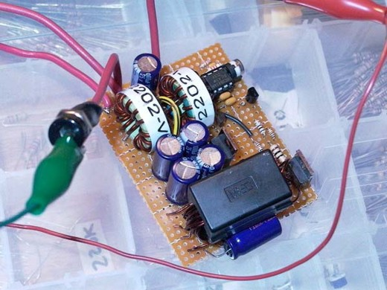
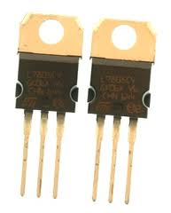
What are DC converters?
DC converters convert one DC voltage level to another.
Very commonly on PCBs
Often have USB or battery power
But might need 1.8V, 3.3V, 5V, 12V and -12V all on the same board.
On-PCB converters allow us to do that
Images from http://itpedia.nyu.edu/wiki/File:V_reg_7805.jpg, http://www.electronics-lab.com/blog/wp-content/uploads/2007/10/p1000255.JPG

Slide 34
Different types of DC converters
Linear converters
Switching converters
Simpler to design
Low-noise output for noise-sensitive applications
Can only drop voltage
And in fact must drop it by some minimum amount
The larger the voltage drop the less power efficient the converter is
Can be significantly more complex to design
Worth avoiding for this class unless you have to do it.
Can drop voltage or increase voltage
“buck” and “boost” respectively
Generally very power efficient
75% to 98% is normal

Slide 35
Characteristics of DC Converters
To better understand how to pick a converter we will go over the following characteristics seen in all DC converters
Power wasted (as heat)
Quiescent current, $I_{Q}$
The leakage current that occurs regardless of operation.
Power supply rejection ratio (PSRR)
The ability to reject output noise at different frequency
External capacitors and equivalent series resistance(ESR)
Output noise filter that helps keeping the signal clean
These characteristics are what people generally look for when selecting converters, but they’re not by any means the only characteristics that matter.

Slide 36
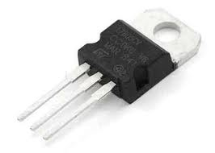
1. Power Wasted (as Heat)
Linear converters waste power = (V_{in}– V_{out})*I_{load}
Example
12 V battery supplying 5V to each device
Microcontroller that draws 5mA
Ultrasonic rangefinder that draws 50mA
Use LM7805 (linear regulator) to drop 12V to 5V
Power wasted = (12V – 5V) * (0.050A + 0.005A) = 0.385W
Which is actually more than the power consumed!
Is this acceptable?
Hope so, because the alternative (switching converter) is a lot more difficult.
Switchers generally waste a more-or-less fixed percent
Say 15% or so…
http://www.dimensionengineering.com/info/switching-regulators is the source for this example. They go into more detail on their site.

Slide 37
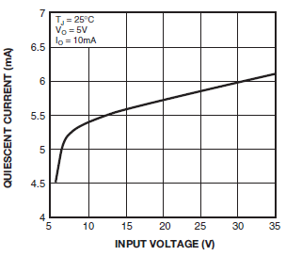
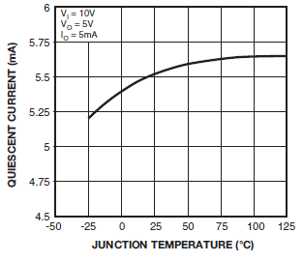
2. Quiescent current, $I_{Q}$
In general…
All have quiescent current ($I_{Q})$, which is different in each IC
$I_{Q}$ is affected by the input and temperature the device is operating at.
Will drain battery so choose carefully when picking converters!
For this device, I_{Q} is huge.
Designed to move 1A.
LM7805 $I_{Q}$ during operation
Diagrams from http://www.fairchildsemi.com/ds/LM/LM7805.pdf

Slide 38
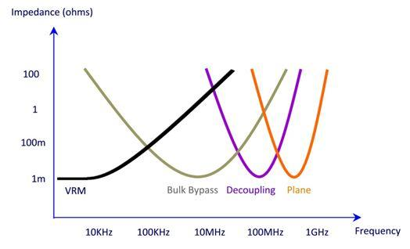
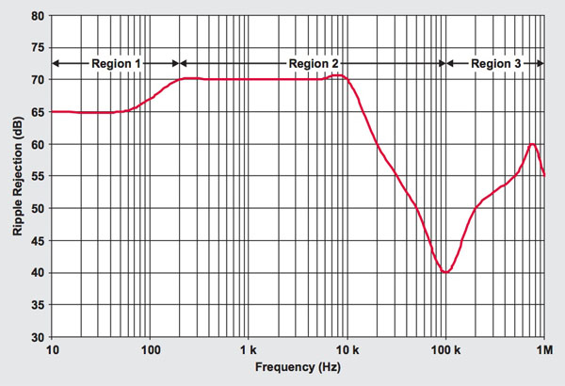
3. Noise
PSRR indicates how well the supply deals with noise.
Recall we rely on the VRM (voltage
regulation module) to keep noise down at low frequencies.
We don’t want noise on the output
You can determine how well a linear converter handle noise by its PSRR
PSRR is used to describe the amount of noise rejected by a particular device
What does PSRR mean for noise rejection?
Take 40dB @100kHz and 1V input, so $1V∗{10}^{−\frac{40}{20}}=.01=10mV$
Meaning for every 1V there may be 10$mV$ superimposed on the output
70dB @ 10KHz is $1V∗{10}^{−\frac{70}{20}} \sim .00032 =0.32 mV$, so 3% of the noise at 100KHz!
PSSR performance is crucial for noise sensitive operation
Typical PSRR profile for an LDO, 40dB @ 100kHz
Graph from digikey http://www.digikey.com/us/en/techzone/power/resources/articles/hybrid-power-supplies-noise-free-voltages.html
Notes:
PSRR is the signal to noise ratio on the output and noise could be white noise or anything else

Slide 39
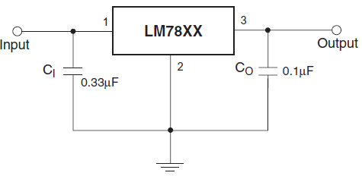
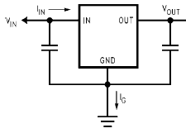
4. Caps and ESR.
What else would we have to look at regarding noise?
Capacitors!
Each converter requires at least a $C_{out}$ and sometimes a $C_{in}$ to reduce noise in the system
Will be specified in datasheets
Capacitors size generally needed from smallest to largest:
General linear converters -> LDOs -> switching converters
min 22$μF$
min 22$μF$
Linear LM7805
LDO LM2940
Diagrams from http://www.fairchildsemi.com/ds/LM/LM7805.pdf and http://www.ti.com/lit/ds/symlink/lm2940-n.pdf

Slide 40
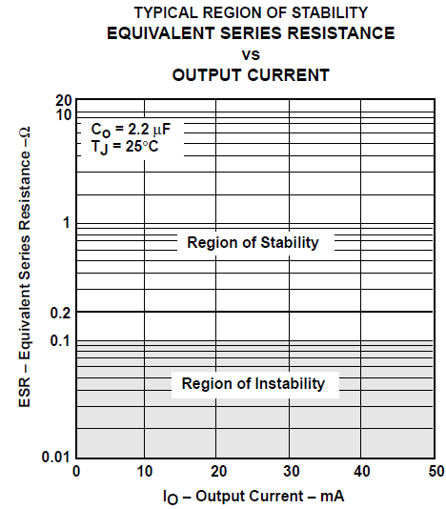
4. Caps and ESR.
Capacitors aren’t the only thing that will determine stability
Sometime an operation demands higher $I_{o}$ and leaves the safe-operating-area (SOA) causing instability as well
So in addition to the capacitors, equivalent series resistance (ESR) comes into play
Like everything else, the capacitor and its ESR will be specified in each IC’s datasheet
There’s also more than just ESR that affects the stability as well for varied $I_{o}$ and is discussed more in the link below
http://www.bcae1.com/switchingpowersupplydesign/datasheets/ldoregulatorstabilityinfoslva115.pdf

Slide 41
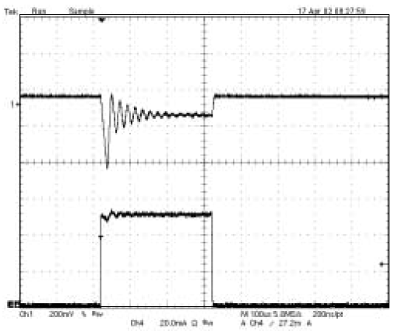
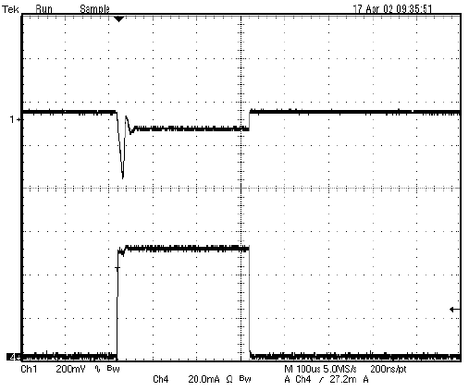
4. Caps and ESR
So let’s take a look at an example of stability/instability with a changing $I_{o}$
Note the amount of noise in the top waveform ($V_{o})$ as $I_{o}$ changes with the presence of ESR
Load transient with $2.2μF$ ceramic capacitor
Load transient with $2.2μF$ ceramic capacitor and $1Ω$ ESR

Slide 42
Quick look at the options
Linear converter
LDO
Switching converter
Buck
Boost
Buck-Boost

Slide 43
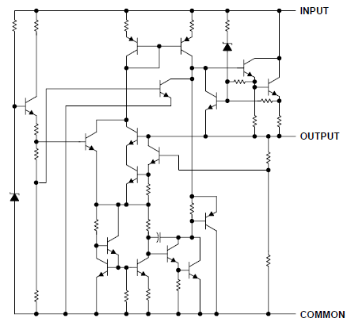
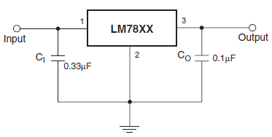
Linear Converters
LM7805 Linear Voltage Regulator Schematic
Now let’s look at linear converters and its LDO variety
In general linear converters…
Acts like a variable resistor
Drop voltage by heat dissipation through the network of resistors
Often have a fairly high minimum voltage drop.
If you want to drop less, need a specific type of linear converters
“low-drop out” or LDO
All this fits in the IC!
Diagrams from http://www.fairchildsemi.com/ds/LM/LM7805.pdf

Slide 44
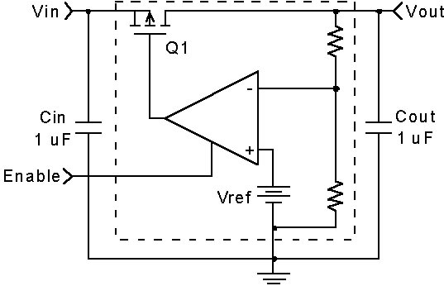
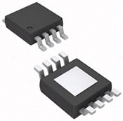
Linear Converters - LDO
What are low-dropout regulators(LDO)?
LDOs are more complex linear regulators, using a transistor and error amplifier for negative feedback
Larger capacitor is now needed
Inherently, the capacitors will have equivalent series resistance that will also contribute to noise reduction. This will be discussed in later slides
Also implemented as ICs like the other linear regulators
LP5900
Generic LDO schematic

Slide 45
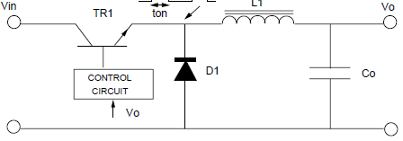
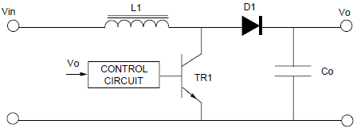
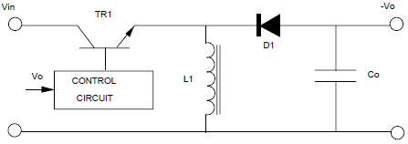
Switching Converters
Once you leave the realms of linear converters it gets more complex.
Introducing common switching converters!
All include a diode, transistor, inductor and a capacitor
Converters | General Topology | Application
Buck |  | Drop voltage
Boost |  | Increase voltage
Buck-boost(inverting) |  | Increase or decrease voltage and inverse polarity
Schematics are from http://www.nxp.com/documents/application_note/APPCHP2.pdf

Slide 46
That’s all for today.
We’ll pick up details of these devices next time.

