Slide 1
EECS 498 Advanced Embedded Systems
Lecture 10:
Power review, Switching power supplies, Start on signal integrity

Slide 2
Class stuff
Exam answers posted
Camera group hasn’t seen me yet
Sign up for design expo
Dec 6th!
Which groups haven’t?
Nov 8th is last day to order PCBs
Milestone 2 next Monday
One page summary/memo of
Where you are
What you are behind on
What you need help with
Meeting as before

Slide 3
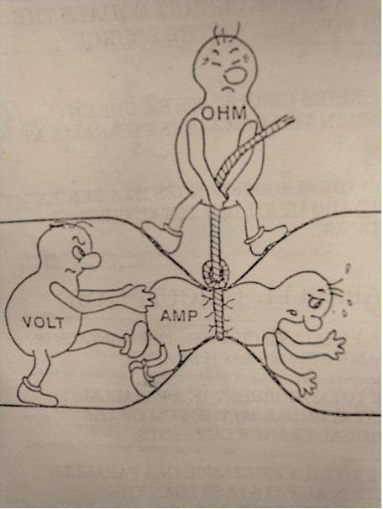
EE review
Exam made it clear I needed to review some basics:
V=IR
P=I²R and P=VI
What if I just have V and R?
Review question
What is the voltage drop across the resistor that has .1A flowing through it? The 10A resistor?
How much power is lost in the bottom resistor?
3.3V
12V
0.1A
10A
0.05Ω
Notes:
.1A+10A=10.1A*.05Ω=.505V, so we have a bit less than 2.8V!
10.1^2~=100 * 0.05=5Watts!

Slide 4
Review: Power Distribution Network
Talked a lot about keeping the power supply voltage constant.
Should think of situation as follows:
If the processor drops 3.3V and uses 100mA, what is it’s effective resistance?
If the power supply is 3.3V, the processor uses 100mA and the total resistance of the PDN (Power distribution network) is .01Ω, what voltage does the processor really see?
Input
PDN
Processor
Output
PDN

Slide 5
Review: Power integrity (1/2)
Processors and other ICs have varying current demands
Sometimes at frequencies much greater than the device itself runs at
Why?
So the power/ground inputs need to be able to deal with that.
Basically we want those wires to be ideal and just supply how ever much or little current we need.
If the current can’t be supplied correctly, we’ll get voltage droops.
How much power noise can we accept?
Depends on the part (read the spec).
If it can run from 3.5V to 5.5V we just need to insure it stays in that range.
So we need to make sure that given the current, we don’t end up out of the voltage range.
Basically need to insure that we don’t drop too much voltage over the wires that are supplying the power!

Slide 6
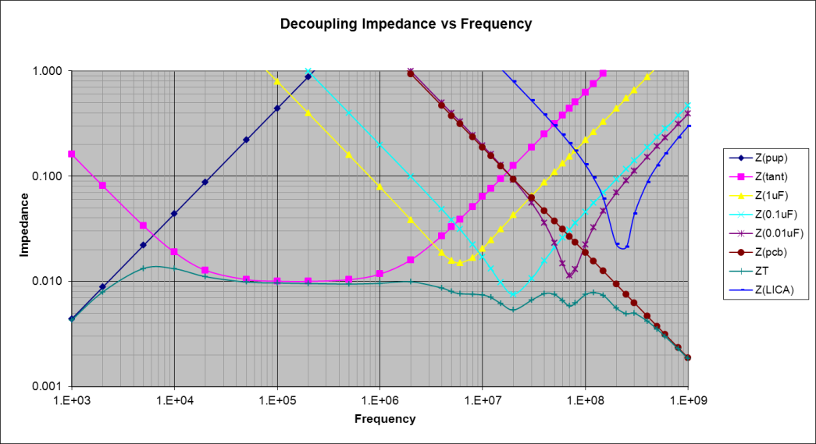
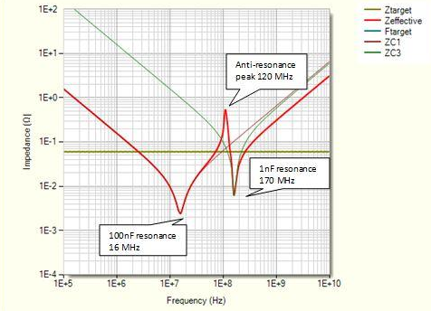
Review: Power integrity (2/2)
So we need the impedance of the wires to be low.
Because the ICs operate at a wide variety of frequencies, we need to consider all of them.
The wires themselves have a lot of inductance, so a lot of impedance at high frequencies.
Need to counter this by adding capacitors.
Problem is that the caps have parasitic inductance and resistance.
So they don’t help as well as you’d like
But more in parallel is good.
Each cap will help with different frequency ranges.
We also can get a small but low-parasitic cap out of the power/ground plane.
Finally we should consider anti-resonance*.
* http://www.n4iqt.com/BillRiley/multi/esr-and-bypass-caps.pdf provides a very nice overview of the topic and how to address it.

Slide 7
Battery review: Lots of terms
Capacity
The amount of electric charge it can store, typically measured in mAh
Charge Density
Charge/Volume, measured in mWh/cm^3 or mWh/kg
Charge Limit
The maximum voltage the battery can produce under ideal conditions
Primary Cells
Non-rechargeable (disposable) batteries
Secondary Cells
Rechargeable batteries
Lifetime
Primary Cells - "self discharge", how long the battery lasts when not in use.
Secondary Cells - recharge limits
Cycle Life
The number of charge cycles until battery can no longer reach 80% maximum charge

Slide 8
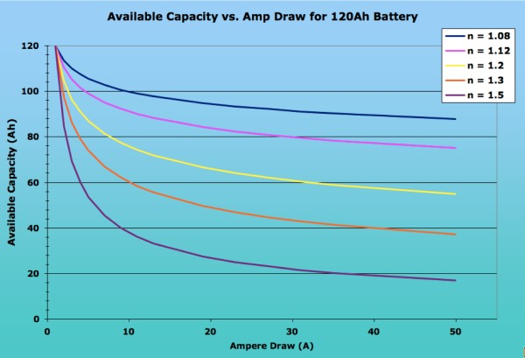
Battery review: Peukert Effect
Image from http://www.vonwentzel.net/Battery/00.Glossary/

Slide 9
But wait…
Peukert numbers are all over the map
No one value for a given type of cell
I’ve found lead-acid car batteries with values from 1.1 to 1.4 (huge variation)
And it is generally agreed LA will have this value move depending on how you drain it.
They hate constant draw, do high- current short draws well…
Other batteries have their own properties…

Slide 10
DC converters

Slide 11
Outline
What are DC converters?
Linear regulators
LDOs
Switching converters
Large parts of this section on converters come from Eric Lin

Slide 12
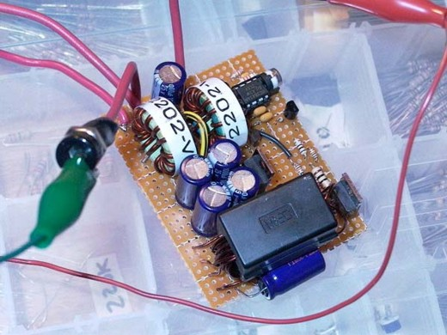
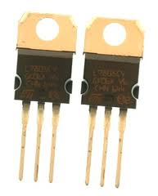
What are DC converters?
DC converters convert one DC voltage level to another.
Very commonly on PCBs
Often have USB or battery power
But might need 1.8V, 3.3V, 5V, 12V and -12V all on the same board.
On-PCB converters allow us to do that
Images from http://itpedia.nyu.edu/wiki/File:V_reg_7805.jpg, http://www.electronics-lab.com/blog/wp-content/uploads/2007/10/p1000255.JPG

Slide 13
Different types of DC converters
Linear converters
Switching converters
Simpler to design
Low-noise output for noise-sensitive applications
Can only drop voltage
And in fact must drop it by some minimum amount
The larger the voltage drop the less power efficient the converter is
Can be significantly more complex to design
Worth avoiding for this class unless you have to do it.
Can drop voltage or increase voltage
“buck” and “boost” respectively
Generally very power efficient
75% to 98% is normal

Slide 14
Characteristics of DC Converters
To better understand how to pick a converter we will go over the following characteristics seen in all DC converters
Power wasted (as heat)
Quiescent current, $I_{Q}$
The leakage current that occurs regardless of operation.
Power supply rejection ratio (PSRR)
The ability to reject output noise at different frequency
External capacitors and equivalent series resistance(ESR)
Output noise filter that helps keeping the signal clean
These characteristics are what people generally look for when selecting converters, but they’re not by any means the only characteristics that matter.

Slide 15
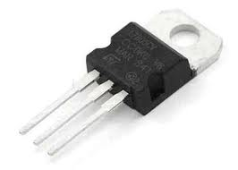
1. Power Wasted (as Heat)
Linear converters waste power = (V_{in}– V_{out})*I_{load}
Example
12 V battery supplying 5V to each device
Microcontroller that draws 5mA
Ultrasonic rangefinder that draws 50mA
Use LM7805 (linear regulator) to drop 12V to 5V
Power wasted = (12V – 5V) * (0.050A + 0.005A) = 0.385W
Which is actually more than the power consumed!
Is this acceptable?
Hope so, because the alternative (switching converter) is a lot more difficult.
Switchers generally waste a more-or-less fixed percent
Say 15% or so…
http://www.dimensionengineering.com/info/switching-regulators is the source for this example. They go into more detail on their site.

Slide 16
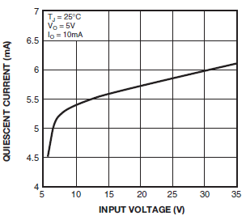
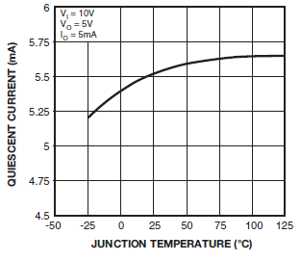
2. Quiescent current, $I_{Q}$
In general…
All have quiescent current ($I_{Q})$, which is different in each IC
$I_{Q}$ is affected by the input and temperature the device is operating at.
Will drain battery so choose carefully when picking converters!
For this device, I_{Q} is huge.
Designed to move 1A.
LM7805 $I_{Q}$ during operation
Diagrams from http://www.fairchildsemi.com/ds/LM/LM7805.pdf

Slide 17
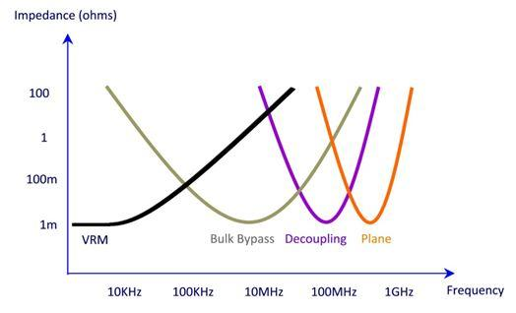
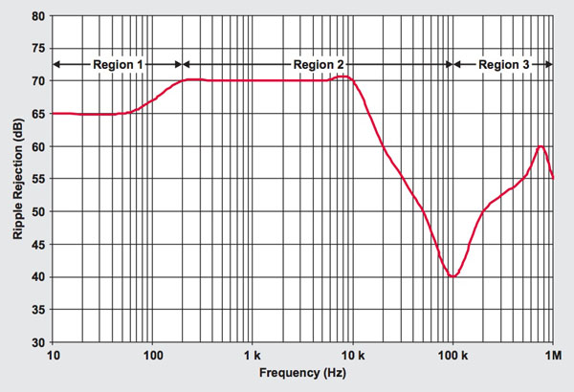
3. Noise
PSRR indicates how well the supply deals with noise.
Recall we rely on the VRM (voltage
regulation module) to keep noise down at low frequencies.
We don’t want noise on the output
You can determine how well a linear converter handle noise by its PSRR
PSRR is used to describe the amount of noise rejected by a particular device
What does PSRR mean for noise rejection?
Take 40dB @100kHz and 1V input, so $1V∗{10}^{−\frac{40}{20}}=.01=10mV$
Meaning for every 1V there may be 10$mV$ superimposed on the output
70dB @ 10KHz is $1V∗{10}^{−\frac{70}{20}} \sim .00032 =0.32 mV$, so 3% of the noise at 100KHz!
PSSR performance is crucial for noise sensitive operation
Typical PSRR profile for an LDO, 40dB @ 100kHz
Graph from digikey http://www.digikey.com/us/en/techzone/power/resources/articles/hybrid-power-supplies-noise-free-voltages.html
Notes:
PSRR is the signal to noise ratio on the output and noise could be white noise or anything else

Slide 18
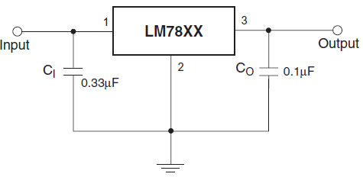
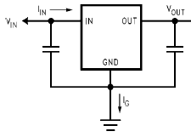
4. Caps and ESR.
What else would we have to look at regarding noise?
Capacitors!
Each converter requires at least a $C_{out}$ and sometimes a $C_{in}$ to reduce noise in the system
Will be specified in datasheets
Capacitors size generally needed from smallest to largest:
General linear converters -> LDOs -> switching converters
min 22$μF$
min 22$μF$
Linear LM7805
LDO LM2940
Diagrams from http://www.fairchildsemi.com/ds/LM/LM7805.pdf and http://www.ti.com/lit/ds/symlink/lm2940-n.pdf

Slide 19
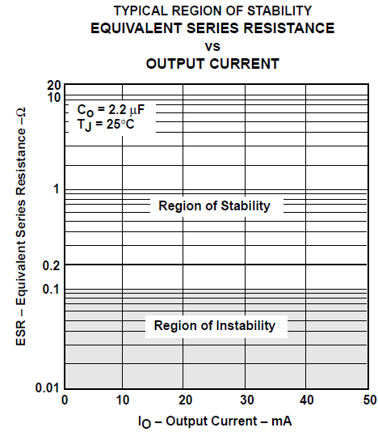
4. Caps and ESR.
Capacitors aren’t the only thing that will determine stability
Sometime an operation demands higher $I_{o}$ and leaves the safe-operating-area (SOA) causing instability as well
So in addition to the capacitors, equivalent series resistance (ESR) comes into play
Like everything else, the capacitor and its ESR will be specified in each IC’s datasheet
There’s also more than just ESR that affects the stability as well for varied $I_{o}$ and is discussed more in the link below
http://www.bcae1.com/switchingpowersupplydesign/datasheets/ldoregulatorstabilityinfoslva115.pdf

Slide 20
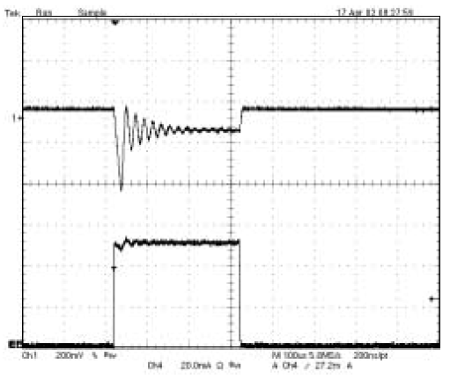
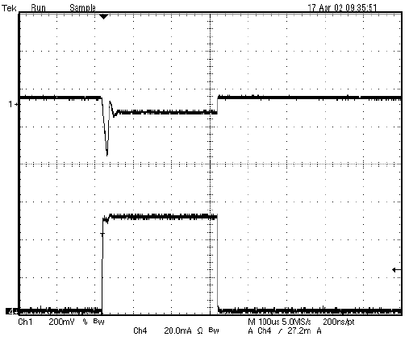
4. Caps and ESR
So let’s take a look at an example of stability/instability with a changing $I_{o}$
Note the amount of noise in the top waveform ($V_{o})$ as $I_{o}$ changes with the presence of ESR
Load transient with $2.2μF$ ceramic capacitor
Load transient with $2.2μF$ ceramic capacitor and $1Ω$ ESR

Slide 21
Quick look at the options
Linear converter
LDO
Switching converter
Buck
Boost
Buck-Boost

Slide 22
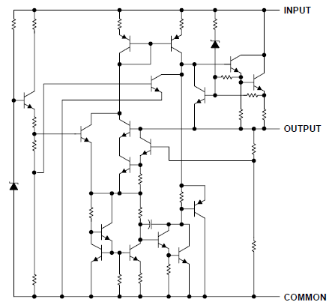
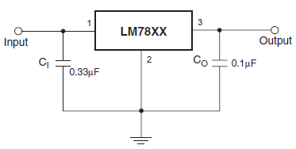
Linear Converters
LM7805 Linear Voltage Regulator Schematic
Now let’s look at linear converters and its LDO variety
In general linear converters…
Acts like a variable resistor
Drop voltage by heat dissipation through the network of resistors
Often have a fairly high minimum voltage drop.
If you want to drop less, need a specific type of linear converters
“low-drop out” or LDO
All this fits in the IC!
Diagrams from http://www.fairchildsemi.com/ds/LM/LM7805.pdf

Slide 23
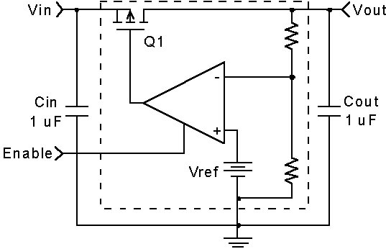
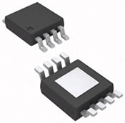
Linear Converters - LDO
What are low-dropout regulators(LDO)?
LDOs are more complex linear regulators, using a transistor and error amplifier for negative feedback
Larger capacitor is now needed
Inherently, the capacitors will have equivalent series resistance that will also contribute to noise reduction. This will be discussed in later slides
Also implemented as ICs like the other linear regulators
LP5900
Generic LDO schematic

Slide 24
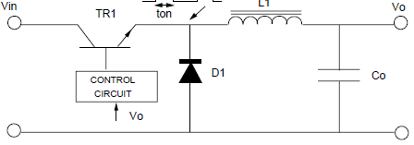
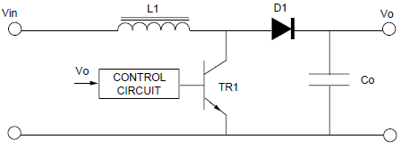
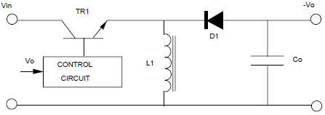
Switching Converters
Once you leave the realms of linear converters it gets more complex.
Introducing common switching converters!
All include a diode, transistor, inductor and a capacitor
Converters | General Topology | Application
Buck |  | Drop voltage
Boost |  | Increase voltage
Buck-boost(inverting) |  | Increase or decrease voltage and inverse polarity
Schematics are from http://www.nxp.com/documents/application_note/APPCHP2.pdf

Slide 25
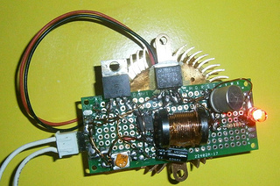
Functionality – Switching Converters
Common switching converters
Converters now includes a transistor and diode used for switching and an inductor as energy storage.
In general, a switching converters works by controlling the frequency and duty cycle that the transistor is operating at
Similar to linear converters, most of the work is already done.
Only have to pick IC with the right parameter and follow the datasheets given for appropriate inductors and capacitors.
Size of inductor in relation to the rest of the component
Example switching regulator from http://ycprojects.wordpress.com/

Slide 26
Functionality – Switching Converters
Common switching converters
Aside from the noble goal of making circuit analysis more complex (☺) both the inductor and capacitor play important roles in switching converters.
Capacitor
Used to store energy due to the voltage applied thus maintaining a constant voltage
Generally selected to limit $V_{o}$ ripple to the correct specification
Inductors
Similar to the capacitor, but an inductor is use to store energy due to current flow. This in turn maintain a constant current or is used to limit the rate of change of current flow.
This will also determine the peak to peak current in the circuit which affects the transistor, diode and the “mode” the converter will operate at

Slide 27
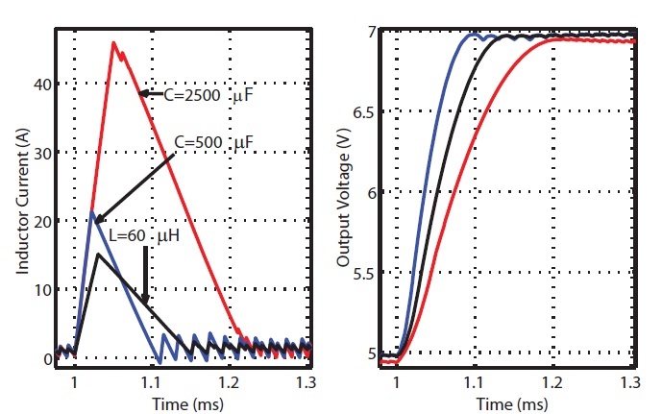
Functionality – Switching Converters
Common switching converters
In addition to filtering and maintaining a constant output, inductors/capacitors will also have effect on the transient response. As you can see on the right, depending on the values of the inductor/capacitor the current flow and the transient response time will be different.
Example transient response of a buck converter
Blue: L= 40$μH$ C = 500$μF$
Red: L = 40$μH$ C = 2500$μF$
Black: L= 60$μH$ C= 500$μF$

Slide 28
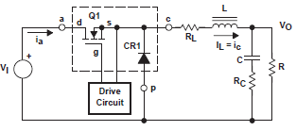
Functionality – Buck
Common switching converters
To better describe the operation for switching converter let’s use the buck converter as an example
Note the drive circuit, this is what the IC is
For simplicity’s sake let’s disregard $R_{L}$ and $R_{C}$, the internal resistance of the inductor and capacitor
We will mainly focus on the effect switching on the current flow of the circuit and the stresses on the transistor and diode

Slide 29
Functionality – Buck
Common switching converters - buck
During operation, the buck converter functions differently depending on the switch
On state
Current flows through the transistor but reverse bias prevents current flow through the diode
Inductor begins to charge and a smaller current becomes $I_{load}$
Off state
Switch opens and the inductor starts discharging as the only power source
This on-off state will determine the “mode” the converter operate in
Buck: switch on
Buck: switch off

Slide 30
Functionality – Switching Converters
Common switching converters
In switching converters, load current and voltage is largely determined by the operation of transistor switching
The duty cycle of the switching will determine the mode each converter operate at various loads
Continuous Mode
The inductor current will never fall to zero when the switch is off
Smaller current peak during operation
Discontinuous Mode
Inductor current will reach zero before the end of the full duty cycle
Each mode has its advantages and disadvantages depending on the switching converters.
In generally it’s how they change the frequency response.

Slide 31
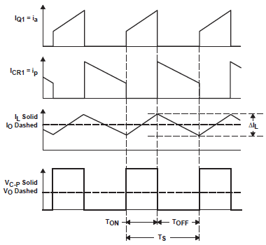
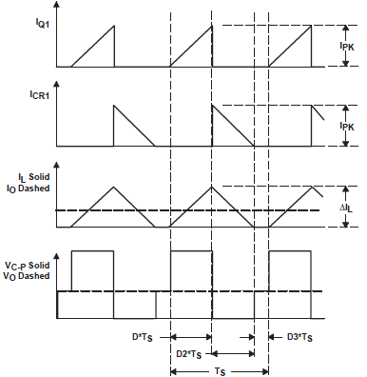
Functionality – Buck
Common switching converters
Continuous mode
Discontinuous mode
Using buck converter as an example, you can see the pulses with a certain $T_{on}$/$T_{OFF}$. This is the duty cycle of the transistor switching
When the transistor is on it also creates a reverse bias voltage ($V_{C−P}$) across the diode. With a large enough voltage the diode will “breakdown” !
Notes:
Add cite

Slide 32
Functionality – Buck
Common switching converters
Continuous mode
Discontinuous mode
As the switch is on there is current flow $I_{Q}$ through the transistor
Current is a ramp because of the inductor
High $I_{Q}$ peak also creates more stress on the transistor

Slide 33
Functionality – Buck
Common switching converters
Continuous mode
Discontinuous mode
During the off time there is now forward bias current flowing through the diode from inductor discharging
This is also when the inductor starts discharging so the current starts to ramp down

Slide 34
Functionality – Buck
Common switching converters
Continuous mode
Discontinuous mode
The output now has a ripple to it and not desirable for controlling the converter
Instead of $I_{o}=I_{L}, I_{o}=I_{L_{avg}}$, so when the feedback happens the control can read a constant value
From the feedback the switching duty cycle is changed to keep the converter in a particular state.

Slide 35
Functionality – Buck
Common switching converters
Continuous mode
Discontinuous mode
For buck converters we want to operate at continuous mode because $V_{o}$only depends on the duty cycle which makes it easier to control
There are many published paper that cover the subject, a good one is http://www.ti.com/lit/an/slva057/slva057.pdf

Slide 36
Functionality – Boost
Common switching converters
Boost(step-up)
Looks similar to buck converter but the topology is different and has different on/off states
On state
Current flow through the transistor(least resistance) making the diode reverse bias and no $I_{D}$
Inductor is charged in the process
Off state
The energy discharged by the inductor is superimposed to the input, generating a higher output
Generic boost schematic
Boost: on state
Schematics from http://en.wikipedia.org/wiki/Boost_converter
Boost: off state

Slide 37
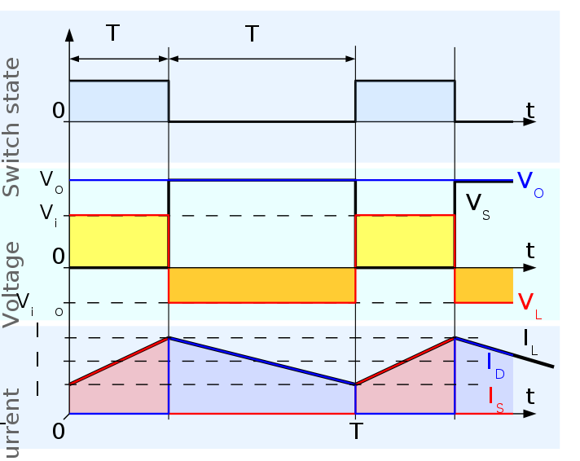
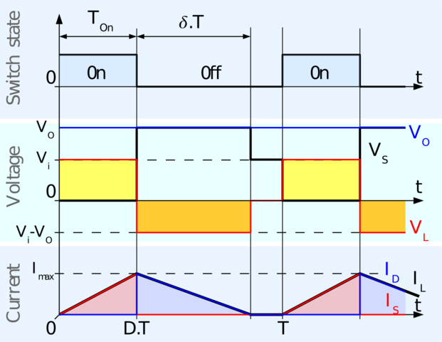
Functionality – Switching Converters
Common switching converters - Boost
Continuous mode
Discontinuous mode
From the timing diagram you can see this is very similar to the buck timing diagram with a difference in that $V_{i}$ only affects $V_{o}$ directly when the switch is off
Similar to buck, in continuous mode the output is control by the duty cycle.
But unfortunately, boost favor discontinuous mode, in continuous mode there is a complex second order characteristic in noise. Discontinuous mode removes the inductance noise, producing simpler response to compensate and control
Schematics from http://en.wikipedia.org/wiki/Boost_converter

Slide 38
Functionality – Switching Converters
Common switching converters
Buck-boost(inverting)
The baby of buck and boost…
On state
Diode is reverse biased and the inductor is charged but input and output is isolated from each other
Creates more stress on the diode!
$V_{o}$ is now the charged $V_{c}$ from off state but different polarity
Off state
Inductor voltage reverses, passing energy to the capacitor and load through forward biased diode
Due to the characteristics of boost, buck-boost suffers the same problem. Therefore a discontinuous mode is favored
Generic buck- boost schematic
Buck-boost: on state
Buck-boost: off state
Schematics from http://en.wikipedia.org/wiki/Buck%E2%80%93boost_converter

Slide 39
Functionality – Switching Converters
To give you a better idea of how duty cycle affect the output of each converter in continuous mode refer to the table below
Each duty cycle equation is equal to the ratio of $\frac{V_{out}}{V_{in}}$
In discontinuous mode these equations are no longer true, but we will not discuss them here and they can also be found online
More information on each of the switching converter can be found at http://www.nxp.com/documents/application_note/APPCHP2.pdf http://ecee.colorado.edu/copec/book/slides/Ch5slide.pdf http://www.ti.com/lit/an/slva057/slva057.pdf
Converters | Duty cycle
Buck | $$\frac{1}{D}$$
Boost | $$\frac{1}{1−D}$$
Buck-boost(inverting) | $$\frac{D}{1−D}$$

Slide 40
Picking converters
Hopefully at this point you can start to see how much more complicated a switching converter is relative to a linear converter
Every change made to the capacitor, inductor, transistor or diode will have an significant effect in not only the efficiency of each converter but also the life and way they operate
Fortunately it won’t be the end of the world if you decide to use switching converters
Using mic2168a, a controller for buck converter, as example. We can see not only do they provide information on the controller but also the external components needed for proper functionality (9pages!).
ON semiconductor also provide a detailed published paper on both linear and switching regulator, covering the theory and design consideration needed.

Slide 41
Picking converters
For those who aren’t as interested in all the technical details behind all this can refer to TI’s power management portal.
You can just enter the parameters and TI will come up with recommendation
Other companies also offer similar things so you’re not stuck with only TI
Try Micrel, Freescale or other brands as needed.

Slide 42
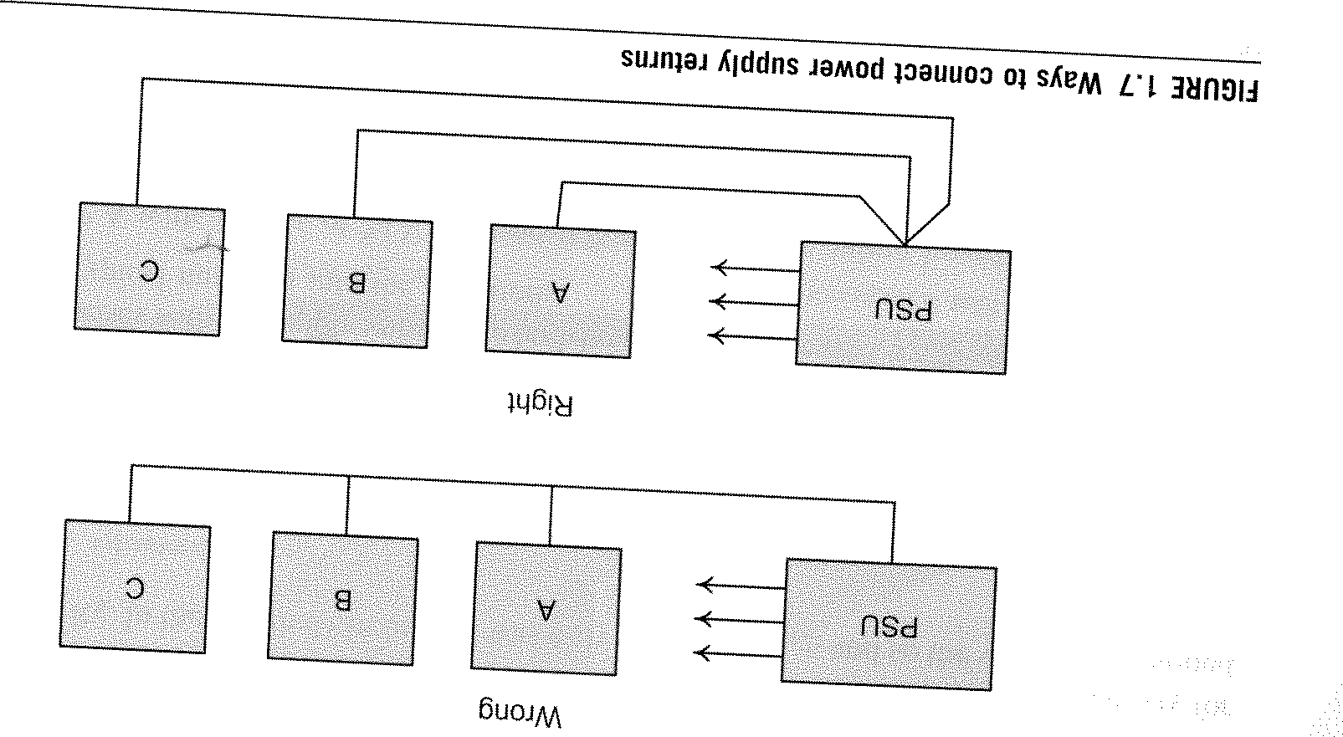
Back to review:
Return paths.
Ground isn’t ground.
This is an important rule.
Back to review question
What is the voltage drop across the resistor that has .1A flowing through it? The 10A resistor?
How much power is lost in the bottom resistor?
How does this relate to anything?
3.3V
12V
0.1A
10A
0.05Ω

