Slide 1
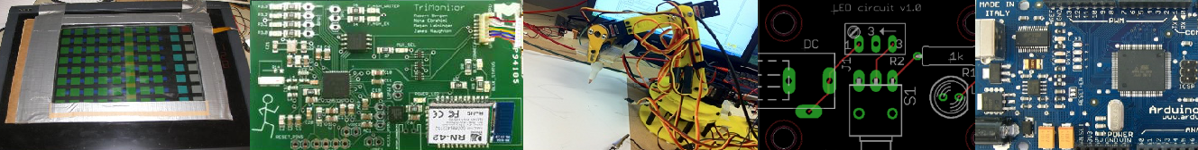

EECS 498
Advanced Embedded Systems
Posters, Final reports, and Class sum-up

Slide 2
Stuff coming up
Wednesday 12/5: We’ll be doing “rough draft” demos in lab.
  Each group will show Jeremy and I their demo for the design expo. We want you to get everything setup and do a dry run for us. Not formal in any way.
Thursday 12/6: Design expo
  At least two people there the whole time
Monday 12/10: Final demo
  Formal presentation in the evening.
    15 minute talk, 10 minutes for Q&A.
    Pizza
    Business casual
Tuesday 12/11 HW3 due by 3pm
Exam is on Monday Dec 17th 4-6pm

Slide 3
Posters for the Design Expo
A few quick things:
  If you have them sent to me (as pdfs) by Tuesday before noon I’ll print them for you, otherwise your on your own.
  The printer I’ll be using is 36” wide. Poster boards are generally 32”x40”

Slide 4
Purpose of the poster
To give people something to read while you are talking to someone else.
  Good pictures
  Solid and clear details
To help draw people in.
  If you project doesn’t move, you need something!
  Pictures!
To give you something to point to as you talk
  For parts of your talk you can point to the project
    But basic ideas, including function and purpose need something more.
  Pictures
    And generally not of your project (it will be there too).
      Sometimes you want pictures of it doing something though

Slide 5
Target audience
You’ll have folks ranging from embedded systems experts to 7th graders asking questions and reading the poster.
  The trick is to keep a narrative flowing with details available.
    Generally “walls of text” can be okay for the detailed stuff.

Slide 6
Image issues
Be really sure you have high-resolution images.
  Things generally look better on the screen than they do printed.
    As an overkill rule-of-thumb, make it 2x as large on the screen as it will be printed. If that looks good, you should be golden.
At least a handful of images should be clear from 7 feet away.
  Put it on the screen in normal size and stand 7 feet away.
  Some, more detailed, images can be smaller. Use that carefully.

Slide 7
Text issues
Title and major topics should be easily readable at 7 feet.
  Detailed text can be smaller.

Slide 8
Narrative clarity
It should be clear what images and text go together.
  If there is an ordering things should be read in, that should be clear.

Slide 9
Viewing Sequences
Thanks to Jack Fishstrom for this and the next slide!

Slide 10
Viewing Sequences
By Column
By Row

Slide 11
Required things
Clear title
List of students
Course identified (EECS 498-6)
Department and/or College Logo
Acknowledgement of Intel and Lockheed-Martin

Slide 12
Things you might want
References/further reading
Costs?

Slide 13
Examples for discussion

Slide 14


Slide 15
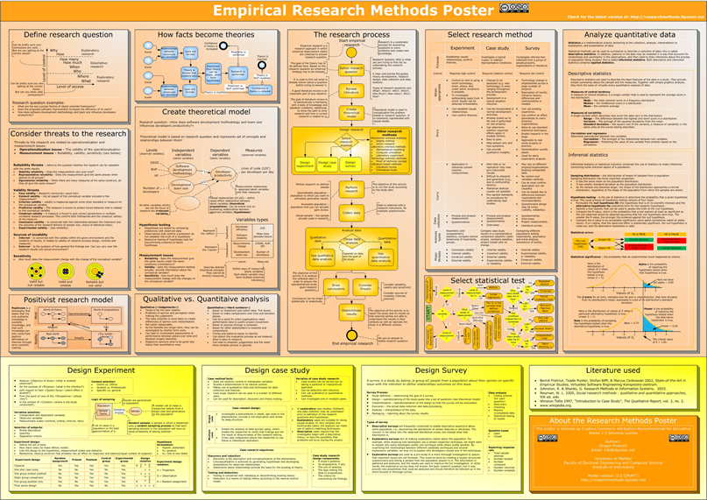

Slide 16


Slide 17
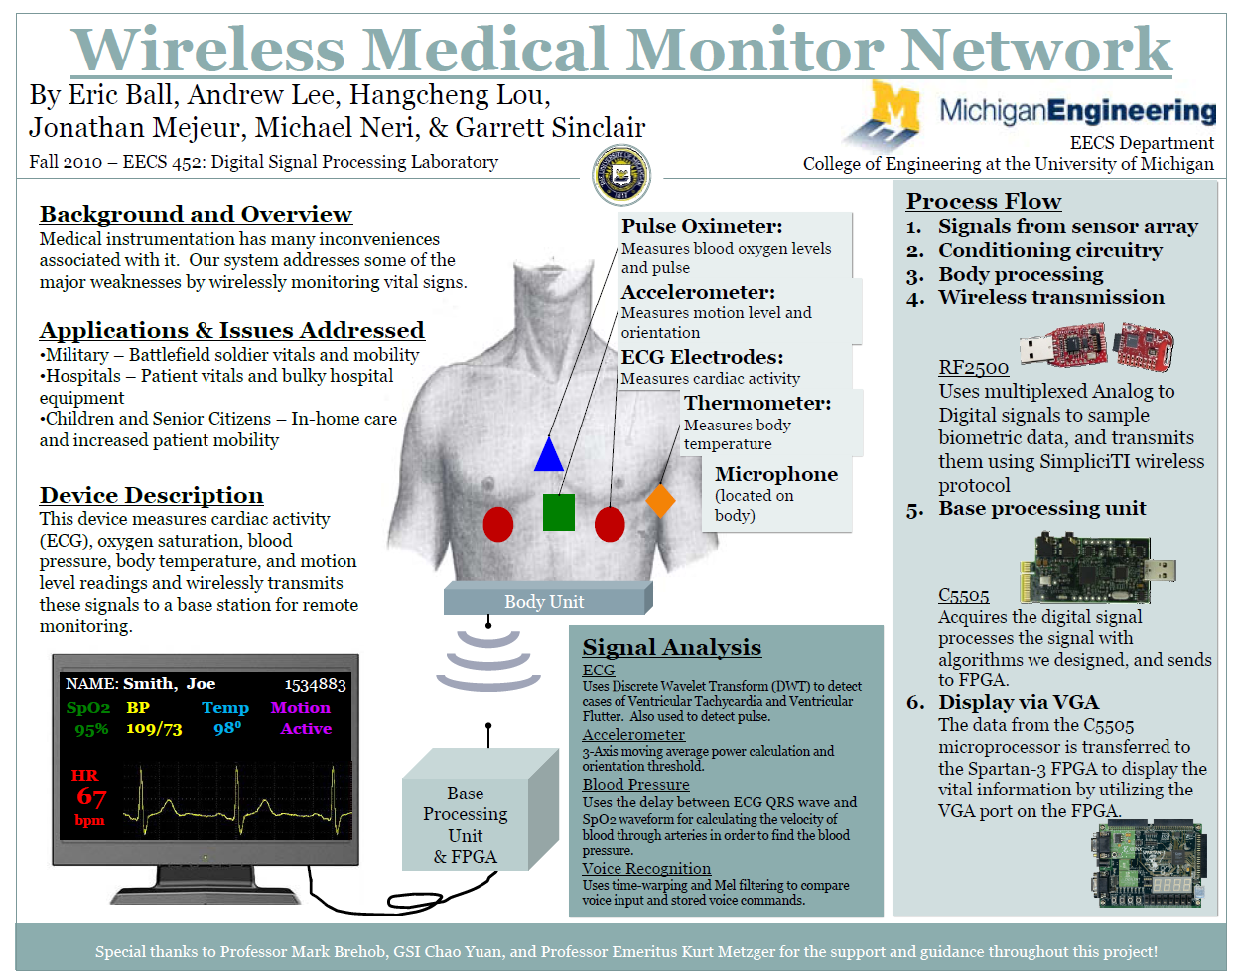

Slide 18
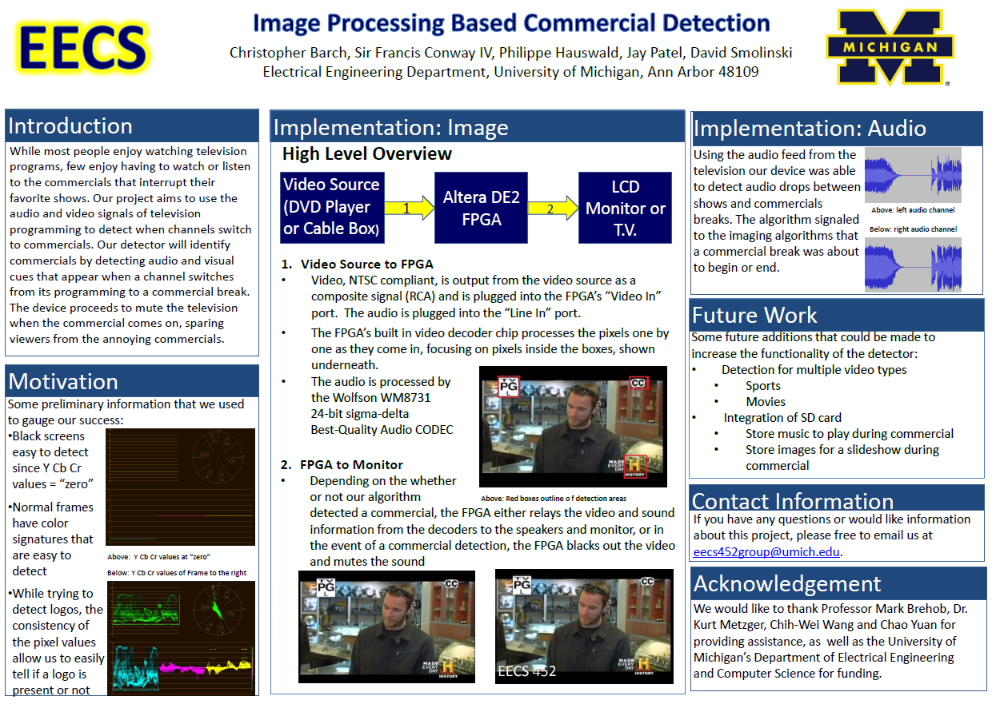

Slide 19
Finally: Practice before printing
Consider answering the following questions:
  What does it do?
  How does it work?
  What was the most difficult part?
  What would you do differently?
Are there any figures you really need to be able to point to in order to answer that question?

Slide 20
Final project report
Document out this weekend.

Slide 22
EMI Issues
2 Common Problems
  Internal EMI: Crosstalk
  External EMI: Antennas
Darren Ashton, Brent Cragin, Megan Leininger

Slide 23
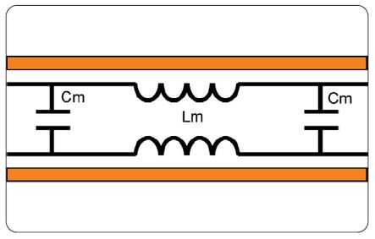
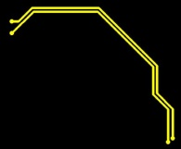
Crosstalk
Inductive and Capacitive Coupling
  Changes in nearby electric and magnetic fields influence change in voltage or current
http://www.basebandhub.com/2010/05/03/crosstalk-optimum-trace-spacing/
http://www.pcbmotif.com/home/index.php?option=com_content&view=article&id=50&Itemid=64

Slide 24
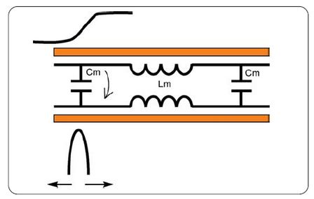
Capacitive Crosstalk
http://www.pcbmotif.com/home/index.php?option=com_content&view=article&id=50&Itemid=64

Slide 25
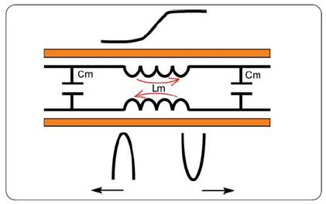
Inductive Crosstalk
http://www.pcbmotif.com/home/index.php?option=com_content&view=article&id=50&Itemid=64

Slide 26
Simple Solutions
Keep space between critical signals 3X the width of the trace
Signals on different planes should cross orthogonal to each other
Reference plane is too

Slide 27
Antennas Galore
Believe or not, everything is an antenna to some extent
What does it mean to be an antenna
  Emit Electromagnetic Radiation
  Collect Electromagnetic Radiation
Worry about susceptibility to radiation

Slide 28
Traces as Antennas
Related to trace length
1/20th Rule
  A wire can be influenced by an external signal if it is longer than 1/20th of the wavelength
  More susceptible if length is ¼, ½ and ¾ of wavelength
Example
  2.4 GHz WiFi signal has wavelength of 12.5cm
  A wire as short as .625cm could be affected by this signal

Slide 29
Better Solutions for Crosstalk and Antennas
Have to protect the traces from EMI
Matching impedance on high-speed data sending and returning traces is ideal
Not easy to do with surface traces generally
Two common trace types that address these problems are Microstrips and Striplines

Slide 30
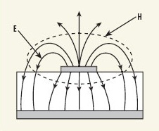
Microstrip
A microstrip basically a regular surface mount trace, the difference being that it is backed by either a ground plane or a vcc plane
The space between the two is the actual PCB, in our case we will use FR-4
  The most widely used dielectric material for PCBs is FR-4, a glass laminate with epoxy resin that meets a wide variety of processing conditions.
Trace
GND Plane
http://mwrf.com/files/30/17725/Figure_02.jpg

Slide 31
Why Microstrips?
Pros and Cons
Pros
  The reference plane acts as a shield to decrease susceptibility to EMI
  The reference plane also helps to control impedance
Cons
  Crosstalk is still an issue due to the traces still being open
  Still inherently act as antennas

Slide 32
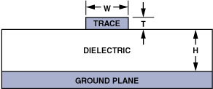

Microstrip Impedance
ε_{r}=dielectric constant of material, H=height of trace above reference plane, W=width of trace, T=thickness of trace
All reference values assuming a 1MHz signal
http://www.analog.com/library/analogDialogue/archives/39-09/3909_13.gif

Slide 33

Microstrip Impedance Example
ε_{r} for FR-4 = 4.1
H = 5 mil
W = 8 mil
T = 1.4 mil
ln

Slide 34
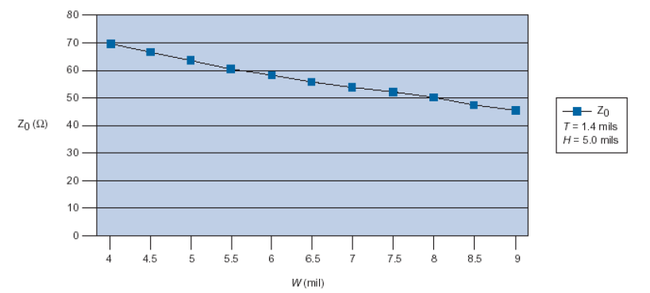
Microstrip
Impedance vs. Trace Width
As trace width increases, impedance decreases
Base value from example
http://cache.freescale.com/files/32bit/doc/app_note/AN2536.pdf

Slide 35
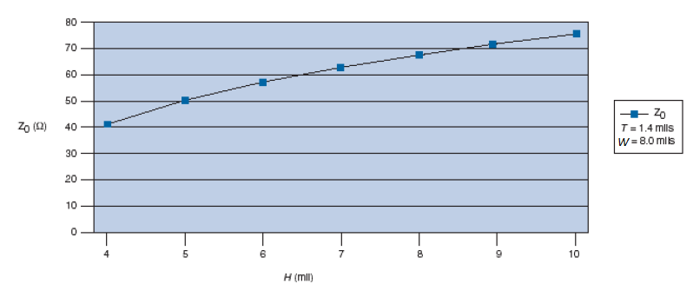
Microstrip
Impedance vs. Trace Height
Base value from example
As trace height increases, impedance increases
http://cache.freescale.com/files/32bit/doc/app_note/AN2536.pdf

Slide 36
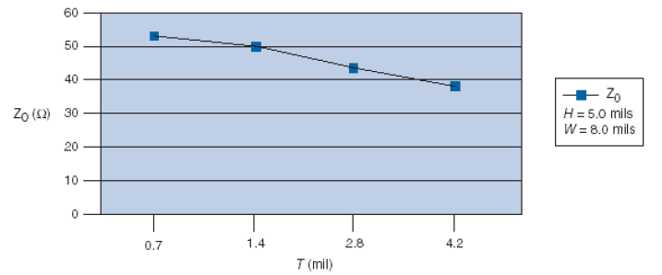
Microstrip
Impedance vs. Trace Thickness
Base value from example
As trace thickness increases, impedance decreases
http://cache.freescale.com/files/32bit/doc/app_note/AN2536.pdf

Slide 37

Striplines
A stripline circuit uses a flat strip of metal which is sandwiched between two parallel reference planes, shielding the trace
The insulating material of the substrate forms a dielectric, FR-4 as before

Slide 38
Why Striplines?
Pros and Cons
Pros
  Shielding on both sides resist EMI even more so than microstrips
  Crosstalk greatly reduced
  Impedance can be controlled based on dimensions
Cons
  More expensive
  PCBs are thicker

Slide 39
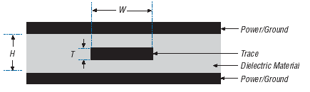
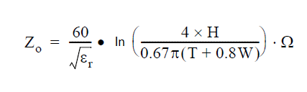
Stripline Impedance
Here
ε_{r}=dielectric constant of material, W = width of trace, T = thickness of trace, H = height between reference planes
All reference values assuming a 1MHz signal
http://cache.freescale.com/files/32bit/doc/app_note/AN2536.pdf

Slide 40
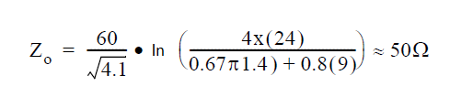
Stripline Impedance Example
ε_{r} for FR-4 = 4.1
H = 24 mil
W = 9 mil
T = 1.4 mil

Slide 41
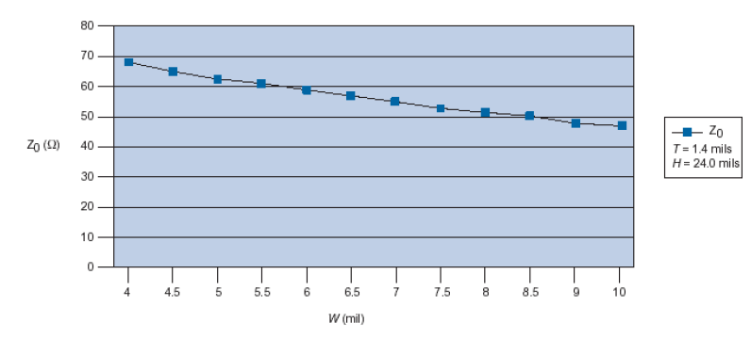
Stripline
Impedance vs. Width
Base value from example
As trace width increase, impedance decreases
http://cache.freescale.com/files/32bit/doc/app_note/AN2536.pdf

Slide 42
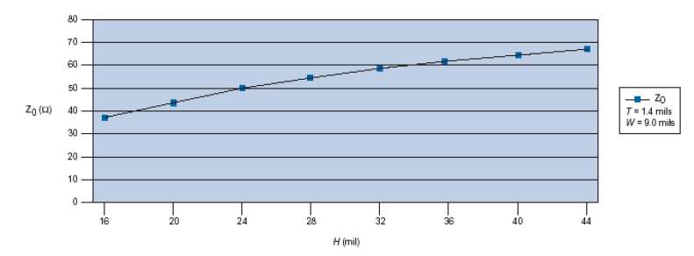
Stripline
Impedance vs. Height
Base value from example
As reference plane height increases, impedance increases
http://cache.freescale.com/files/32bit/doc/app_note/AN2536.pdf

Slide 43
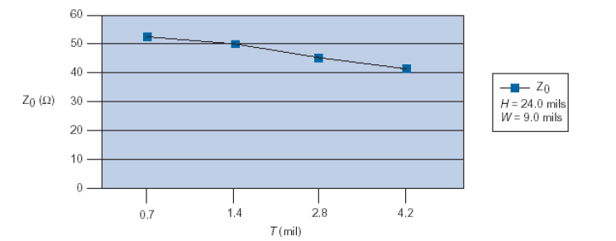
Stripline
Impedance vs. Thickness
Base value from example
As trace thickness increases, impedance decreases
http://cache.freescale.com/files/32bit/doc/app_note/AN2536.pdf

Slide 44
Conclusion
A couple more things
Keep traces fat and short
Spacing 3x’s space width
1/20th rule
Everything is an antenna
Hire an expert!

Slide 45
Extra Topics
Just touching on topics
You will be confused
A closer look = more math
Good luck!

Slide 46
Extra Topics: Shielding
Shielding plays a huge role in EMC
Shielding is basically the addition of grounded metal around signal wires or other data sending mediums such as traces
Principles behind them are based on Faraday cages
For shielding and more try
  http://en.wikipedia.org/wiki/Shielded_cable
Faraday cages
  http://en.wikipedia.org/wiki/Faraday_cage

Slide 47
Extra Topics: Ground Planes
It is good practice to design a board with ground planes
Ground planes offer benefits ranging from signal stabilization to EMI reduction
Good places to start
  http://en.wikipedia.org/wiki/Ground_plane
  http://www.elmac.co.uk/pdfs/Lord_of_the_board.pdf

Slide 48
Extra Topics: Transmission Lines
Impedance matching, crosstalk, microstrips, shielding, and ground planes are all related to transmission lines
Knowing how transmission lines work will help to give a good understanding of signals on PCBs since fast signals act like transmission lines
Good resources to consult:
  http://www.williamson-labs.com/xmission.htm
  http://home.sandiego.edu/~ekim/e194rfs01/tlsmthek.pdf
  http://en.wikipedia.org/wiki/Transmission_line

Slide 49
Extra Topics: Capacitors
Capacitors help in filtering out signals we don’t want
They are also useful in stabilizing power and switching devices
To learn more we suggest
  http://www.radioing.com/eengineer/pcb-tips.html
  http://en.wikipedia.org/wiki/Capacitor

Slide 50
Extra Topics: Device Layout
Device layout can be very influential on what type of EMI is emitted and received
Separating analog and digital circuits, as well as power supply circuits is a good idea
Traces for analog and digital circuits must be thought about carefully
More information
  http://www.analog.com/library/analogDialogue/archives/39-09/layout.html
  http://www.analog.com/en/content/CU_over_Tips_for_improving_High-Speed_PCB_Layout/fca.html

Slide 51
Resources
http://www.analog.com/library/analogDialogue/archives/39-09/layout.html
http://www.ce-mag.com/archive/05/07/kimmel.html
http://www.learnemc.com/tutorials/guidelines/Important_Guidelines.html
http://www.ece.unh.edu/courses/ece711/refrense_material/s_parameters/xlx_high_speed_pcb_trans_line_design.pdf
http://en.wikipedia.org/wiki/Microstrip
http://en.wikipedia.org/wiki/Crosstalk_(electronics)
http://en.wikipedia.org/wiki/Stripline
http://www.radio-electronics.com/info/electronics-design/pcb/pcb-design-layout-guidelines.php
http://www.emisoftware.com
http://en.wikipedia.org/wiki/Electrical_impedance
http://en.wikipedia.org/wiki/Characteristic_impedance
http://www.fcc.gov/our-work

Slide 52
Class sum-up

