Slide 1
An introduction to
Digital Signal Processors (DSP)
Using the C55xx family

Slide 2
There are different kinds of embedded processors
There are a fair number of different kinds of microprocessors used in embedded systems
  Microcontrollers
    Small, fairly simple devices. Non-volatile storage. Generally a fair bit of basic I/O (GPIO, SPI, etc.)
  “Processor”
    More-or-less a desktop processor with favorable power numbers. Atom, ARM A8, etc.
  System on a Chip
    Generally more CPU power than a microcontroller, but has lots of “add-ons” including perhaps analog I/O and specilized devices (ethernet controller, LCD controller, FPGA) etc.

Slide 3
Digital Signal Processor (DSP)
DSP chips are optimized for high performance/low power on very specific types of computation.
  Price:
    C5515 hits 22mW @ 100MHz
  Tasks:
    Filtering, FFT are the big ones.

Slide 4
Fixed point vs. floating point
It’s not unfair to break DSPs into two camps
  Floating point
  No floating point
Floating point is generally much better for DSP applications
  But it is usually slower and certainly adds cost and a lot of power drain.

Slide 5
Basic fixed point
“Qn” is a naming scheme used to describe fixed point numbers.
  n specifies the digit which is the last before the radix point.
    So a normal integer is Q0.
Examples
  0110 is 6
  0110 as a Q2 is 1.5
Numbers are generally 2’s complement
  1100 is -4.
  1100 as Q3 is 0.5

Slide 6
Factoids
Signed x-bit Q_{x-1} numbers represent values from -1 to (almost) 1.
  This is the form typically used because two numbers in that range multiplied by each other are still in that range.
Multiplying two 16-bit Q15 numbers yields?

Slide 7
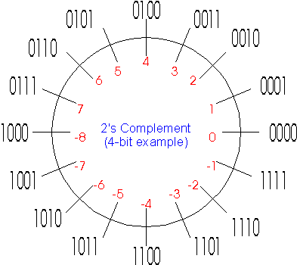
And this is important…

Slide 8
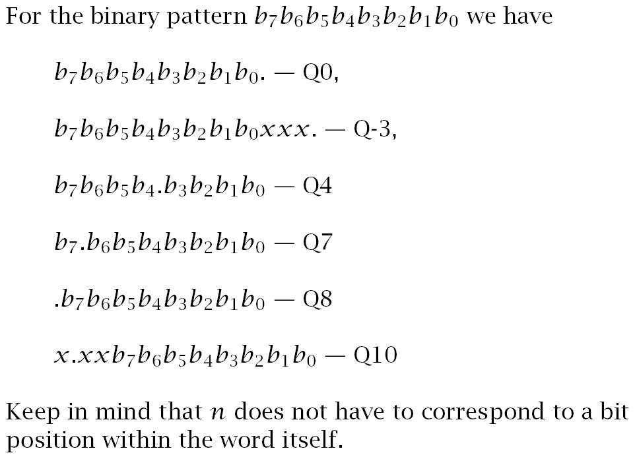

Slide 9
FIR filter
Basic idea is to take an input, x, but it into a big (and wide) shift register.
  Multiply each of the x values (old and new) by some constant.
    Sum up those product terms.
Example:
  Say b₀=.5, b₁= .75, and b₂=.25
  x is 1, -1, 0, 1, -1, 0 etc. forever.
    What is the output?

Slide 10
Consider a traditional RISC CPU
For reasonably large filter, b_{y} doesn’t fit in the register file.
  top: LD x++
  LD b++
  MULT a,x,b
  ADD accum, accum, a
  goto top
  (++ indicates auto increment)
  That’s a lot of instructions
    Plus we need to shift the x values around.
      Also a loop…
    Depending on how you count it, could be 8-10 instructions per Z⁻¹ block…

Slide 11
Some FIR “tricks”
Most obvious is to use a circular buffer for the x values.
The problem with this is that you need more instructions to see if you’ve fallen off the end of the buffer and need to wrap around…
  And it’s a branch, which is mildly annoying due to predictors etc.
0 | 1 | 2 | 3 | 4 | 5

Slide 12
How fast could one do it?
Well, I suppose we could try one instruction.
  MAC y, x++, z++
That’s got lots of problems.
  No register use for the arrays so very heavy memory use
    2 data elements from memory/cache
    3 register file changes (pointers, accumulator)
  Plus we need to do a MAC and mults are already slow—hurts clock period.
  Plus we need to worry about wrapping around in the circular buffer.
  Oh yeah, we need to know when to stop.

Slide 13
Data
I need a lot of ports to memory
  Instruction fetch
  2 data elements
I need a lot of ports to the register file
  Or at least banked registers

Slide 14
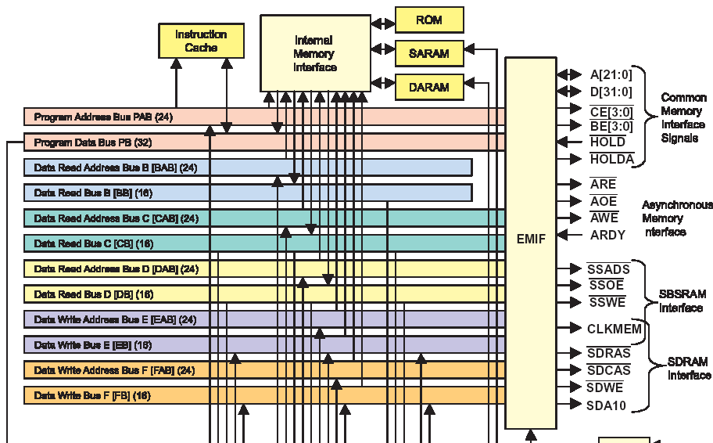
C55xx Data buses

Slide 15
C55xx Data buses (cont.)
Twelve independent buses:
  Three data read buses
  Two data write buses
  Five data address buses
  One program read bus
  One program address bus
So yeah, we can move data
  Registers appear to go on the same buses.
    Registers are memory mapped…

Slide 16
OK, so data seems doable
Well sort of, still worried about updating pointers.
  2 data reads, 1 data write, need to update 2 pointers, running out of buses.

Slide 17
MAC?
Most CPUs don’t have a Multiply and accumulate instruction
  Too slow.
  Hurts clock period
    So unless we use the MAC a LOT it hurts.
But for a DSP this is our bread and butter.
  So we’ll take the 10% clock period hit or whatever so we don’t have to use two separate instructions.

Slide 18
Wrapping around?
Seems possible.
  Imagine a fairly smart memory.
    You can tell it the start address, end-of-buffer address and start-of-buffer address.
    It knows enough to be able to generate the next address, even with wrap around.
  This also takes care of our pointer problem.
0 | 1 | 2 | 3 | 4 | 5

Slide 19
Circular Buffer Start Address Registers
(BSA01, BSA23, BSA45, BSA67, BSAC)
The CPU includes five 16-bit circular buffer start address registers
Each buffer start address register is associated with a particular pointer
A buffer start address is added to the pointer only when the pointer is configured for circular addressing in status register ST2_55.

Slide 20
Circular Buffer Size Registers
(BK03, BK47, BKC)
Three 16-bit circular buffer size registers specify the number of words (up to 65535) in a circular buffer.
Each buffer size register is associated with particular pointers
In the TMS320C54x-compatible mode (C54CM = 1), BK03 is used for all the auxiliary registers, and BK47 is not used.

Slide 21
By the way…
If we know the start and end of the buffer
  We know the length of the loop.
Pretty much down to one instruction once we get going.
  The TI optimized FIR filter takes 25 cycles to set things up and then takes 1 cycle per MAC.

Slide 22
Digital Signal Processor so far…
We’ve seen an amazing amount of optimization for a single operation (FIR).
  Massive data movement
  Circular buffer support
  MAC
  Crazy instruction encoding
    bob=bob+(x++*)&(y++*)
All of that is useful for other tasks too.
  IIR filter benefit from all of the above
  FFT likes the MAC and the data movement.
  Big vector/matrix operations can use it also.

Slide 23
Other algorithm support
FFTs typically take an array in “normal” order and return the output in “bit reversed” order.
  So they can swap the order of the address bits to make it (much) faster to deal with the output.
Verterbi is an algorithm commonly used for error correct/communication.
  Provide special instructions for it
    Mainly data movement, pointer, and compare instructions.

Slide 24
And a bit more
Overflow is a constant worry in filters
  TI’s accumulators provide 4 guard bits for detection.
    That’s unheard of in a mainstream processor.

